Slide 2
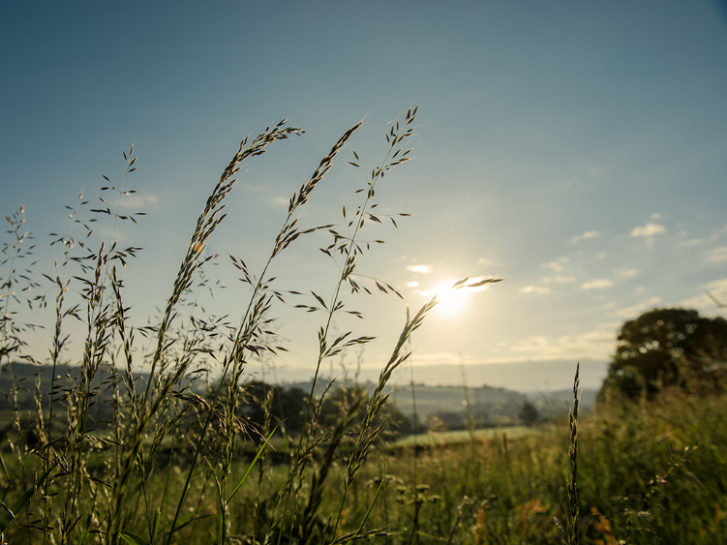
“ We wish to operate our business in a way that has minimal
impact on the Somerset environment and to create a truly symbiotic relationship with the countryside that
provides our food, our income and our home.”

Slide 3
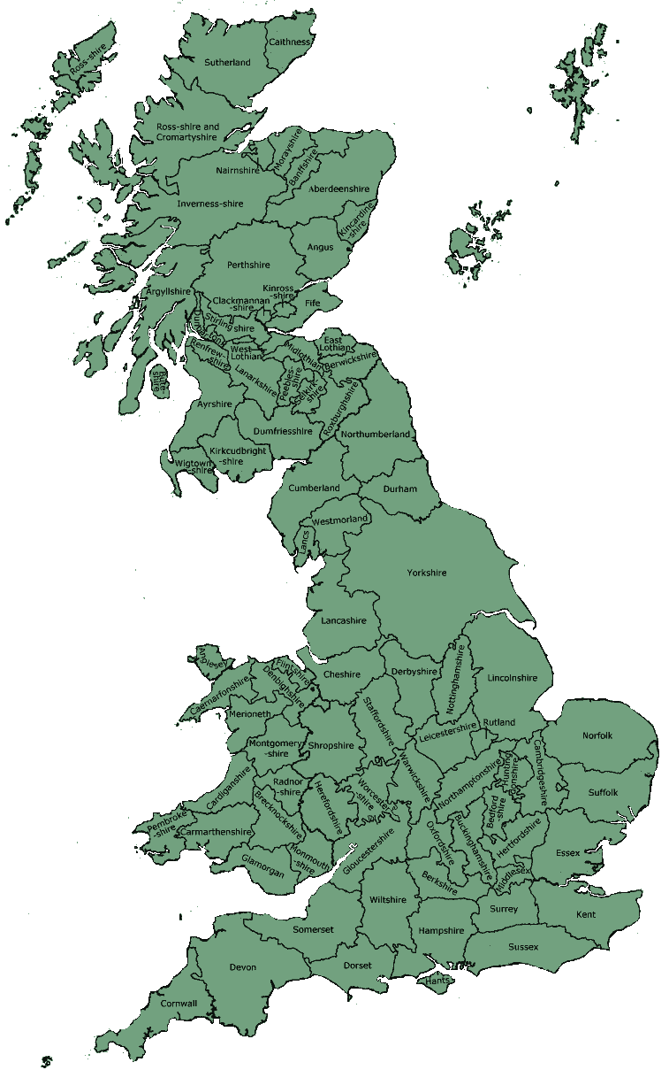
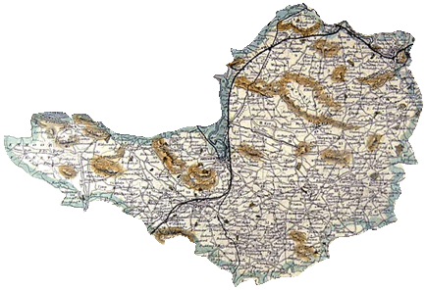
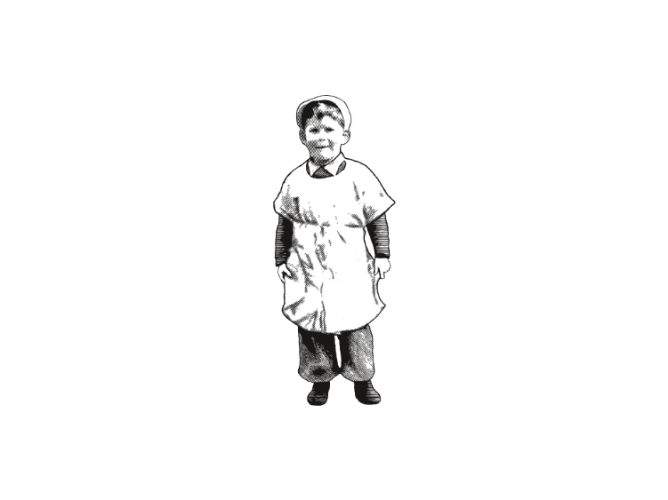
Only 15 miles from the town of ‘Cheddar’
Cheddar Town
We farm and make our Cheddar in Wyke Champlower in Somerset, close to the true home of cheddar
(Our village was named ‘Wyke Champfleur’ meaning Wyke ‘fields of flowers’ by a French ‘visitor’ after the Norman invasion in the late 11 century.)
Wyke Champflower

Slide 4
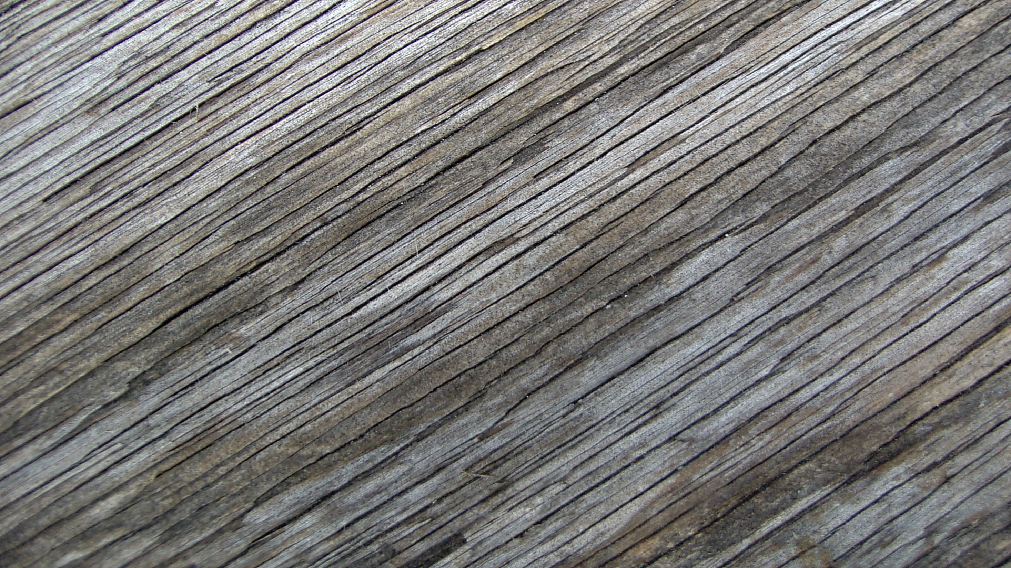
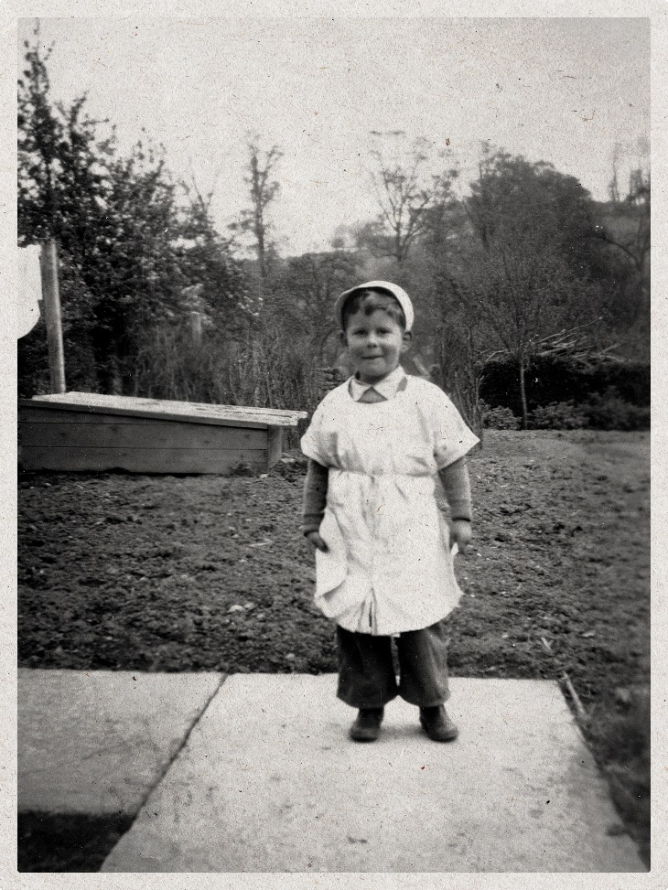
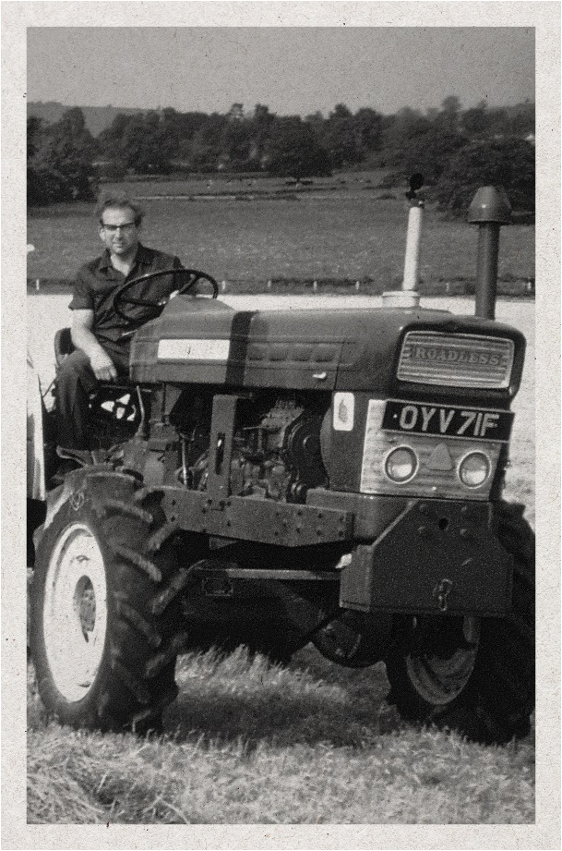
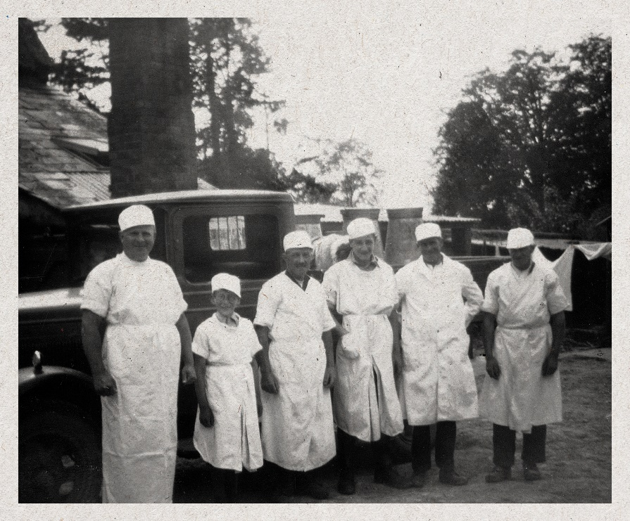
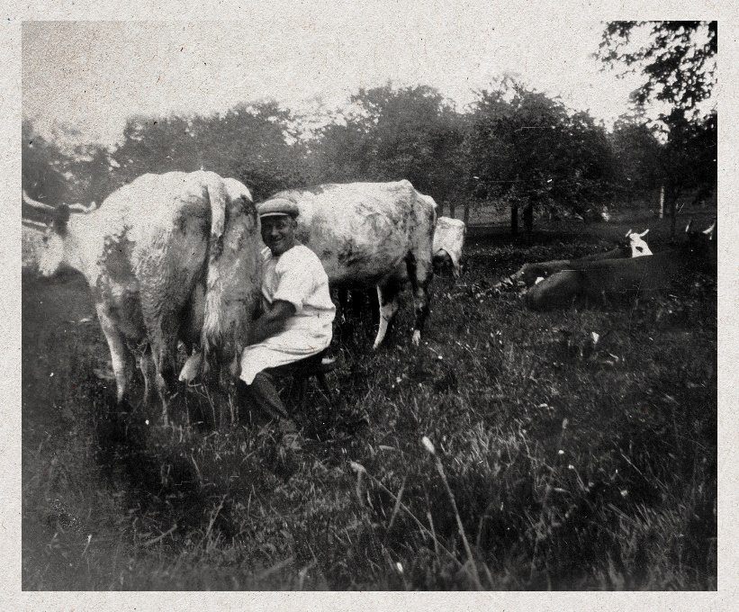
Our History
Dad
Uncle Jim mowing
The Milking Team
Grandfather Tom
Milking

Slide 5
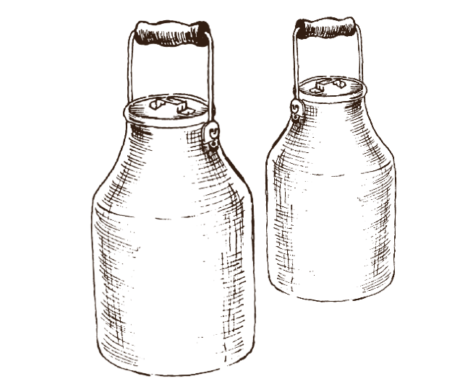
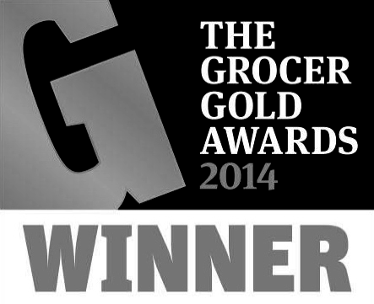
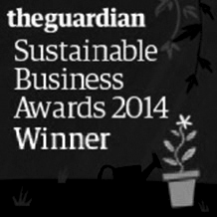
Facts About Wyke
Wyke is an 150 year old family farmhouse cheese making business
Trading in UK retailers and 160 countries inc. Carrefour, France
Family farm 1500 acres and have 1000 milking cows in Somerset
Leading the field in Green and Sustainable branding
51k fans on Facebook
Sourcing milk from 110 local farm assured farms within a 35 miles radius of the dairy
25k followers on Twitter
Food Manufacturing Awards ‘Dairy Company of the Year 2013’
Wyke process up to 300 million litres milk per annum
Guardian Sustainable Business of the Year 2014 & 2015
Wyke is 5% of the UK cheddar market with a 25% penetration of UK households
Grocer Sustainable Supplier of the Year 2014
Largest organic milk processor in UK due to cheese, butter and skimmed milk concentrate contracts with OMSCO

Slide 6
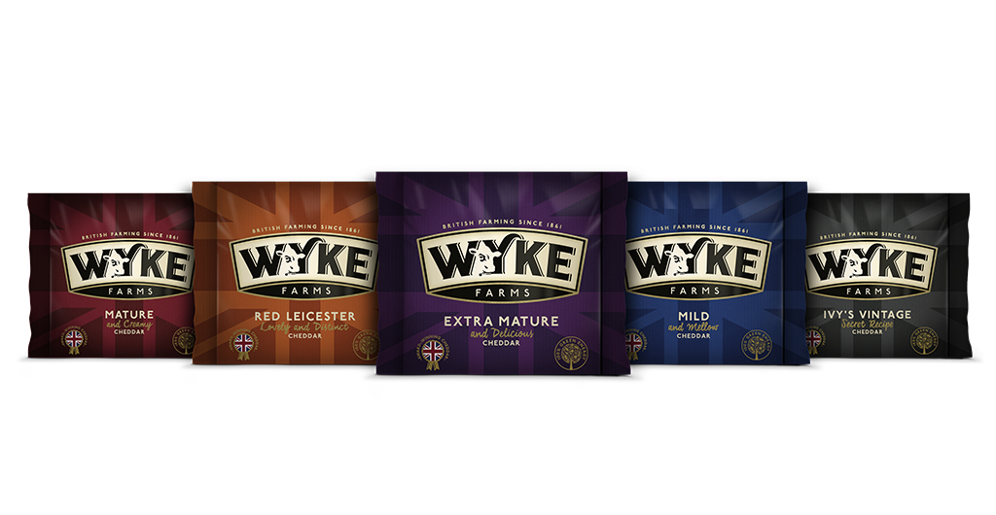
Export Variants

Slide 9
‘We respect the land, we respect the animals and we respect the environment. The natural way is the only way to make great Cheddar’
‘If you look after nature; then nature will look after you.’
Roger Clothier c.1980

Slide 10
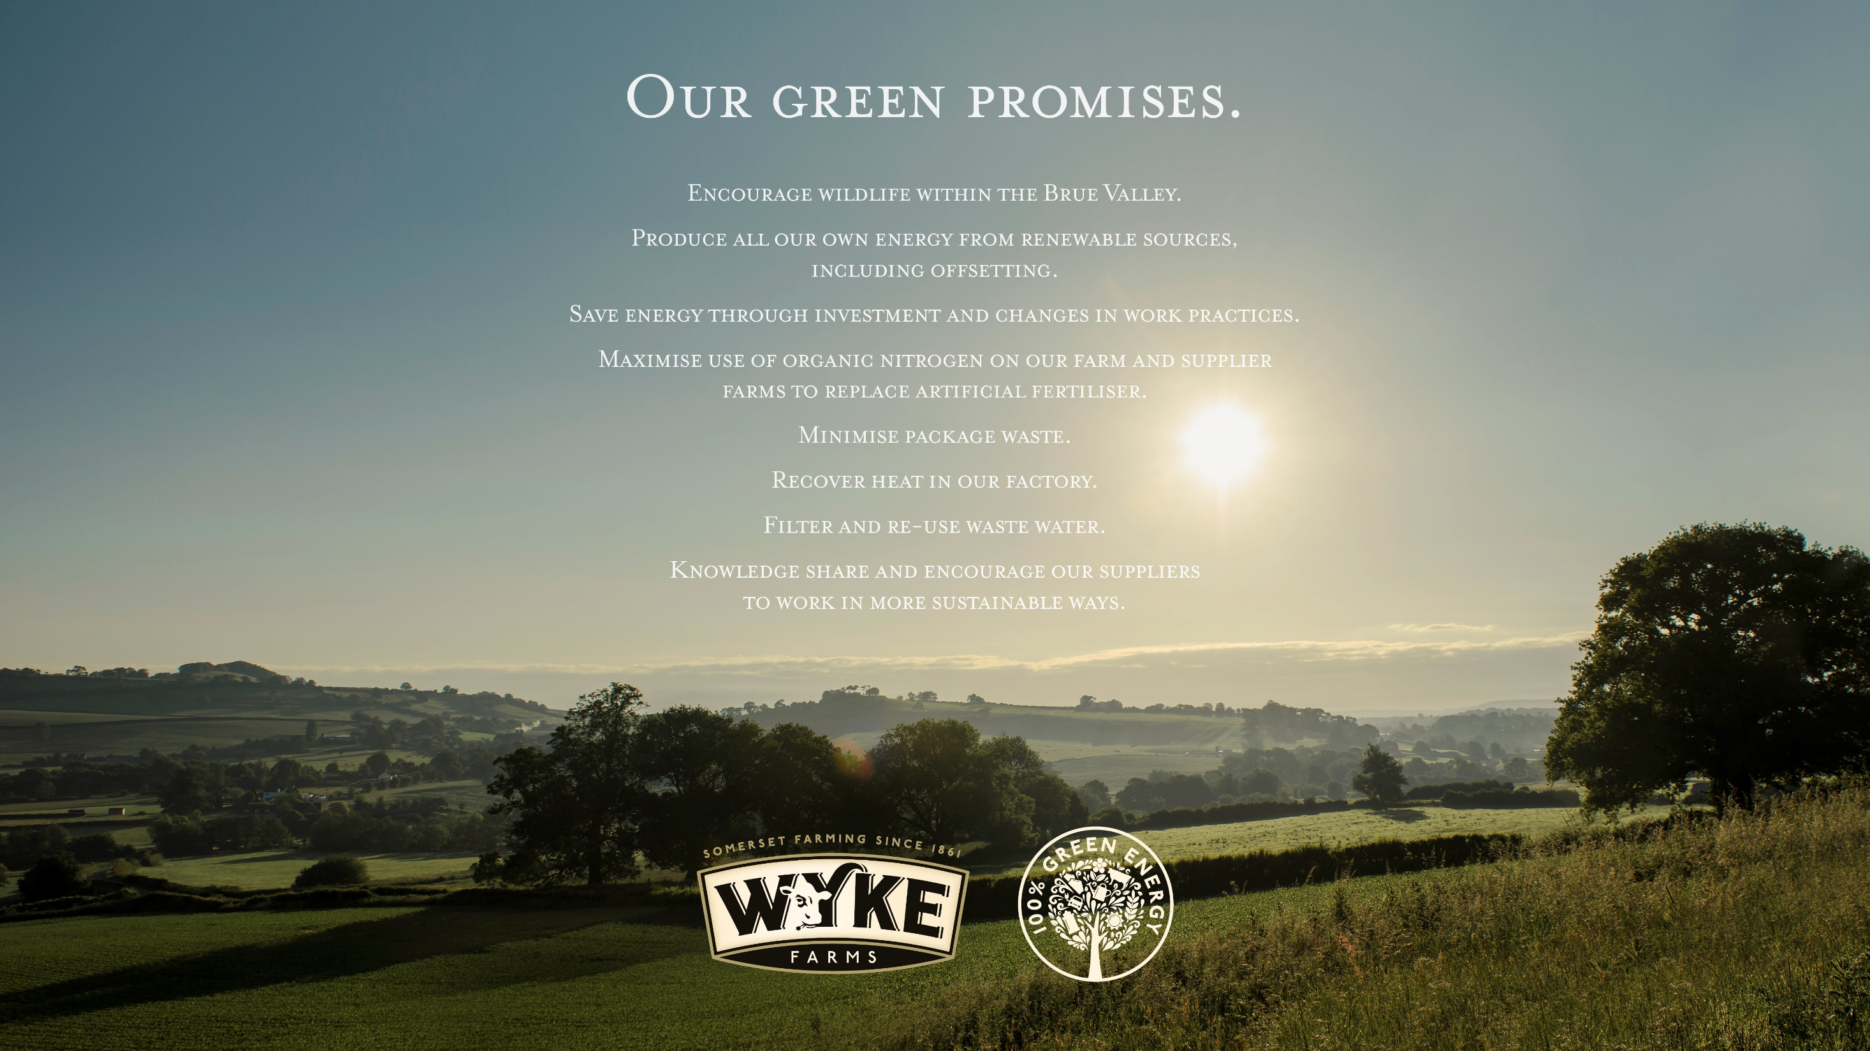

Slide 11
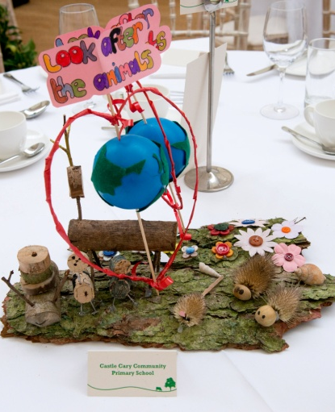
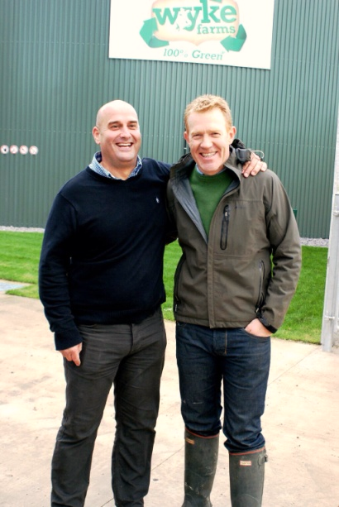
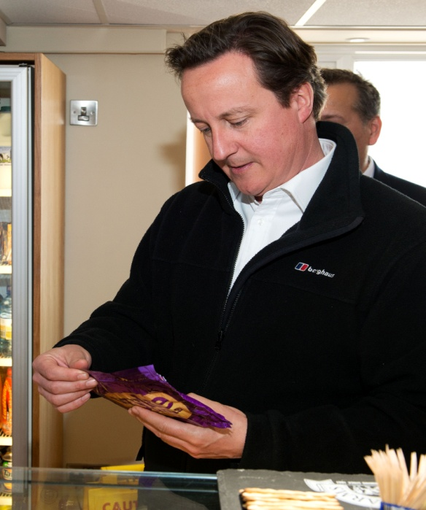
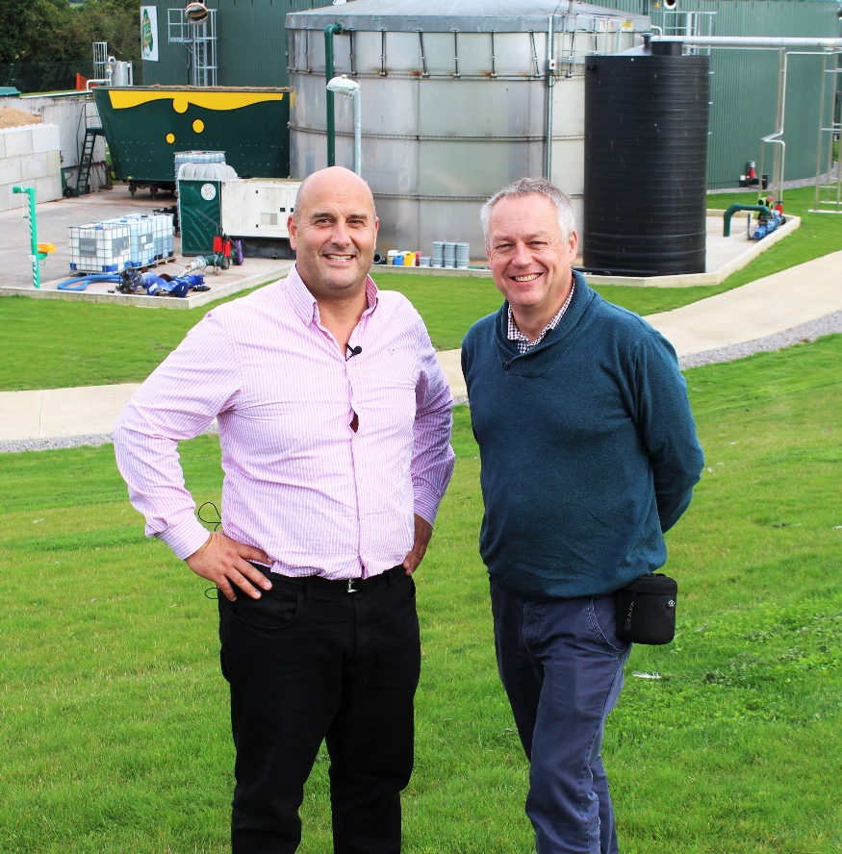
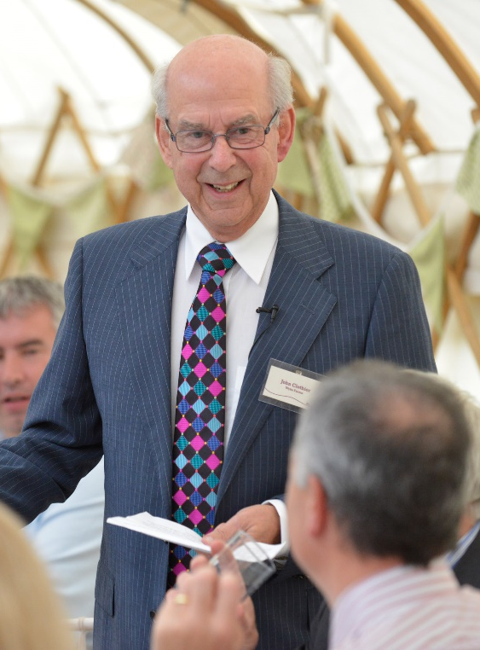
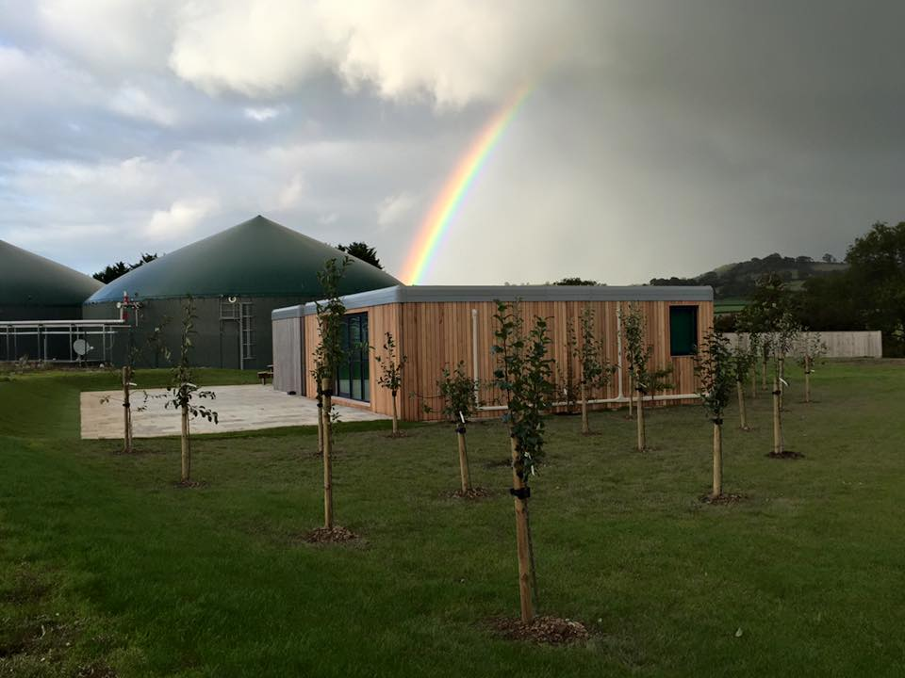
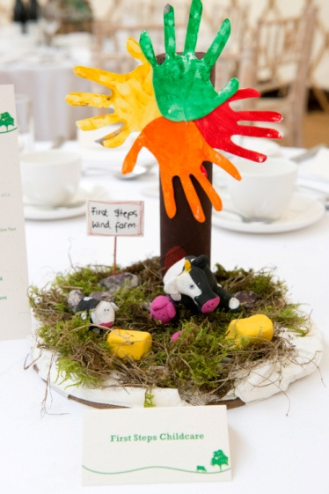
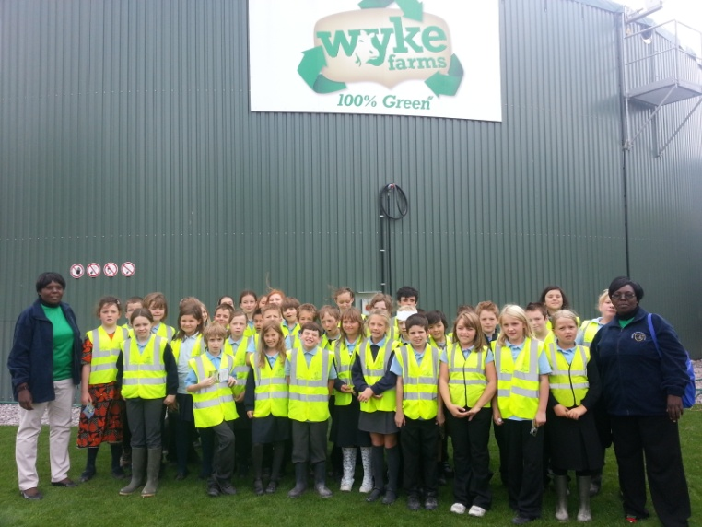

Slide 12
SUMMARY
Quality products produced on our Somerset farm
History of Wyke is a unique family brand story
Best selling cheddar brand in France and selling in 150 countries around the world
Experienced professional team
Committed to operating our business in a sustainable way
Wyke is the first national food brand to be 100% self sufficient in Green energy
We are efficient, well invested, diversified and ‘Fit for the Future’
‘’It’s something that our ancestors would be proud of as well as our children”

