Slide 1



River Power around Frome
Anthony Battersby
Chairman, Mendip Power Group

Slide 2
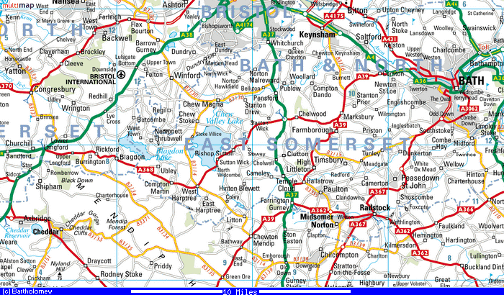
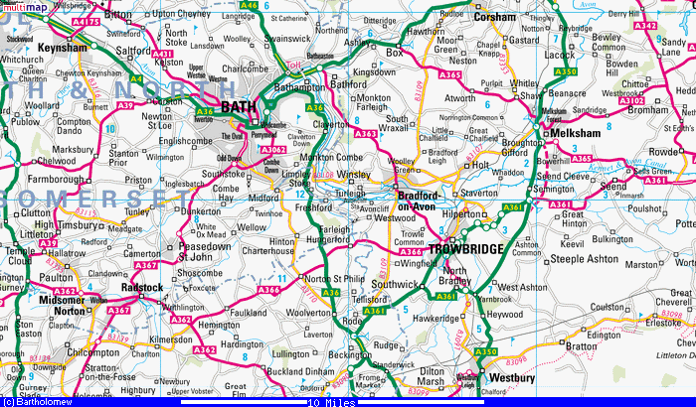
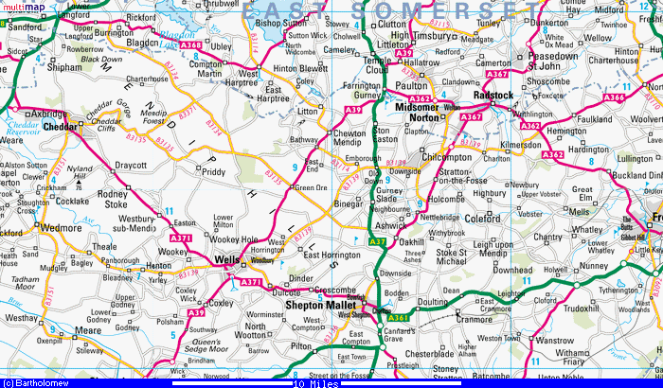
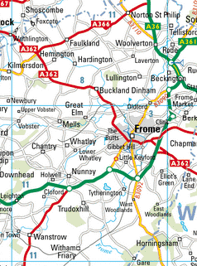
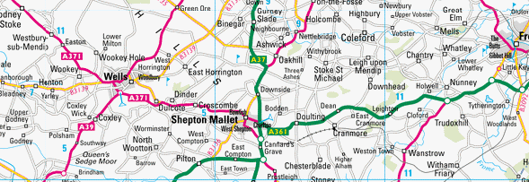

Mendip Power Group
Farthingham
*
Iford
*
•
Farleigh Hungerford
•
Stowford
Tellisford
*
Shawford
•
Clifford
*
*
Lullington
•
•
*
•
Staplemead
Coleford
Ironstone
Hapsford
•
•
Burcott
•
Bleadney
Croscombe
•
Witham Hole

Slide 3
Objectives of MPG
To install effective renewable energy generating systems.
To promote improved energy efficiency and increased development and use of renewable sources of power.
To attract funding to meet these objectives.

Slide 4
Operational Hydropower Sites in Mendip
Site | Capacity (kW) | Type
Dunkirk | 3 | crossflow
Farthingham | 55 | Archimedes screw
Hapsford | 58 | crossflow
Iford Manor | 44 | Archimedes screw
Lullington | 66 | Archimedes screw
Tellisford | 60 | Kaplan
Wallbridge | 12 | Francis
Burcott Mill | 10 | water wheel
Alhampton | 10 | Archimedes screw
Wookey Hole | 30 | Kaplan
Iwood Manor | 11 | crossflow
Littleton Mill | 28 | Francis
Total | 387

Slide 5
Hydropower sites under development in Mendip
Site | Capacity (kW) | Proposed Type
Clifford Hydro | 50 | propeller
Iron Mill | 75 | Kaplan
Stowford | 70 | Kaplan
Wadbury | 70 | Kaplan
West Lydford | 55 | Kaplan
Weavers Mill | 90 | Kaplan
Kingston Mill | 50 | Kaplan
Job's Mill | 10 | Kaplan
Total | 470

Slide 6
Hydropower sites existing but undeveloped
Undeveloped sites | Capacity (kW)
23 | 670
Grand Total | 1,527

Slide 7
Experience with Turbine Types

Slide 8
Constraints
1 Environment Agency Licensing
  Flood risk assessment
  Geomorphology study
  River corridor study
  Provision of fish pass (may cost £100,000)
  Screening for eels (proposed gauge 2mm, which will kill most hydro)
  Flow split at best 1.3 x mean flow, but may be less
2 Feed in Tariff
  Now one third of original (8.54p/kWh plus price of electricity exported 4.8p)
  Great uncertainty due to frequent changes
3 Cost
  Small scale hydro sites are expensive (£7,000-£10,000 per installed kW)

Slide 9
Cost of installing Hydropower

Slide 10
Further Information
  Anthony Battersby
  Tellisford Mill, Tellisford, Bath BA2 7RL, UK
  Telephone 44-(0)1373-830322
  E-Mail FBA@FBATM.BIZ

