Slide 1



Community Power, Anna Francis,
Frome Town Council, Frome Renewable Energy Co-op

Slide 2
Aims
Why Zero Carbon Frome?
Community Energy
Energy Reduction
Local Supply
Reducing Energy from Lifestyles

Slide 3
Why zero carbon?
We need to reduce from a three planet life style
One Planet Living is part of our Neighbourhood Plan
We spend £13m on energy in Frome
Going ‘zero carbon’ could create 840 jobs and generate £42m for the local economy

Slide 4
Community Energy – what is it?
Enables the community to invest in local clean energy production through community shares
Profit is put into a community fund
Members have democratic control over the energy enterprise
There are 5000 groups in the UK

Slide 5
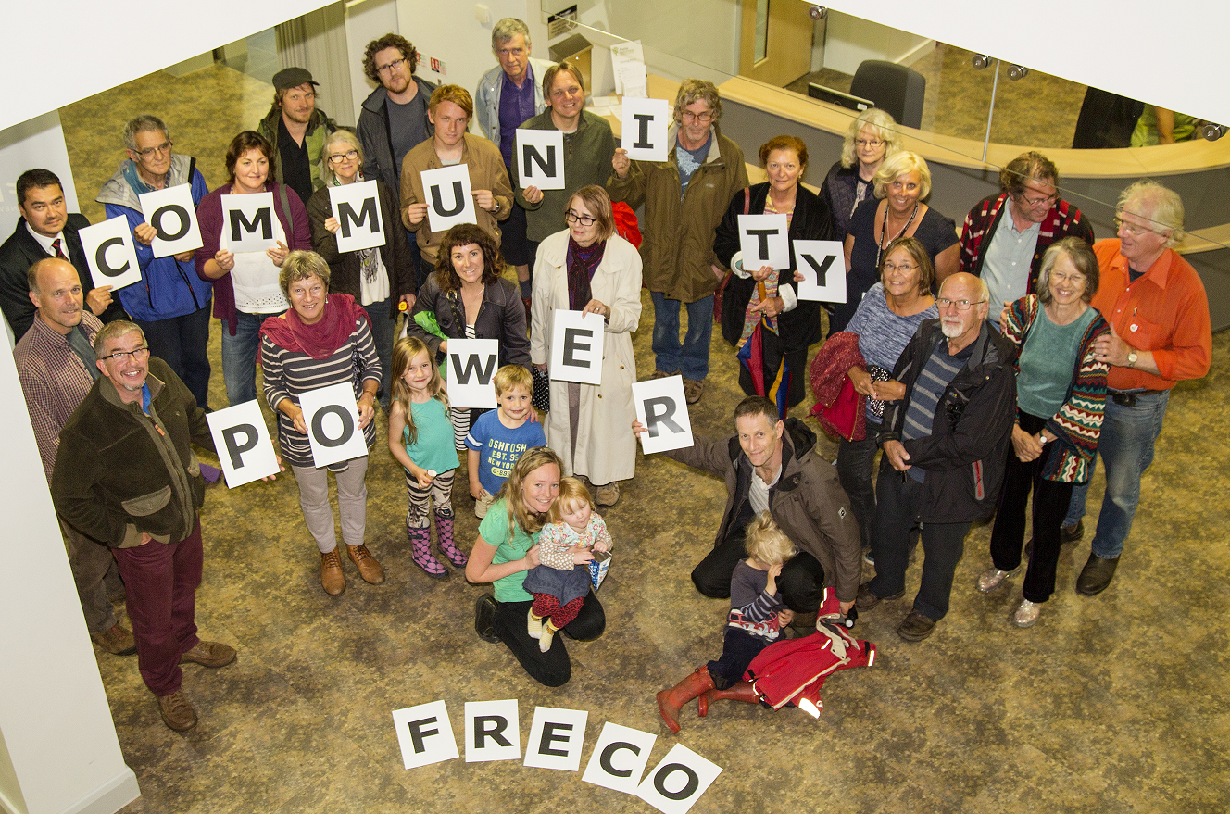
Frome Renewable Energy Co-op
Raised £280,000 in four days May 2015
200kw solar Frome Medical Practice, 50kw solar Frome Football Club

Slide 6
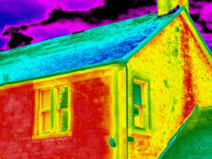
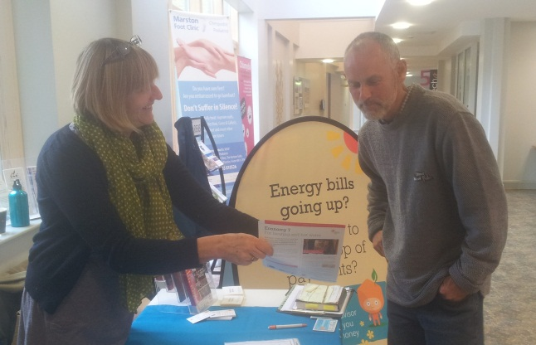
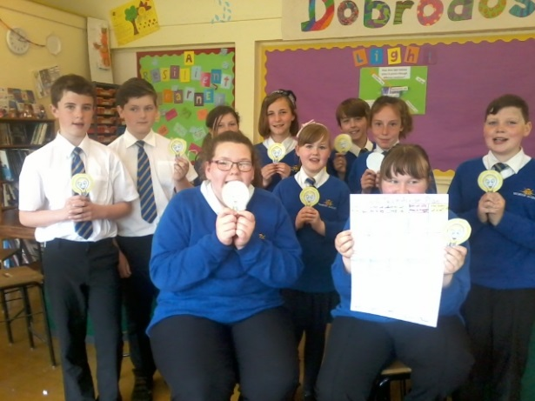
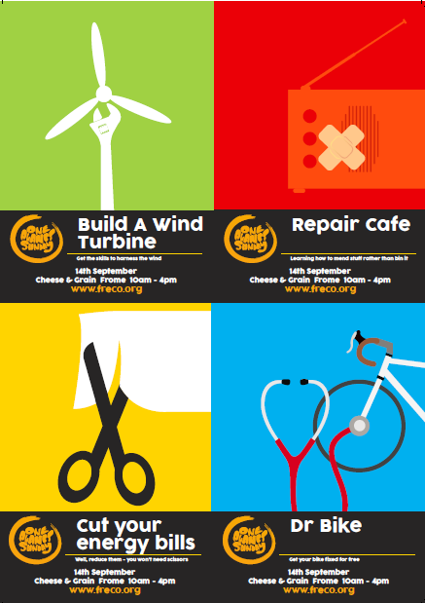
Energy Reduction
What’s been happening?
Working with local schools
Energy advice sessions
Thermal imaging
Open Homes
One Planet Sunday

Slide 7

The future
Local energy supply
  Benefiting the community and local renewable energy generators
Working towards grid parity
Smaller solar projects
Storage and demand management

Slide 8
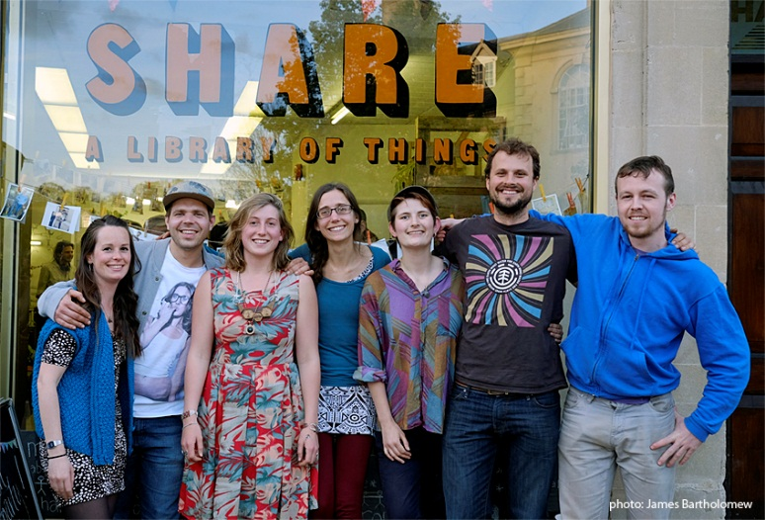
Beyond Direct Energy Use
Cutting emissions from goods
Cutting emissions from transport

Slide 9
Further Information
Anna Francis
francisa@frometowncouncil.gov.uk or anna@freco.org
www.freco.org www.frometowncouncil.gov.uk
Tel 01373 475574

