Slide 1
Can Frome be the first UK town with an all-renewable electricity supply?
Keith Barnham
Emeritus Professor of Physics
Imperial College London
k.barnham@ic.ac.uk
The Burning Answer:
a User’s Guide to the Solar Revolution
Weidenfeld and Nicholson 2014
www.burninganswers.com

Slide 2
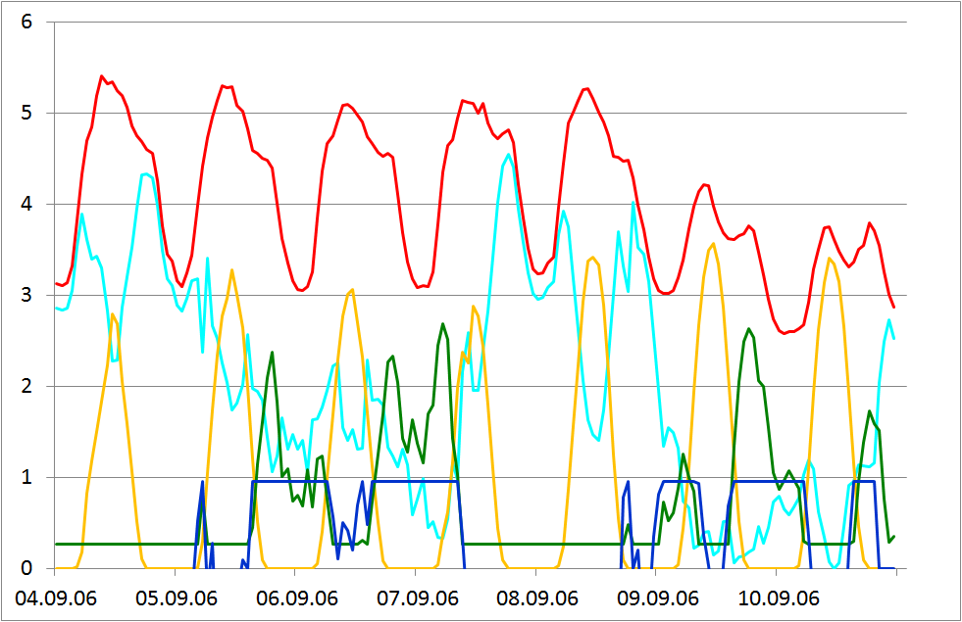
KKW: combined power plant
Kombikraftwerk all-renewable project started in 2006
Over 2006 it matched 1/10,000 of actual German electric power demand with real-time output of PV, wind & biogas generators
PV and wind together can supply 78% German power demand
Only 17% back-up power by
biogas electricity required
Only 5% back-up from storage
was necessary
Gives KKW installed power
targets for PV, wind, biogas in
an all-renewable Germany

Slide 3
A KKW simulation for Frome
I have an Excel spreadsheet with UK data from Centre for Alternate Technology (CAT)
Need Frome electricity demand by hour
- scale South West demand by population?
Needs PV and wind resources in UK or South West in hourly intervals over year

Slide 4
Assume PV & Wind KKW targets for UK
Storage
Inflexible nuclear power obsolete when all renewable supply
Expensive nuclear will have to compete with cheap wind for storage

Slide 5
Storage recycles Excess Supply

Slide 6
Supply less than Demand: Biogas
The grid itself will smooth out excess wind fluctuations

Slide 7
Conclusions
Spreadsheet could give PV, wind and biogas power targets for an all-renewable electric Frome
PV: encourage householders, schools, Silkmill etc.
Wind: supply contracts, build our own?
Biogas: collect equivalent food/farm waste for AD
Encourage residents to switch
Recalculate targets for hydro and switching

