Slide 1
Bristol’s Municipal and Energy Investment Programme

Slide 2
ELENA Funding
ELENA technical assistance grant of £2.5m to provide additional staff resources and funding for preparing the programme
£62.5m of investment by the end of the 3-year ELENA period
4 strands of work, set up of sustainable business model
Energy Saving measures on social and private housing properties, energy efficiency measures on public buildings, solar PV installations on social housing and public sector buildings

Slide 3
Energy Company www.bristol-energy.co.uk
Obtained Cabinet approval Feb 2015 to set up a fully licenced energy company, wholly owned by Bristol City Council
Controlled Market Entry completed in December 2015
Energy Supply and Service
Bristol Energy is:
A different type of Energy Company – supporting the business of the council and the city
Strives to be the most environmentally conscious and trusted local energy supplier
Supports the most financially stretched households in Bristol – giving them extra support to switch and to cut their bills
Bring more jobs and investment to Bristol

Slide 4
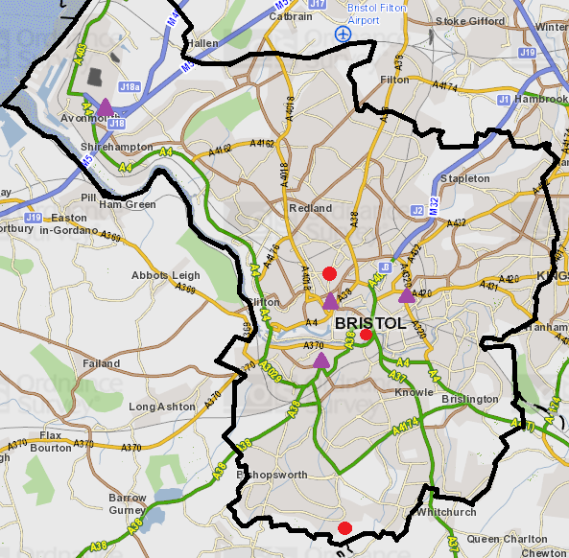
District Heating Projects
District networks in progress (red) and proposed networks (purple)
Avonmouth/ Sevenside project collaborating with South Gloucestershire Council
City Centre Part 1
Easton
City Centre Part 2
Redcliffe and Temple Project
South Bristol
Rowan Complex
Notes:
District Heating Phase 1 - (being developed)
City Centre Part 1 – CABOT Ward
Temple – LAWRENCE HILL Ward
Rowan – WHITCHURCH PARK Ward
District Heating Phase 2 – (potential)
City Centre Part 2 – CABOT Ward
Avonmouth district heating investigation collaboration with South Gloucestershire Council, Sita and 6 West London authorities / looking at an Avonmouth network and potential to pipe heat into Bristol Centre.
Blaise Wood fuel station in liaison with Neighbourhoods
Horfield Leisure Centre Biomass Boiler.

Slide 5
BCC Renewable Energy - Completed
Completed:
1500kW solar PV installed
EU compliant Solar PV procurement framework
Up to £47m works
Corporate buildings, leisure centres and schools
Work with other public sector organisations such as the Cabinet Office/the NHS to do work on their buildings

Slide 6
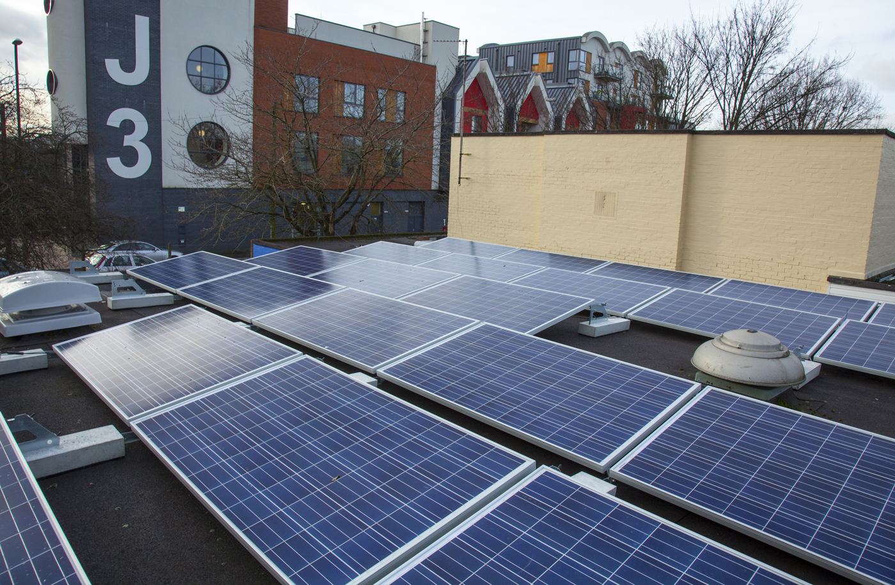
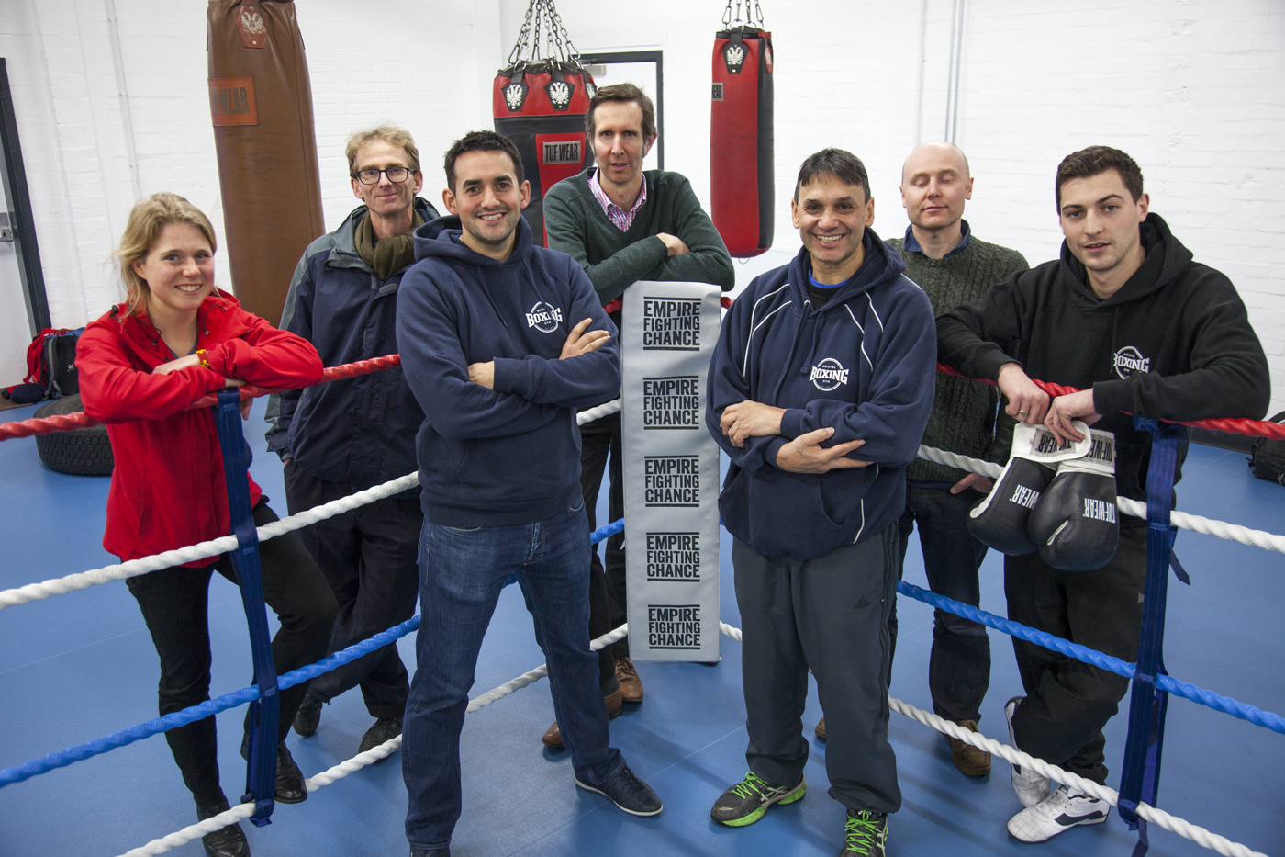
Community Solar PV
BCC facilitating solar PV installations by Community Energy Groups on BCC owned buildings
Pilot package completed:
100kW on community
centres and South Bristol
Sports Centre
Community PV Competition:
Further 550kW on BCC owned
buildings
Installations ongoing
BCC match maker with business community
coming on board, grant and loan fund

Slide 7
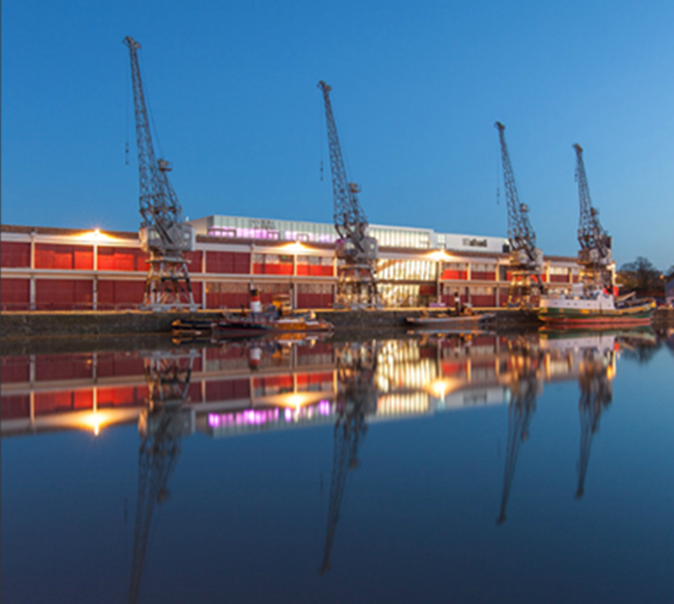
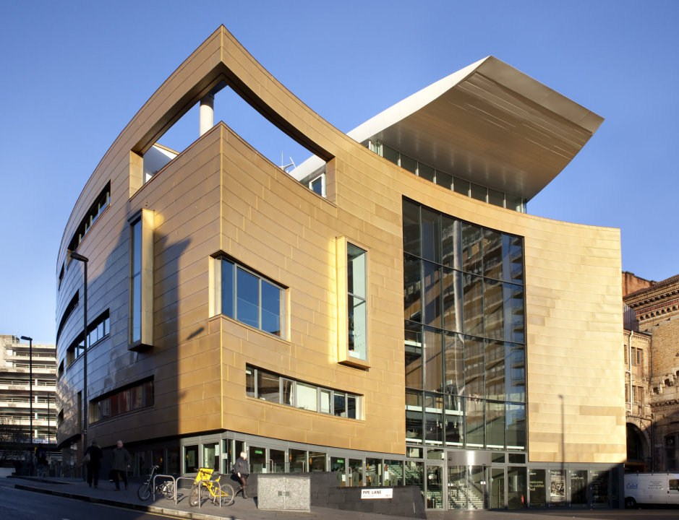
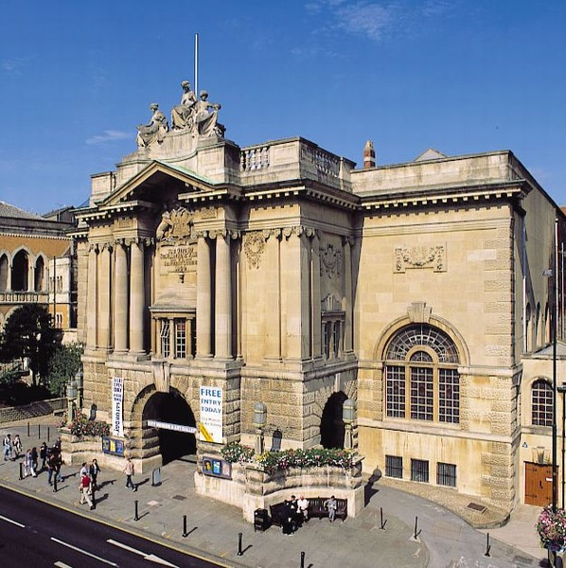
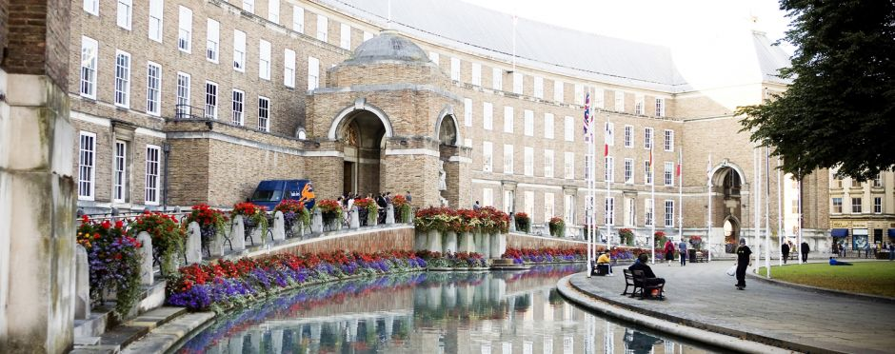
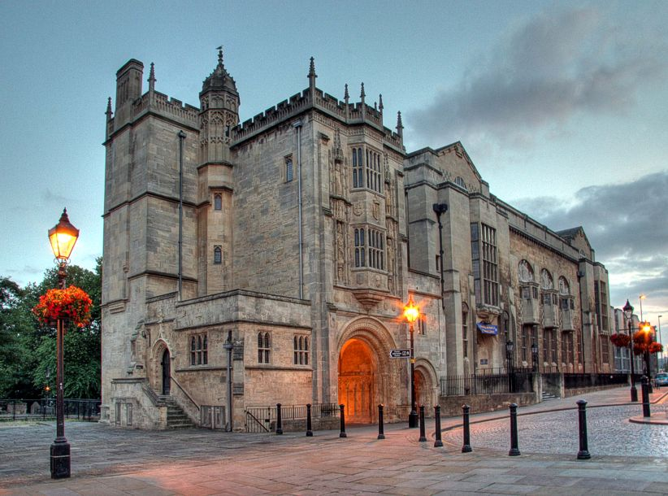
Energy Efficiency - Salix
Utilising Salix Recycling Fund (£1.2m with up to 5 year paybacks)
Focus on high profile Hard to Treat buildings
City Hall underway
M Shed planning application in progress
Colston Hall, City Museum, Central Library and 20 other projects

Slide 8
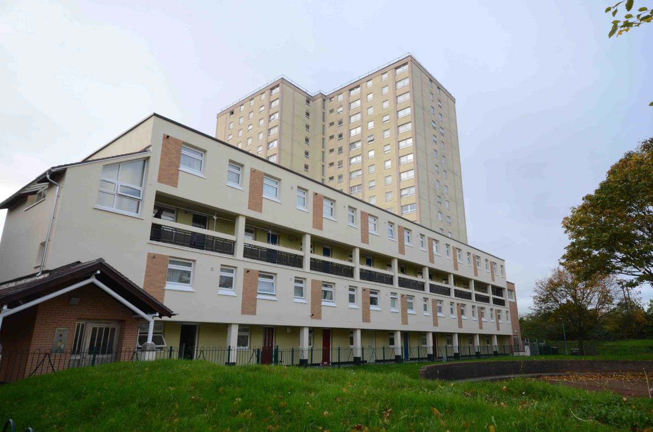
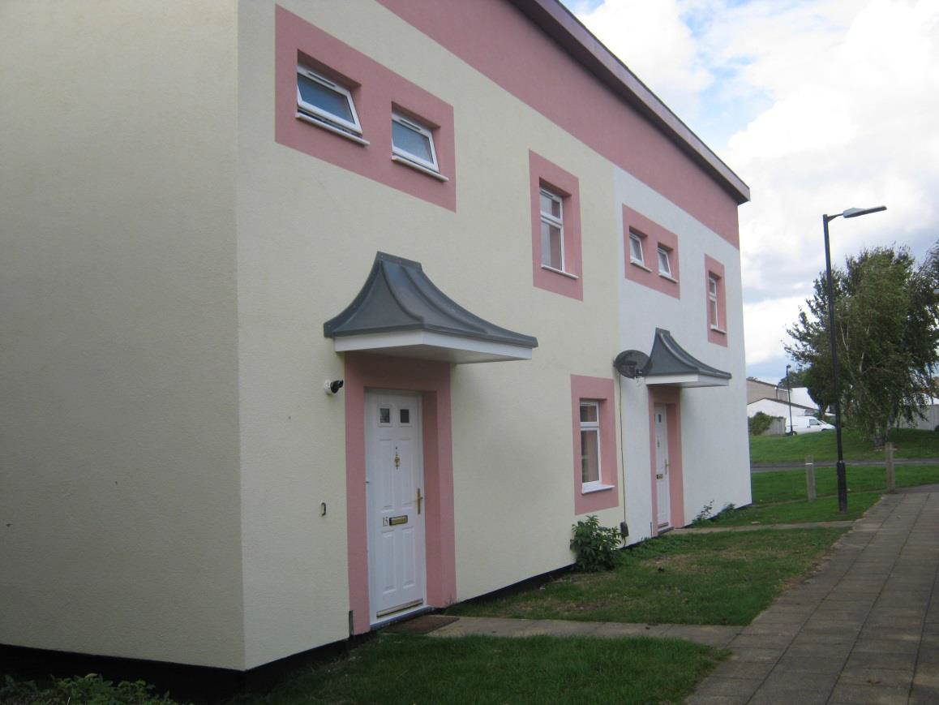
External Cladding on social housing
Completed:
Tower block programme of £32m ongoing
Low-rise insulation programme of £25m currently being delivered, pilot programme completed
EU compliant External Cladding Programme and low-rise insulation procurement frameworks

Slide 9
Warm up Bristol
Warm up Bristol - launched Oct 2014. Based on Green Deal – support installation of energy efficiency measures.
3 Streams
Green Deal Communities scheme – 100 streets in Easton, Totterdown and Horfield (£5.3million DECC)
Private Rented Sector pilot - targeting properties with poorest rated EPCs (E, F & G), (£2million DECC)
Citywide – ECO supported or able to pay
Delivery Partners:
ECO funding provider & main delivery partner (Climate Energy)
Community Involvement:
Engagement activity and referral fee for community groups
Total contract value estimated at £40m

Slide 10
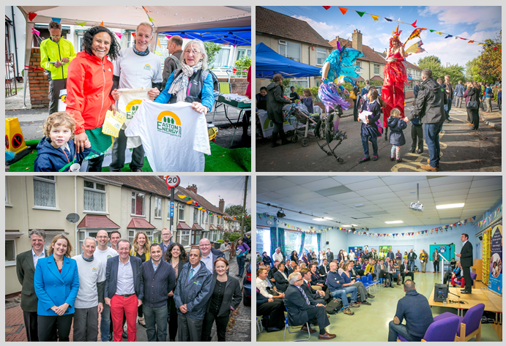
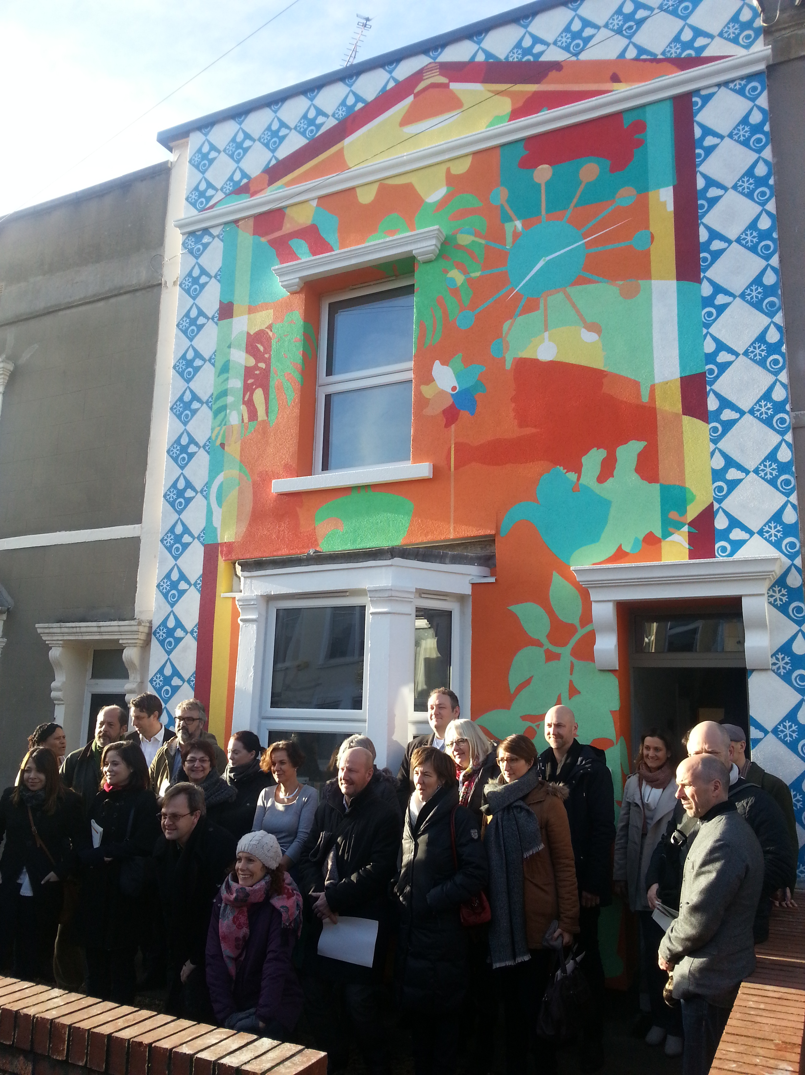
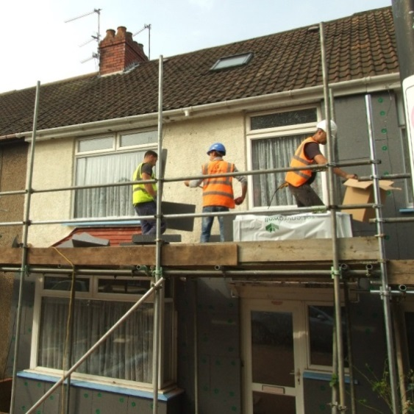
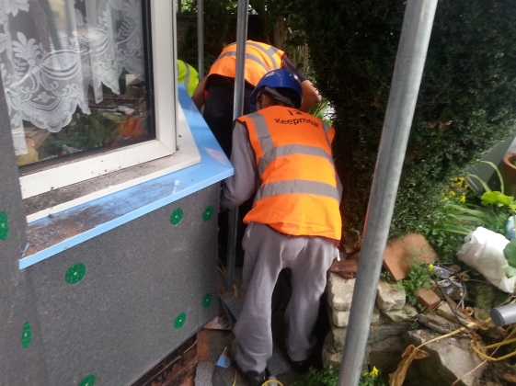

Slide 11
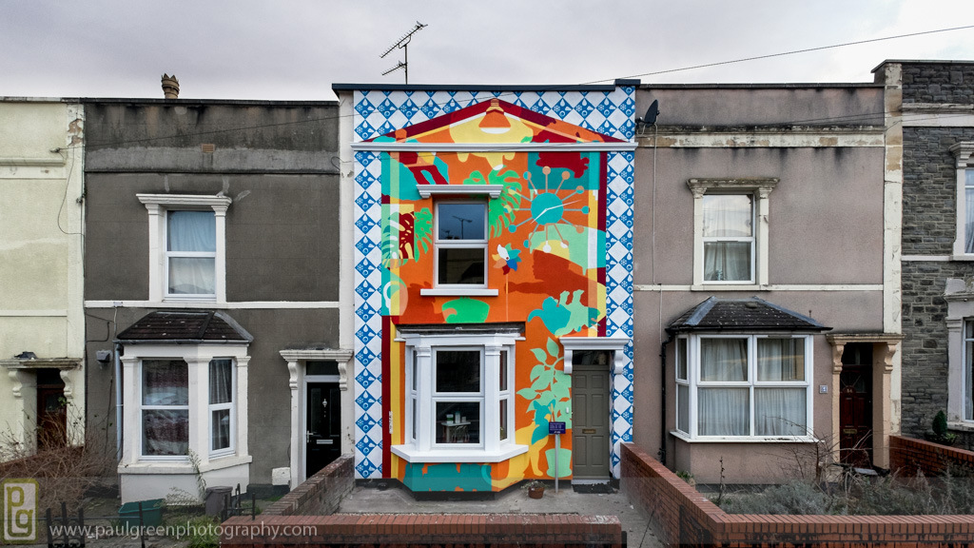
Show Home
Notes:
Bristol City Council has created a show home in Easton so that people can see first hand how you can make your older home warmer with energy saving insulation and other measures.
The measures include: under floor insulations throughout the ground floor, double-glazed windows, internal wall insulation in the kitchen and bathroom, draught-proofing, etc.
Our community partners, Easton Energy Group, are managing the property and will be there to explain the different measures available, show you samples and help you register for our initiative. They will also be hosting other activities such as knit and natter sessions and hosting the travelling seamstress who will help you make your own draught-proofing sausage dog as a cheap and simple way to keep those draughts at bay and make your home warmer to live in.
It has been recently been painted by a local business, Paintsmith.

Slide 12
Warm up Bristol Progress
October 2015:
6,217 enquiries received
5,706 Green Deal Advice reports booked
3,102 Green Deal Advice reports completed
2,201 quotes issued at £11.7m
1,065 orders @ £5.7m
551 installations @ £1.9m
Target – approx. 1800
January 2016:
All outstanding works completed
118 installations completed since mid Nov 2015
200+ enquiries to join the scheme

Slide 13
Fuel Poverty – social housing
Social Housing
Decent Homes Standard
Planned repairs programme
Upgrade programme
10 year tower blocks
5 year low rise
Picking up windows, doors and boiler replacements
District heating in high rise
replacing electric system

Slide 14
Fuel Poverty – Private Housing
Private Rental Sector
Category 1 cold hazards
Enforceable
Able to offer grant through PRS scheme to improve energy efficiency rather than prosecute
Gas connections
Replaces more expensive electric heaters
Wessex Home Improvement Loans
5 year repayment scheme in revolving fund
5% interest rate

Slide 15
Fuel Poverty – Warm Up Bristol
Owner Occupier sector
No legal requirement to improve properties
Energy Company Obligation
HHCRO (Home Heating Cost Reduction Obligation)
Qualifying benefits only
Boiler replacements; loft and cavity wall insulation
Fuel Poverty focus for GDC since Sept 2015
Wider than HHCRO
Delayed roll out due to CE administration

Slide 16
LESSONS LEARNT
Long-term strategic policy development at the local level crucial
Data analysis and mapping important
Area based/street-by-street schemes a good way of engaging householders and public sector organisations,
Whole house retrofit approach vs measure by measure
Partners crucial to successful running!
Local authorities can be the main driver for implementing energy investment and sustainable business models at the local level in co-operation with the private sector
Municipal energy company model ensures long-term continuity of ELENA Programme
Notes:
How does this compare with what you thought about the Energy Service?

Slide 17
What would we do differently?
Agreement to recruit all staff from the beginning on
Less consultancy more in house expertise
Start municipal energy company process earlier and build in more resource
Bundling of EU compliant procurement processes – medium sized city
European Green Capital title a challenge but also an opportunity, resource in that context
Manage retrofit schemes in-house or have more over-sight!
Notes:
How does this compare with what you thought about the Energy Service?

Slide 18
Contacts
Kate Watson
Housing Strategy Manager – Energy Service
Tel: 0117 922 4578
Email: kate.watson@bristol.gov.uk
Notes:
How does this compare with what you thought about the Energy Service?

