Slide 1
LED Filament Bulb Introduction
A. Current LED Filament Bulb
B. Why has the LED filament bulb been developed?
C. Product Comparison
1. Which is the end user’s best choice? Take 40W and 60W as
example - incandescent, Halogene, CFL, LED Bulb, LED Filament Bulb
2. Filament Bulb Merits
D. Key product design
1. Transparent substrate to replace traditional substrate (light emission 360°)
2. Lower current level than nominal for higher efficacy and less thermal load
3. With gas convection the heat of the LEDs can be removed
E. Future Challenges
1. Higher wattage >6W to 10W to replace 75W and 100W incandescent bulbs
2. Increase of efficiency to reduce thermal load on filament LED (max. temp. < 80°C)
3. New LED technologies
F. Conclusions
1. Will LED be the dominant light source?
2. Will LED filament bulb be the dominant design to replace incandescent bulb?
3. Early entrance company will be in a better position to win the market
4. Traditional bulb producers are in a favorite position as they can upgrade their equipment

Slide 2
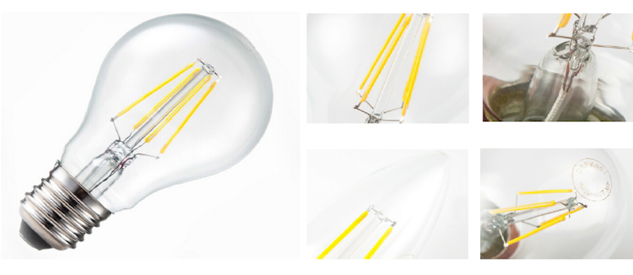
This is the current technology of a
FILAMENT BULB with 4.0 - 5.4 W
with an efficiency when warm
of 120 - 140 lm/W
This new LED Bulb combines LED Technology with conventional Glas Bulb Production

Slide 3
Why has LED Filament Bulb been Developed?
A. The new Energy saving requirement in many countries banned the traditional incandescent bulb because of efficiency being too low.
Traditional bulb company have to scrap incandescent bulb production lines if there is no appropriate product with high Efficiency in Light Output.
B. The Current Filament - LED bulb weakness is balanced by many advantages
Disadvantages:
1. Price is still too high to be widely accepted by end users.
2. Light output needs to be increased to be on par with 75W and 100W incandescent bulb.
3. LED filament not 100% identical to Tungsten Filament
Advantages
1. LED Efficiency almost 10x better than Tungsten
2. Lifetime is at least 20 times of that of a traditional bulb (10 - 20 years depending on usage)
3. Much less heat dissipation
4. Amortisation within 2 - 3 years depending on price of electricity
5. During lifetime only 25% - 30% degradation of light output.

Slide 4
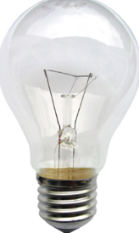
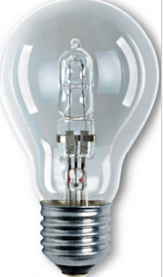
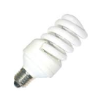
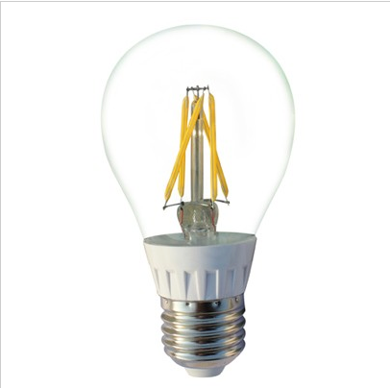
Product Comparison
Type and Consuption | Incandescent 60W | Halogene 43W | Fluorescent 14W | LED - generic 10W | LED Philips L-Prize 9,7W | LED-Filament 5.4w
Lumen output | 860 | 620 | 800 | 800 | 970 | 650
Lumens/W | 14,3 | 14.4 | 57.1 | 80 | 100 | 120
Color Temperature Kelvin | 2.700 | 3100 | 2700 | 3000 | 2700 | 2700
CRI | 100 | >75 | >75 | >85 | >85 | >90
Lifespan (h) | 1.000 | 2.500 | 8.000 | 20.000 | 30.000 | 30.000

Slide 5
Why is the Filament Bulb the End User’s Best Choice?
LED Filament Bulb Merits
1. Higher Efficiency (lm/W) with traditional light emission - Incandescent Bulbs can be replaced in any lamp with immediate energy savings of up to 90% - many Standard
Sockets are waiting.
2. Lower production cost of Filament by using traditional Equipment with small modifications
3. Lower material cost by removing heat sink which is about one third of traditional LED bulb cost. The Heat Dissipation is done by using Helium as gas filling of the bulb.
4. Immediate Light Output < 0.2sec. start up time. There is no Degradation of Lifetime due to switching the Lamp on and off.
5. Low degradation of Light Output during Lifetime ( < 30% over a period of 30.000h which is 20 Years when used daily for 4 Hours))

Slide 6
Design Features of next Generation
LED Filament Bulb
1. The Transparent Substrate (next Slide) will increase light extraction from the LED Chips. This will increase the efficiency >30% in respect to Standard LED Packaging. Due to this feature the LED Efficiency increases to 160lm/W. Efficiency of about 50%.
2. The average Current applied to the LED is 50% below the nominal Specification. This will increase the lifetime of the LED and increase Light Output.
3. The LED Filament Bulb is using a standard Glass Body with convection cooling. The inert Gas Filling (Helium) is cooling the LED Filament and will prevent it from overheating.
4. The LED Filament Power Supply has Power Regulation which is protecting the LED Filament from being overloaded due to Supply Voltage Fluctuation.

Slide 7
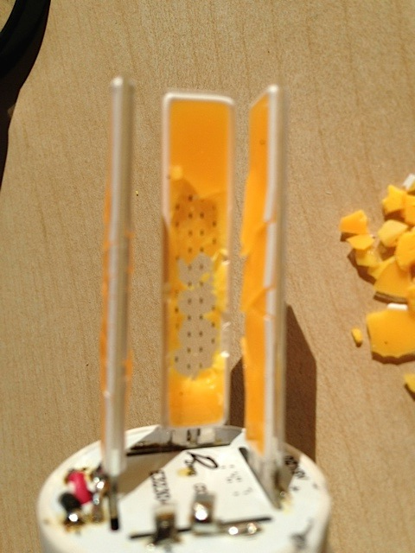
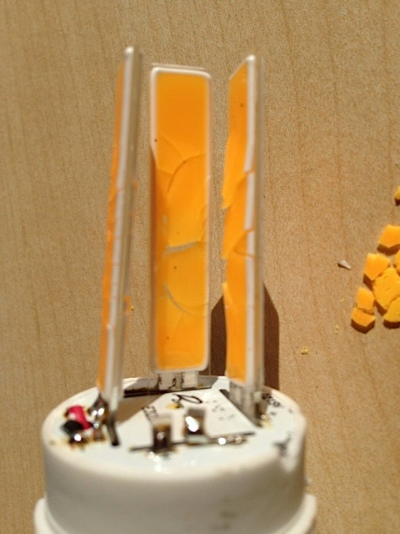
LED Bulb using COG with no Gas Filling
Result After 500h!

Slide 8
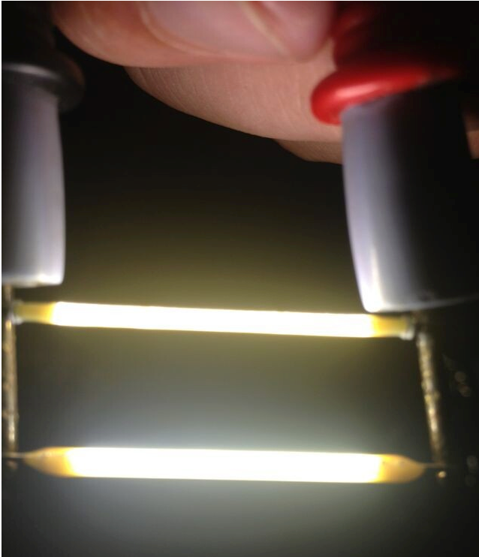
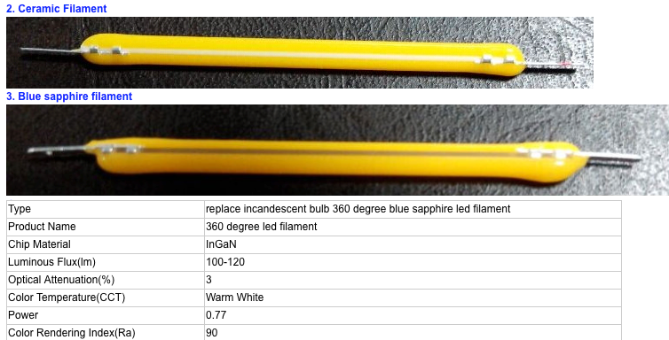
Some Pictures of LED Filament
Two different Type of LED Filament
Lab Test of LED Filament

Slide 9
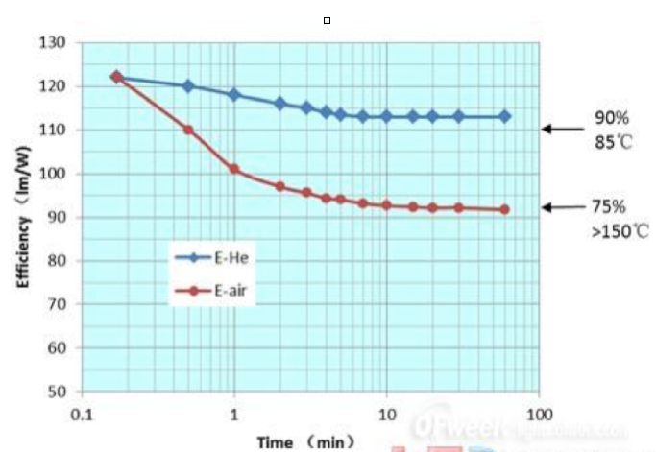
Improvement with Gas filled Bulb
Difference of efficiency and junction temperature with and without Gas Filling
19% difference in Efficiency between with and without sealed Gas at stable state(113 vs 92 lm/W)
With sealed Gas
- 10% efficacy loss
between cold and
stable state
- LED junction temperature
is about 85C.
3. Without sealed gas
- 25% efficacy loss
between cold and
stable state
- LED junction temperature
is more than 150C.

Slide 10
Gas Filling of LED Filament Bulb Conclusions
1. LED filament bulbs will only work reliably up to 2W of Power consumption without Gas Filling
2. Only hermetically Sealed Glass Bulbs can keep the Gas for
the lifetime of the LED Filament Bulb.
In order to fulfil the UL Requirements, a Plastic Film das to
protect the Glas Bulb from breaking.
3. LED Filament Bulb is the dominant design to replace
incandescent bulb.

Slide 11
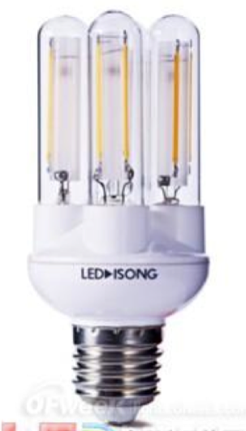
Future Challenges of LED Filament Bulb
Higher lumen output and better Efficiency can be achieved by:
1. Larger Bulb size: A15, A19, A21, A23
(now in Test a 15W Version to replace 100W Incandescent)
2. Multi Bulb Technology
- 2 globes: 850lm, 6.4W, 133 lm/W,
dimensions: D40 mm* L110 mm,
weight: 58g；
- 3 globes:1250lm, 9.3W, 134 lm/W,
dimensions: D48mm * L110mm,
wight：64g；
- 4 globes:1630lm,12.2W,134 lm/W,
dimensions: D52 mm* L110mm,
weight：70g；

Slide 12
Conclusions
1. LED Filament Technology will be the dominant light source for Private Use
2. LED filament bulb will be the dominant Technology to
replace incandescent bulb
3. It is NOW that the Market will be Divided between the Global contenders having best Technology and Price

