Slide 1
Ellie Grebenik: Regional Manager Co-wheels Car Club

Slide 2
Intro to Car Clubs: What is Co-wheels?
The largest Social Enterprise car club in the UK
50 locations nationwide
Largest supplier of Electric Car Club cars in the UK
Also supply Hybrids and other low emission vehicles

Slide 3
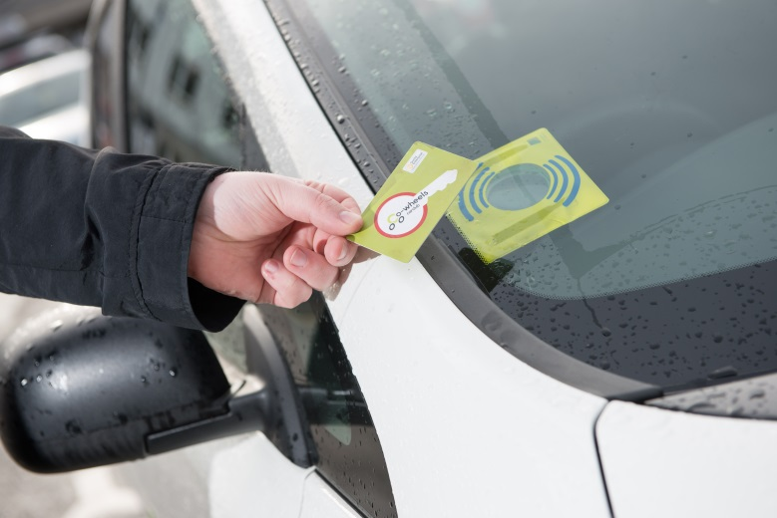
How does it work?
£25 sign up fee gives access to national fleet
After a DVLA license check a Smartcard linked to your online account is posted out to you
Use the website to choose & book vehicles
Present your Smartcard to the windscreen to unlock the car
Ignition keys are stored in the glove box

Slide 4
Aims of the Car Club
Car clubs reduce private car ownership significantly
Members of car clubs use other forms of sustainable transport much more than non-members and drive less than car owners
Cars are greener and cleaner than most private cars
Cost of car ownership can lead to transport poverty
Reduction of parking demands in areas

Slide 5
In Frome: 3x Low Emission cars

Slide 6
Elsewhere in the UK….

Slide 7
Overall
Shift away from private car ownership
Increased interest in “environmentally friendly” cars such as Electric, Hybrid and Hydrogen
Councils and large employers see the benefits too
Thank you
Any Questions

Slide 8
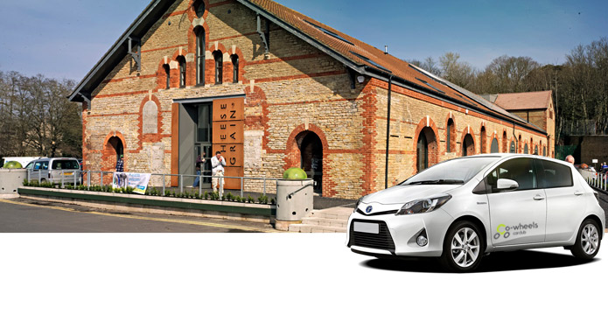
Contact information
Ellie Grebenik ellie@co-wheels.org.uk
www.co-wheels.org.uk
Tel 0191 375 1050

