Slide 1

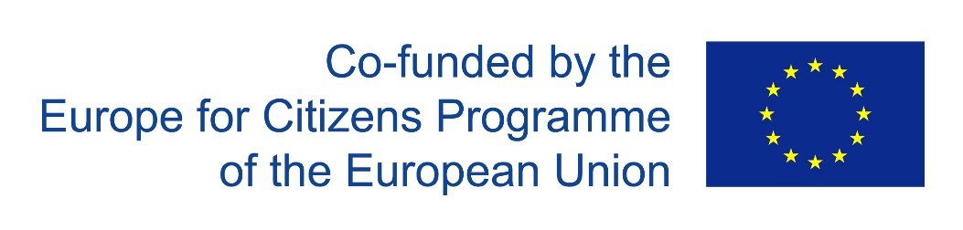

Renewable energy for residential buildings
Dietmar Bässler, energy craftsman

Slide 2
Renewable energy sources (RES) for residential buildings
content
Energy demand in residential buildings
RES-technology and systems for energy supply of buildings
Efficacy and efficiency
system integration
System combination
summery

Slide 3
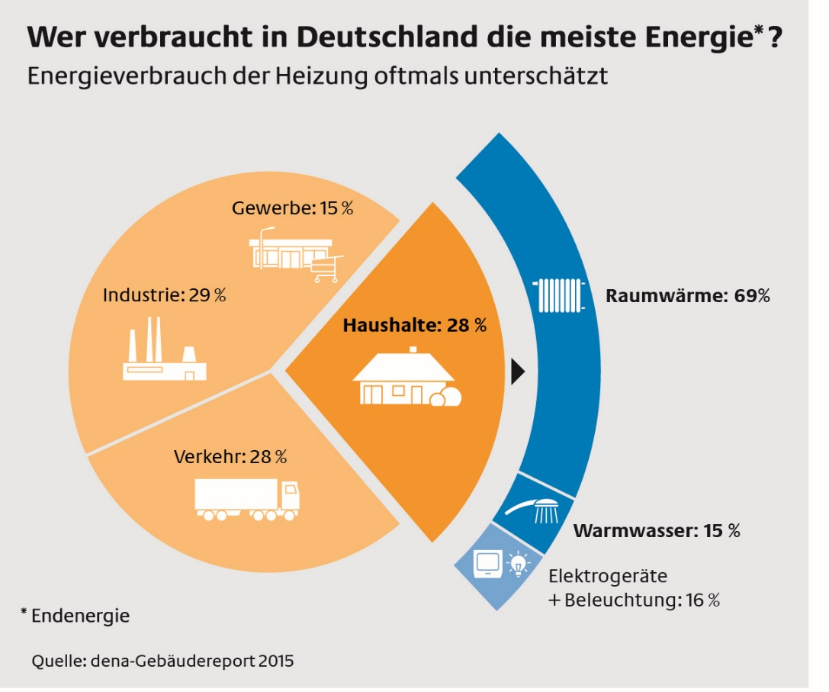
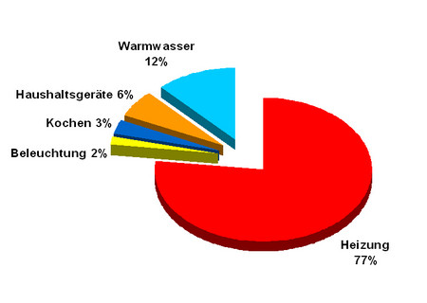
What and where?
Energy demand in residential buildings
Der Energiebedarf der Heizung wird unterschätzt
ca. 85%
ca. 85%

Slide 4
Diversity of systems
RE technology for building energy supply
Electricity from photovoltaic (PV)
Electricity and heat from CHP
Electricity from small wind turbines
Heat from solar thermal
Heat from biomass
(Wood, pellets, wood chip heating systems)
Heat from heat pumps

Slide 5
conditions
RES systems for building energy supply
Criteria on site:
Structural situation
  Roof, roof orientation, utility room, boiler room, heat distribution
Living conditions of the inhabitants and users
  Automatic-manual mode (firewood, ash, etc.)
Wishes and financial possibilities of the customer
  possibly divided into several stages of the project

Slide 6
You have the choice
RES systems for building energy supply
Criteria for system selection:
Energy sources with no or the lowest energy cost
  Sun (solar energy + solar thermal), pellets, wood, wood chips, etc.
Devices with high efficiency and more efficient use of energy
  High efficiency in partial load operation
Integration into the overall system
  Are future enhancements and supplements possible?
Combination of equipment and systems
  Smart combinations with the aim RES = 100%, energy costs = 0,- €

Slide 7
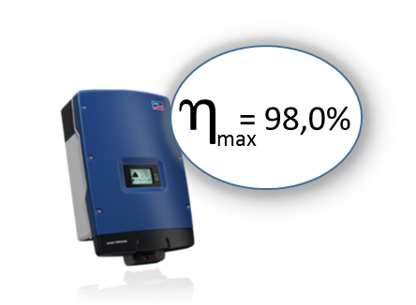
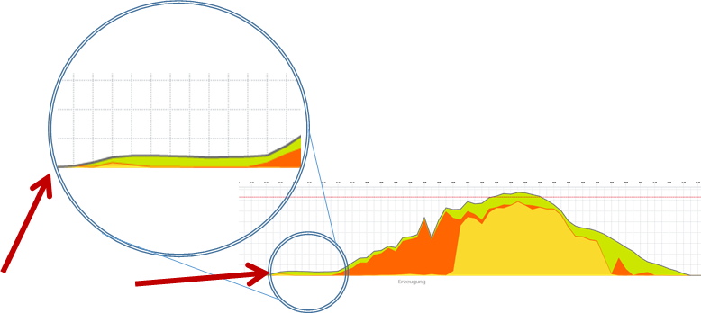
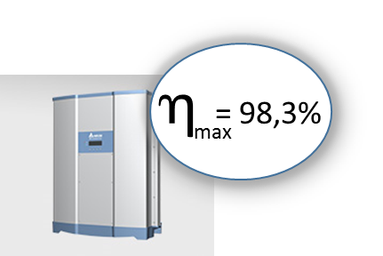
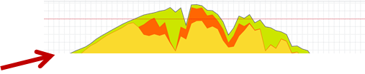
Efficiency and utilization counts
  High efficiency at part load
Ex. solar power - Inverter

WR 1
time in use is increased by up to 4 hrs. per day
energy output increases by 5 - 10%
turn-on
> 188 V DC
bis 15 hrs.

WR 2
turn-on
> 250 V DC
bis 11 hrs.

Slide 8
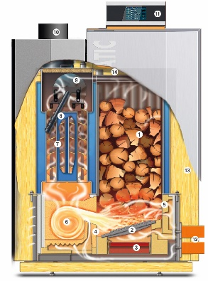
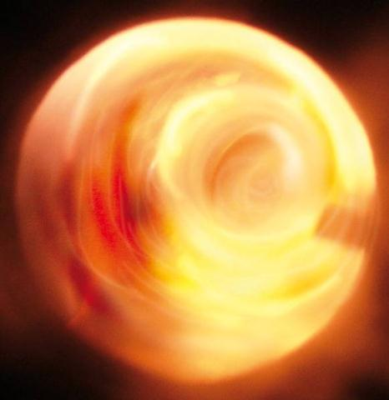
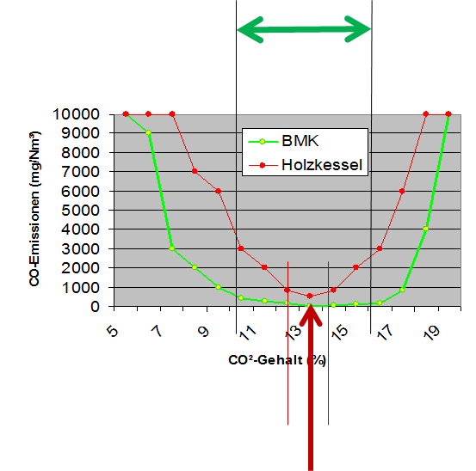
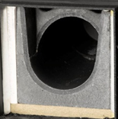
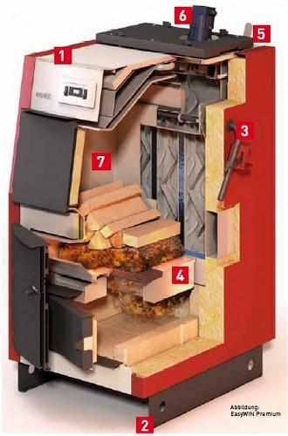
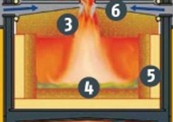
Efficiency and utilization counts
  High efficiency at part load

Ex. Wood
Gasification Boiler
with swirl combustion chamber
Large operating range with high efficiency
Very low emissions

Standard combustor
operating range good at only one point
long heating period

Slide 9
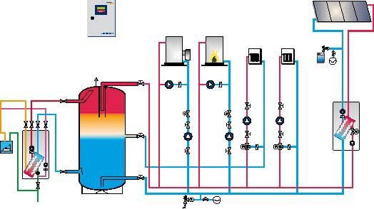

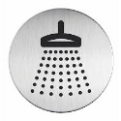
Efficiency and utilization counts
System integration is important
Ex. Central buffer

heat sources
heat consumers
Direct distribution of heat
Characteristics:
Direct distribution of heat
Central storage of heat
Fresh hot water
Heat sources operate independently of each other
Advantages:
Fast heat supply to consumers
Low Standby – losses
Very good combination possibilities
Anytime, easily extendable

Slide 10
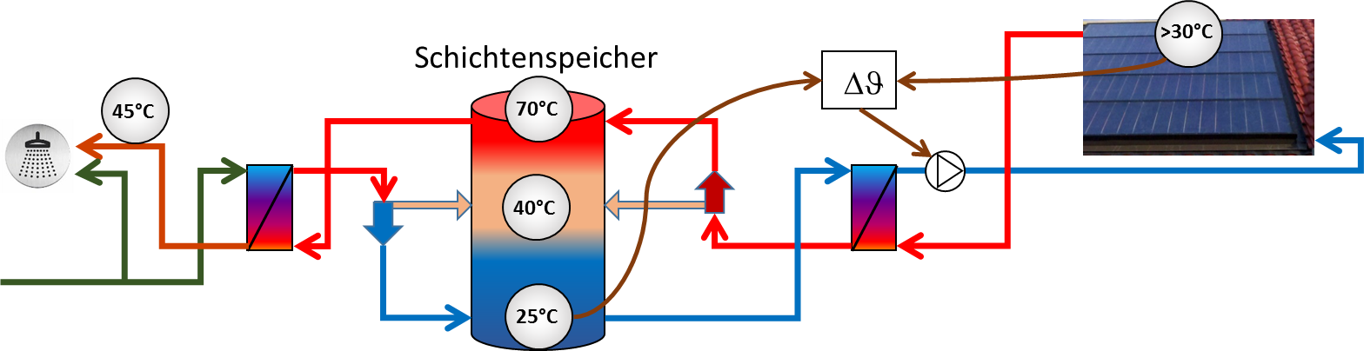
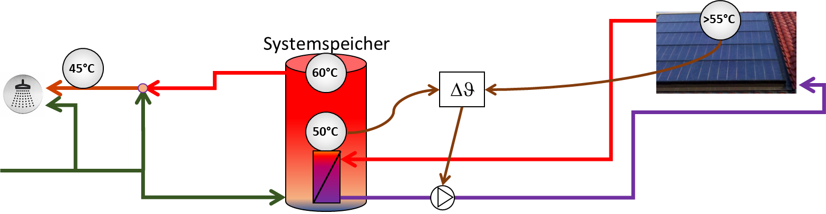
Efficiency and utilization counts
System integration is important
Memory heat storage /

Ex. Solar water heating
Var. 1
Increase of usage time
Energy saving up to about 50%
Heat storage /

Var. 2
Energy saving up to 20%

Slide 11
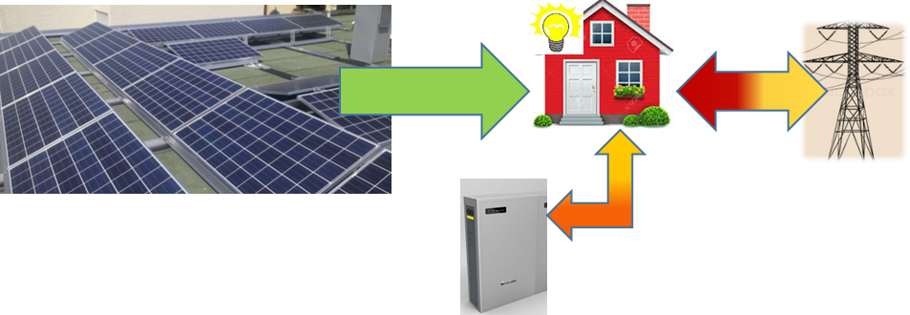
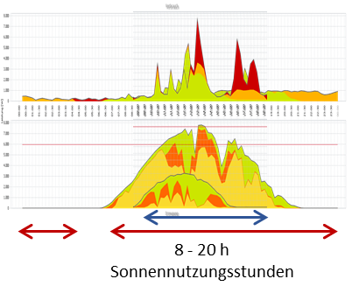
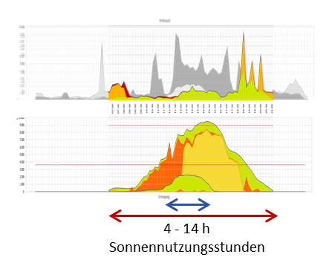
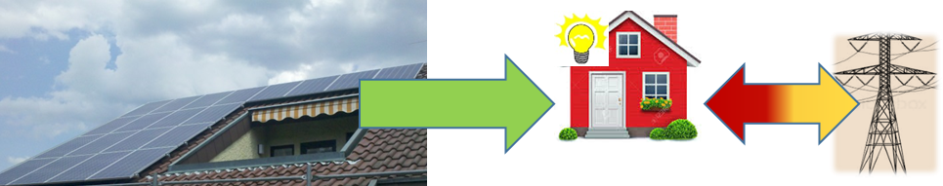
Efficiency and utilization counts
System integration is important

Ex. PV system / solar power usage (overfeeding)
Var. 1
Own efficiency about 50%
Energy saving about 60%
Electricity costs reduction
with electricity sales 95%
9,9 kWp
alignment:
East 10° + south 13° + west 10°
+ battery storage
6,4 kWh

Var. 2
Own efficiency about 30%
Energy saving about 20%
Electricity costs reduction
with electricity sales 45%
5,2 kWp
alignment: south-west 32°

Slide 12
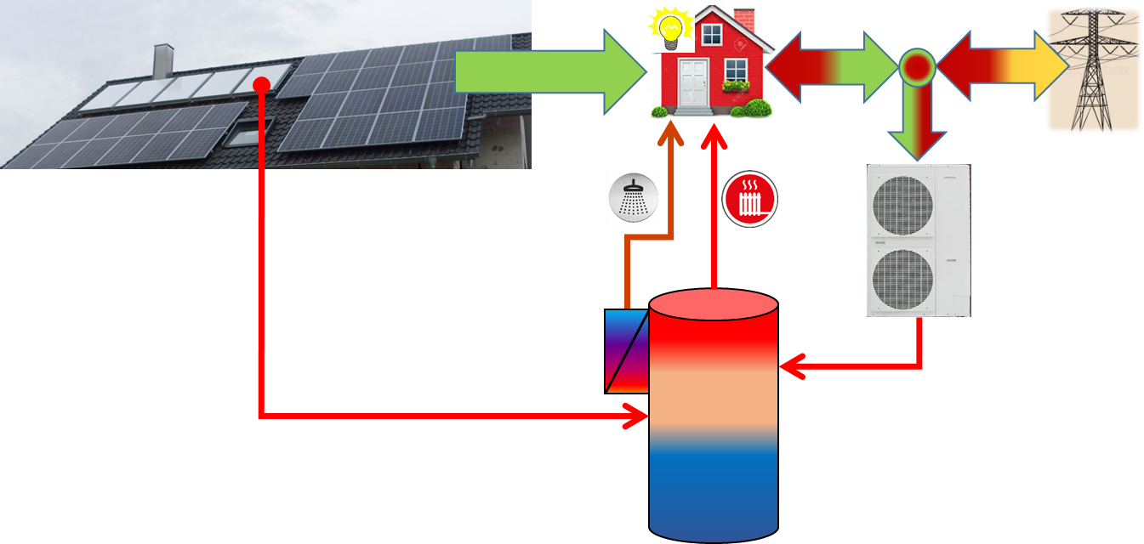
Efficiency and utilization counts
Combination of systems
Ex. PV-conditioning / heat pump / solar thermal system

Self-efficiency PV 12%
Percentage of e-energy and thus Energy saving about 80%
(For PV power, ST-heat, WP-heat)
Energy costs per annum 680, - €
(For House-power, WP-electricity, heat)
With electricity sales approximately -550, - €
10 m² solar thermal
8,2 kWp PV
alignment: south 34°
9 kW
Heat pump
(air / water)

Slide 13
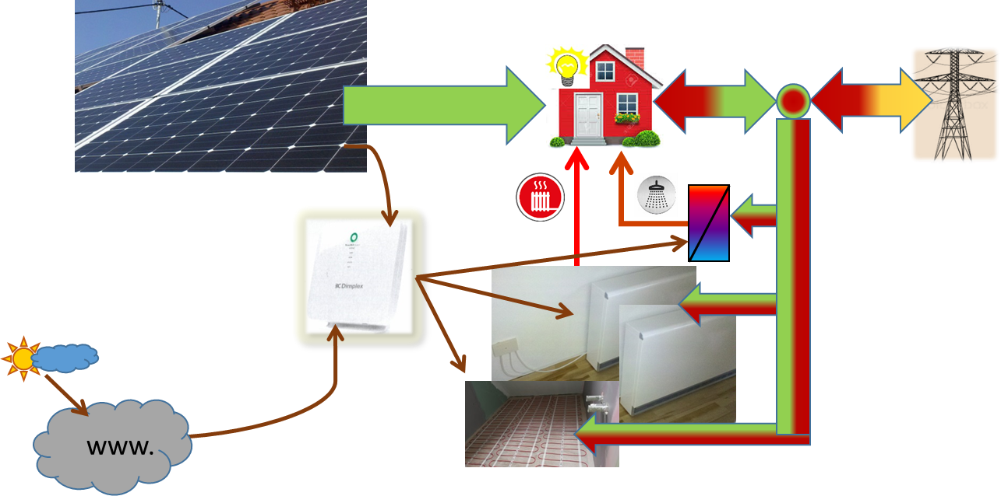
Efficiency and utilization counts
Combination of systems
Ex. PV system / Electric storage heaters / electric storage for hot water

Self-efficiency PV 40%
Percentage of e-energy and thus
Energy saving about 50%
(For PV power, PV-thermal, PV WW)
9,9 kWp
alignment:
East – West 30°
electric storage
for hot water2-6 kW
electrical
storage heaters 8 kW
Home-Manager
electrical
underfloor heating 0,6 kW

Slide 14
summary
consider local situation
 → objective: use the variety of possibilities
using Renewable Fuels
 →objetive: Goal: no costs for energy
Devices with high efficiency
 →objective: high efficiency at partial load
integrate systems efficiently
 →objective: high efficiency!
combine systems smart
 →objective: low energy / operating costs!

Slide 15
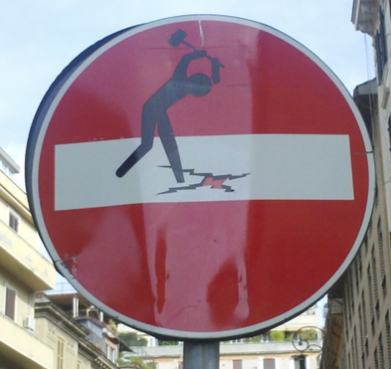


Ask dogmas in question!
Think cross!
And have fun!
Thank you for your attention

Slide 16
energy cooperative & wind energy
Jakob Schäfer, Murrhardt, Germany

Slide 17
Aims of presentation
citizens energy cooperative in Murrhardt (EGM)
role of citizens energy cooperatives in Germany
planned wind farm project in Murrhardt (Zollstock-Springstein)

Slide 18
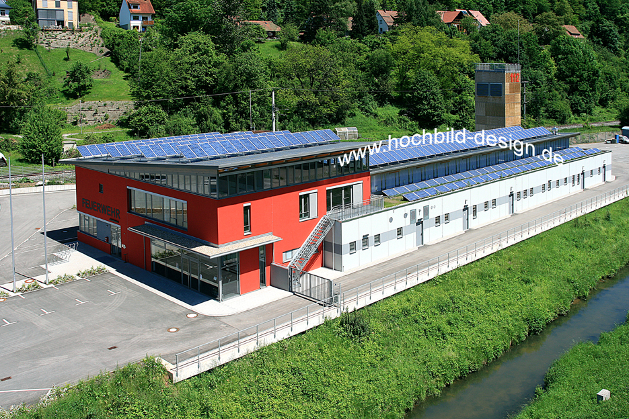
citizens energy cooperative Murrhardt
Citizens solar power plants in Murrhardt since 2008
in the legal form of a limited partnership
shares available to hold from ~800 £ onwards
classical investment into renewable energy
security through guaranteed feed-in tariff

Slide 19
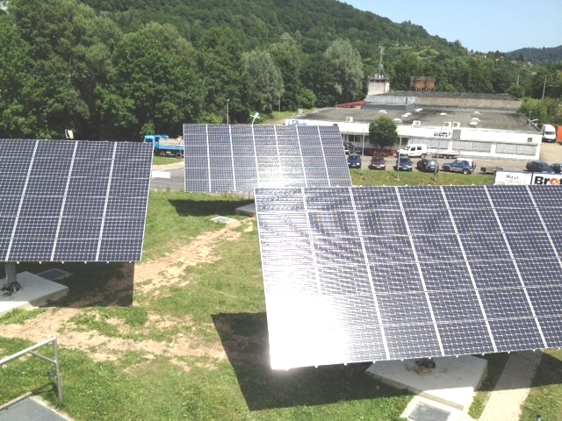
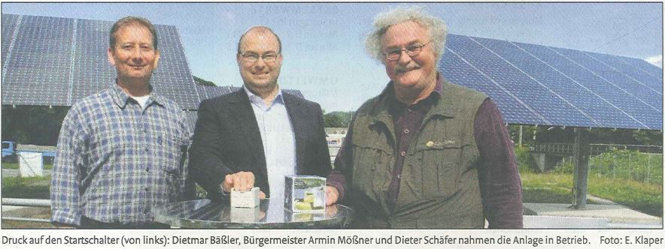
in total 6 facilities
installed production capacity (kWp):
20, 22, 52, 20, 8, 32 (each in kWp)
in total 154 kWp

Slide 20
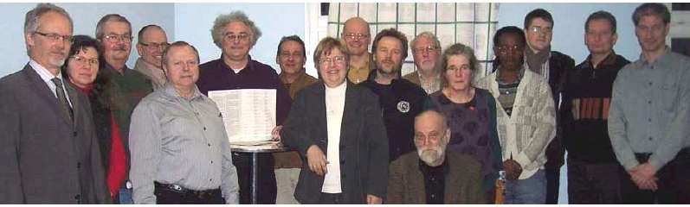
about four weeks before Fukushima
energy cooperative Murrhardt (EGM) eG
founded on 15 February 2011
in the legal form of a cooperative
shares available to hold from ~76 £ onwards
availability for more members to participate through low costs

Slide 21
agenda since 2011
Commitment in tender for new operator of the power grid in Murrhardt
  target not reached
Commitment in Murrhardt´s all new electricity grid operating company
  target not reached
Distribution of electricity through own local brand (support through partner company with experience in deregulated power market)
  target reached

Slide 22
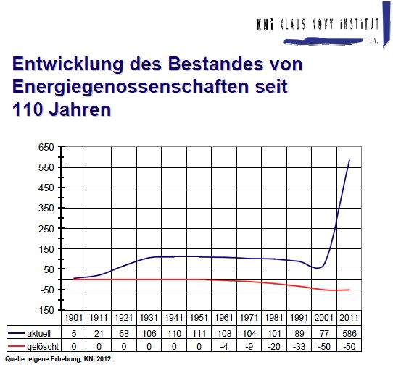
boom of energy cooperatives in Germany
within ten years growth
from ~ 50 to over 550

Slide 23
recent projects and initiatives brief overview of dates in german energy policy
agreement 2002 to leave nuclear technology in Germany
extensional use agreed in 2010
few months later roll-back after Fukushima in March 2011
Energiewende and last shut down of german nuclear power plant in 2022
new provincial government in our province since 2011
complete change in provincial policy regarding use of wind energy

Slide 24
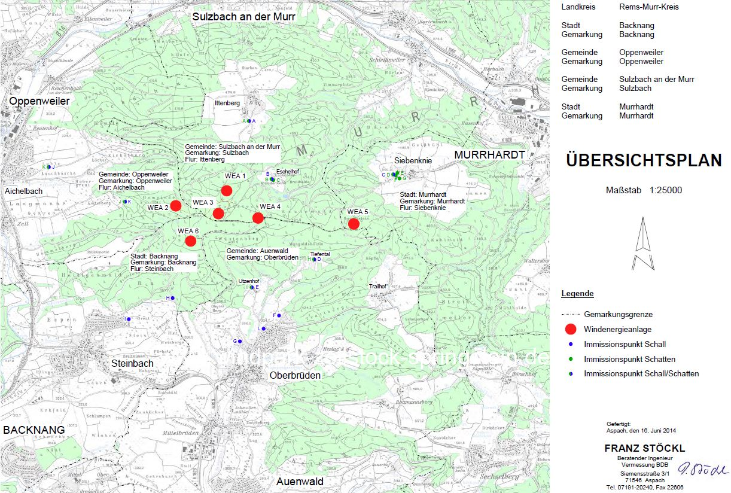
location of planned wind farm
6 turbines
Nordex N 117 (2,4 MW)
3 Mio. £ per turbine
consortium of various
shareholders
estimated time of
building permit:
December 2014
Photo / picture

Slide 25
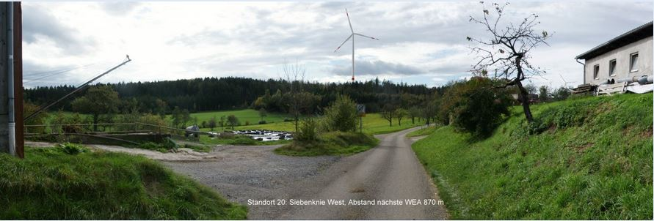
visualization of the Springstein hill in Murrhardt
view from Siebenknie to Springstein
(everything within Murrhardt municipality)

Slide 26
Conclusion
unexpected difficulties with state authorities hit´s our energy cooperative Murrhardt hard
still no clearance when building permit to expect
difficult to establish a profitable energy cooperative in Murrhardt
nevertheless engagement for climate justice with climate summit Paris 2015 in mind
strong will of civil society to move the energy sector in a innovative way forward

Slide 27
