Slide 1
Buildings with low carbon dioxide emission
Building renovation for reducing
energy demand.

Slide 2
What is energy-efficient construction?
Energy-efficient construction is characterized by the kind of design technology and construction that makes it possible to gain high comfort of living and low energy consumption, which means low cost of exploitation. This is gained by the reduction of energy needed for heating and hot water, and the reduction of electrical energy used for lightning and ventilation.

Slide 3
What is energy-efficient construction?
The reduction of heating energy is gained by the usage of the right insulation of the whole building, which means the insulation of walls, slab roofs, foundations, cellar ceilings and floors, window frames with high insulation parameters, elimination and avoidance of all thermal bridges, the preservation of the high tightness and regaining of the heat that escapes the building either with the heated air through ventilation, or through wastewater sewerage.

Slide 4
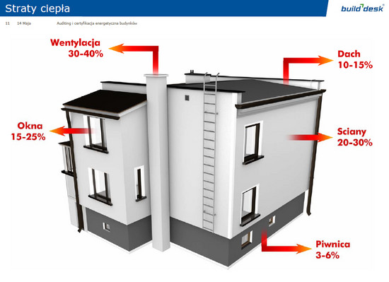
The percentage of heat loss of the building is illustrated in the picture below.
Źródło: http://www.ucn.pl/

Slide 5
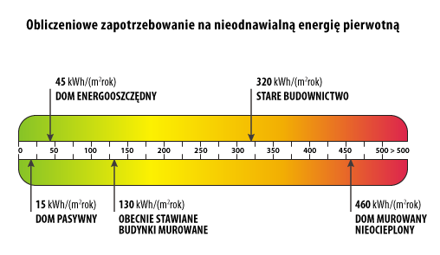
Źródło: www.dasa.com

Slide 6
What is thermo-modernisation?
Nowadays there is a tendency to design and build buildings by using energy-efficient technology, however, the older buildings with high heat losses require thermomodernisation.
Thermomodernisation stands for all changes in the structure of a building and the heating system that lead to the reduction of heat loss.

Slide 7
Energy audit
The correct energy audit of a building is crucial in any successful thermomodernisation investment.
An energy audit is an analysis of the given state of energy flows and evaluation of possible savings, but also the choice of optimal technical solutions allowing for the reduction of energy loss.
An energy audit is the basis of making the right decision as to what steps should be taken in a specific case.

Slide 8
Thermomodernisation
Exemplary thermomodernisation improvements to be made in buildings:
- external walls insulation
- insulation of slab roofs, attic ceilings
- cellar ceiling insulation
- replacement of window and door frames
- modernization of heating system
- modernization of water heating installation
- modernization of ventilation system

Slide 9
Thermomodernisation
Heating system modernisation includes:
- modernisation of thermal centers (the replacement of boilers for burning solid fuels for those with ”eco-pea coal” of the 5th class or gas boilers),
- the replacement of heaters and pipes, wires insulation,
- the installation of thermostatic valves and weather compensations,
- usage of renewable resources

Slide 10
Thermomodernisation
Thermomodernisation benefits:
- energy-savings
- heating costs reduction
- reduction of air pollution
- improvements in building’s aesthetics and convenience

Slide 11
The above procedures can be implemented fully or one by one depending on technical state of the building and owner’s financial abilities.

Slide 12
Over the last decade
the thermomodernisation of numerable public and residential buildings has been carried out in Rabka-Zdrój.

Slide 13
The thermomodernisation of buildings
owned or co-owned by Rabka-Zdrój municipality in the Municipal Housing Department in Rabka-Zdrój.
In the years 2009 - 2011 the thermomodernisation of 10 buildings was carried out.
The works were financed by owners’ financial resources and bank loans with thermomodernisation benefit.
The thermomodernisation included styrofoam insulation of external walls, slab roofs insulation, the replacement of window and door frames in staircases and cellars.

Slide 14
Furthermore, in the years 2013-2014 the central heating modernisation of two buildings was done:
- old gas boilers were replaced for condensing boilers with high efficiency, weather compensations and thermostatic valves in staircases and flats were installed.
Thanks to the renovations the heating costs were reduced by approx. 40%.

Slide 15
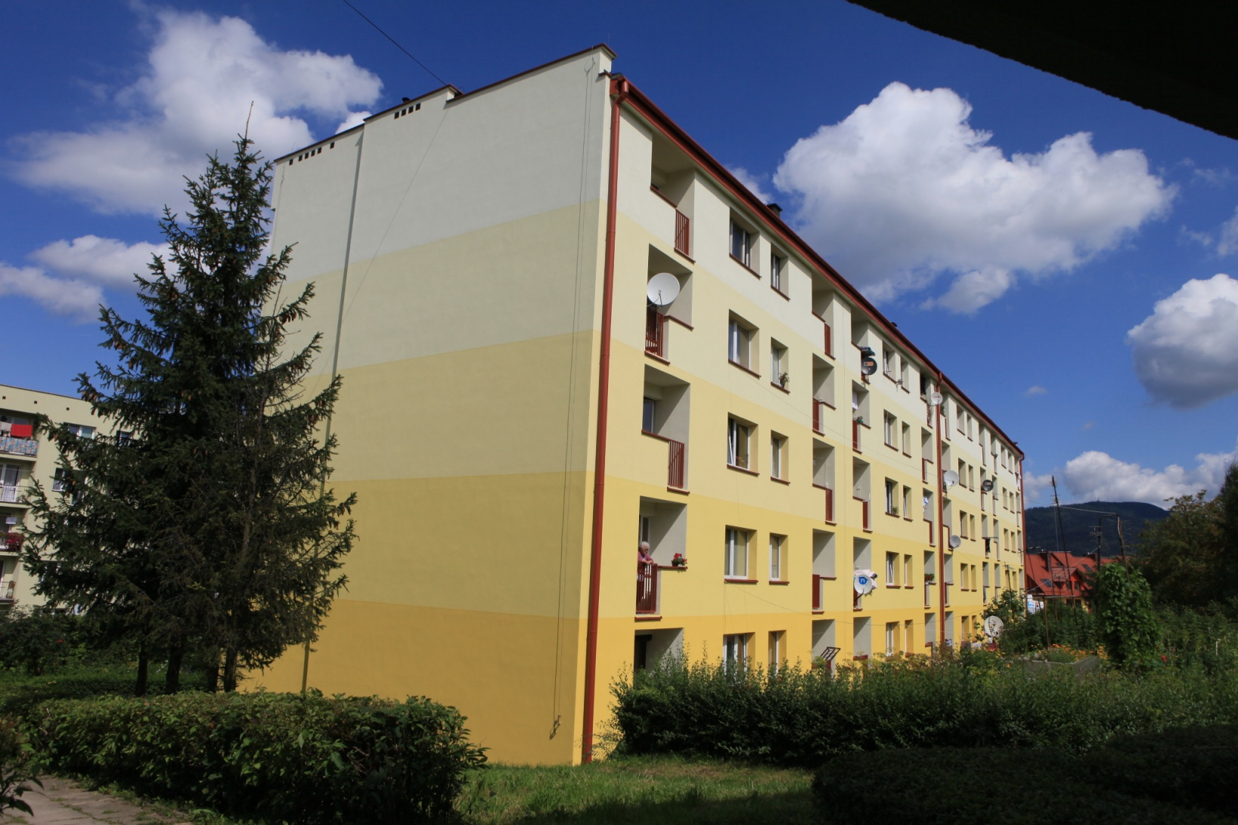
The thermomodernisation of buildings
owned or co-owned by Rabka-Zdrój municipality in the Municipal Housing Department in Rabka-Zdrój.

Slide 16
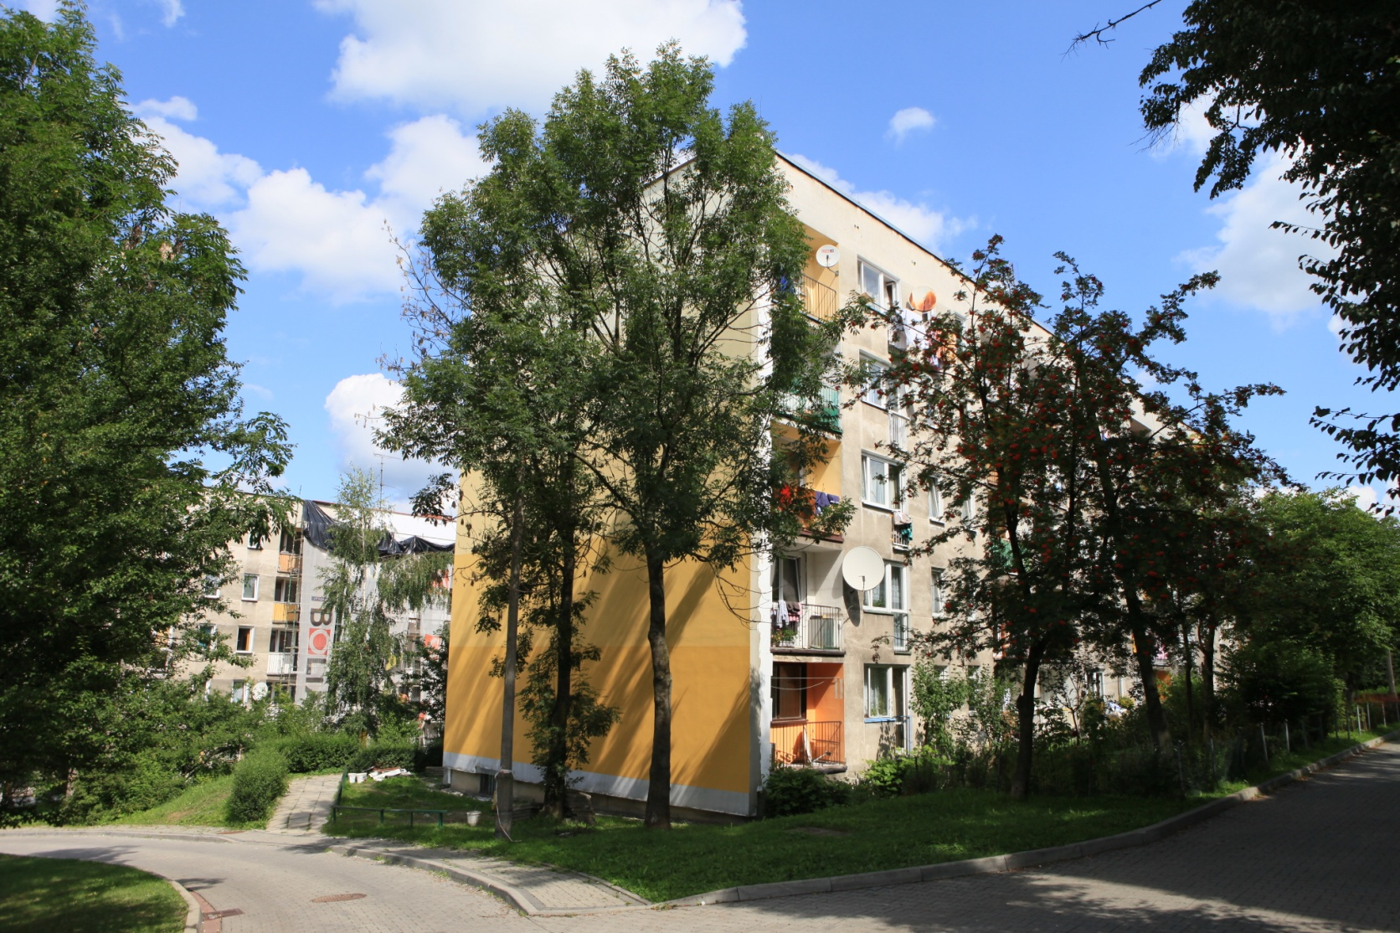
The thermomodernisation of buildings
owned or co-owned by Rabka-Zdrój municipality in the Municipal Housing Department in Rabka-Zdrój.

Slide 17
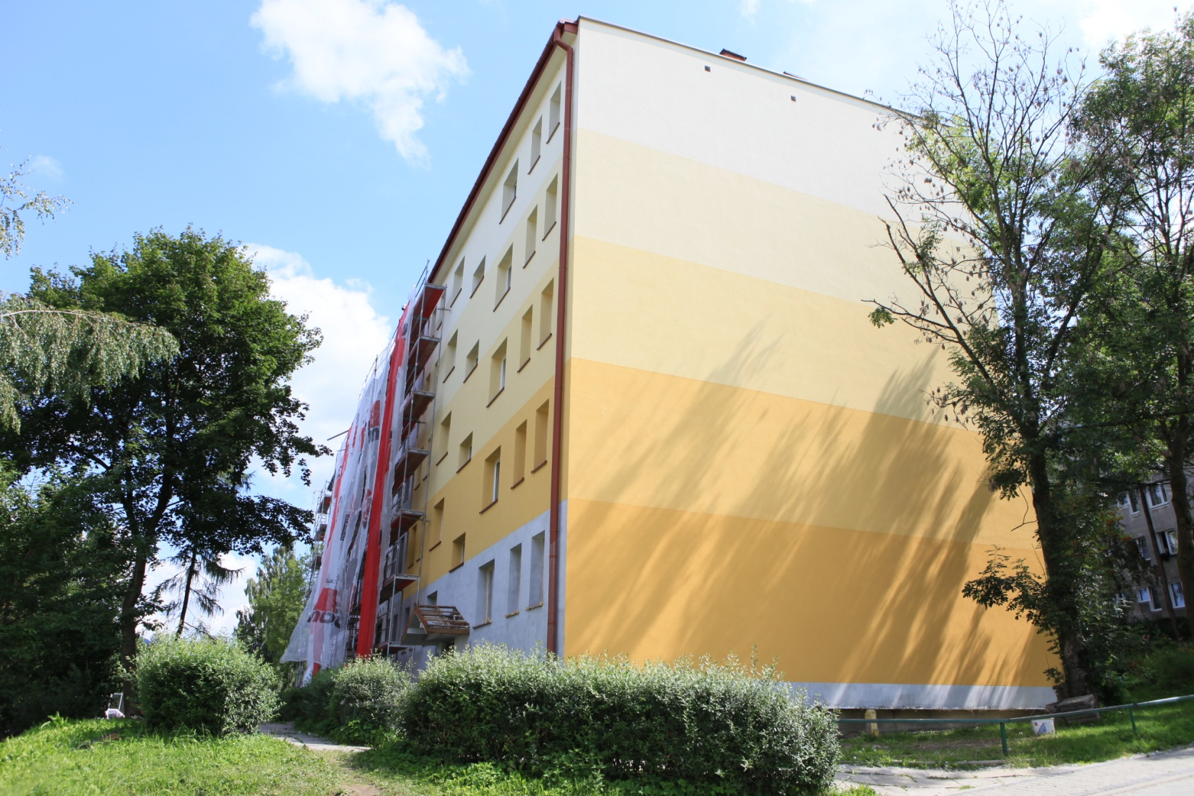
The thermomodernisation of buildings
owned or co-owned by Rabka-Zdrój municipality in the Municipal Housing Department in Rabka-Zdrój.

Slide 18
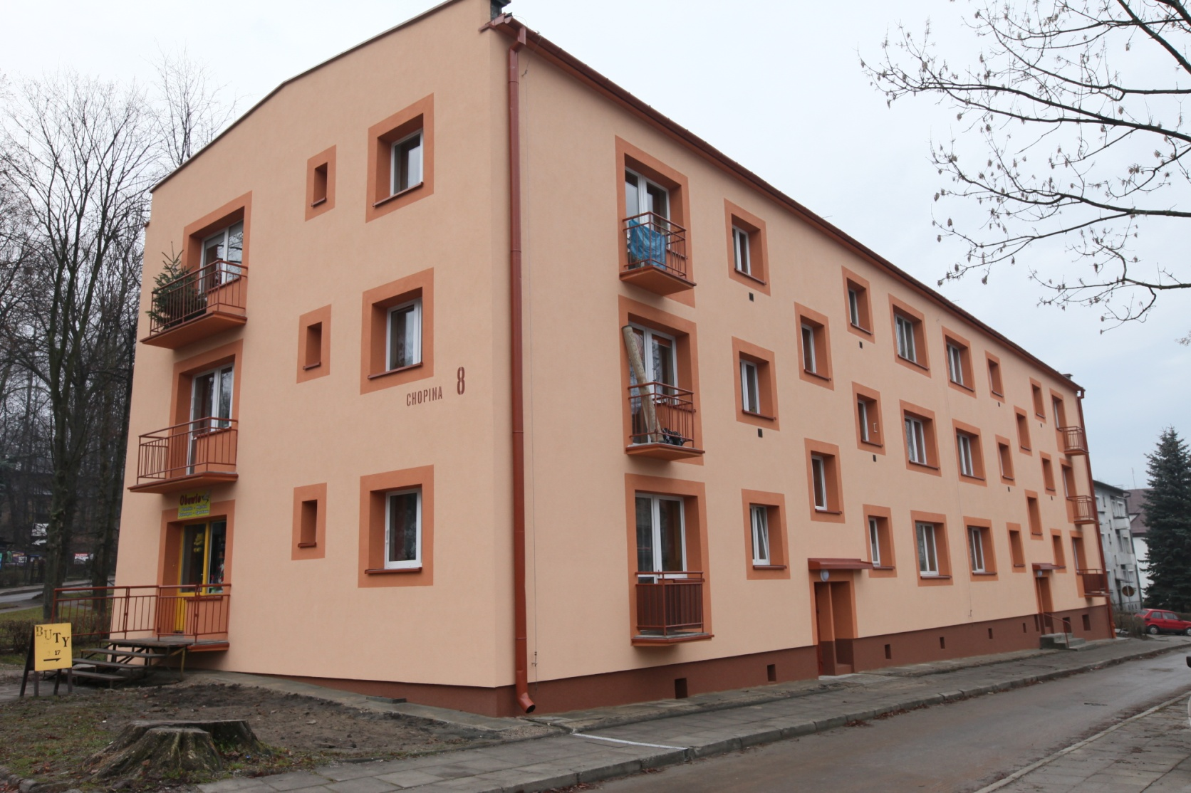
The thermomodernisation of buildings
owned or co-owned by Rabka-Zdrój municipality in the Municipal Housing Department in Rabka-Zdrój.

Slide 19
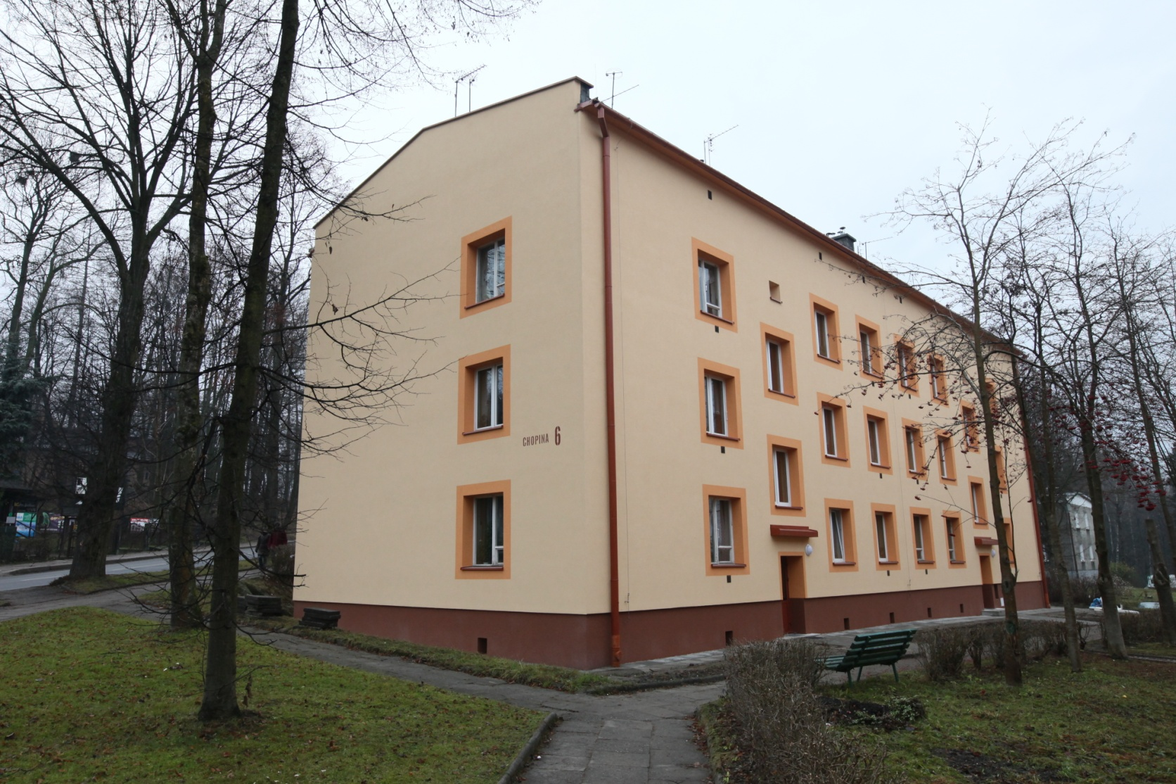
The thermomodernisation of buildings
owned or co-owned by Rabka-Zdrój municipality in the Municipal Housing Department in Rabka-Zdrój.

Slide 20
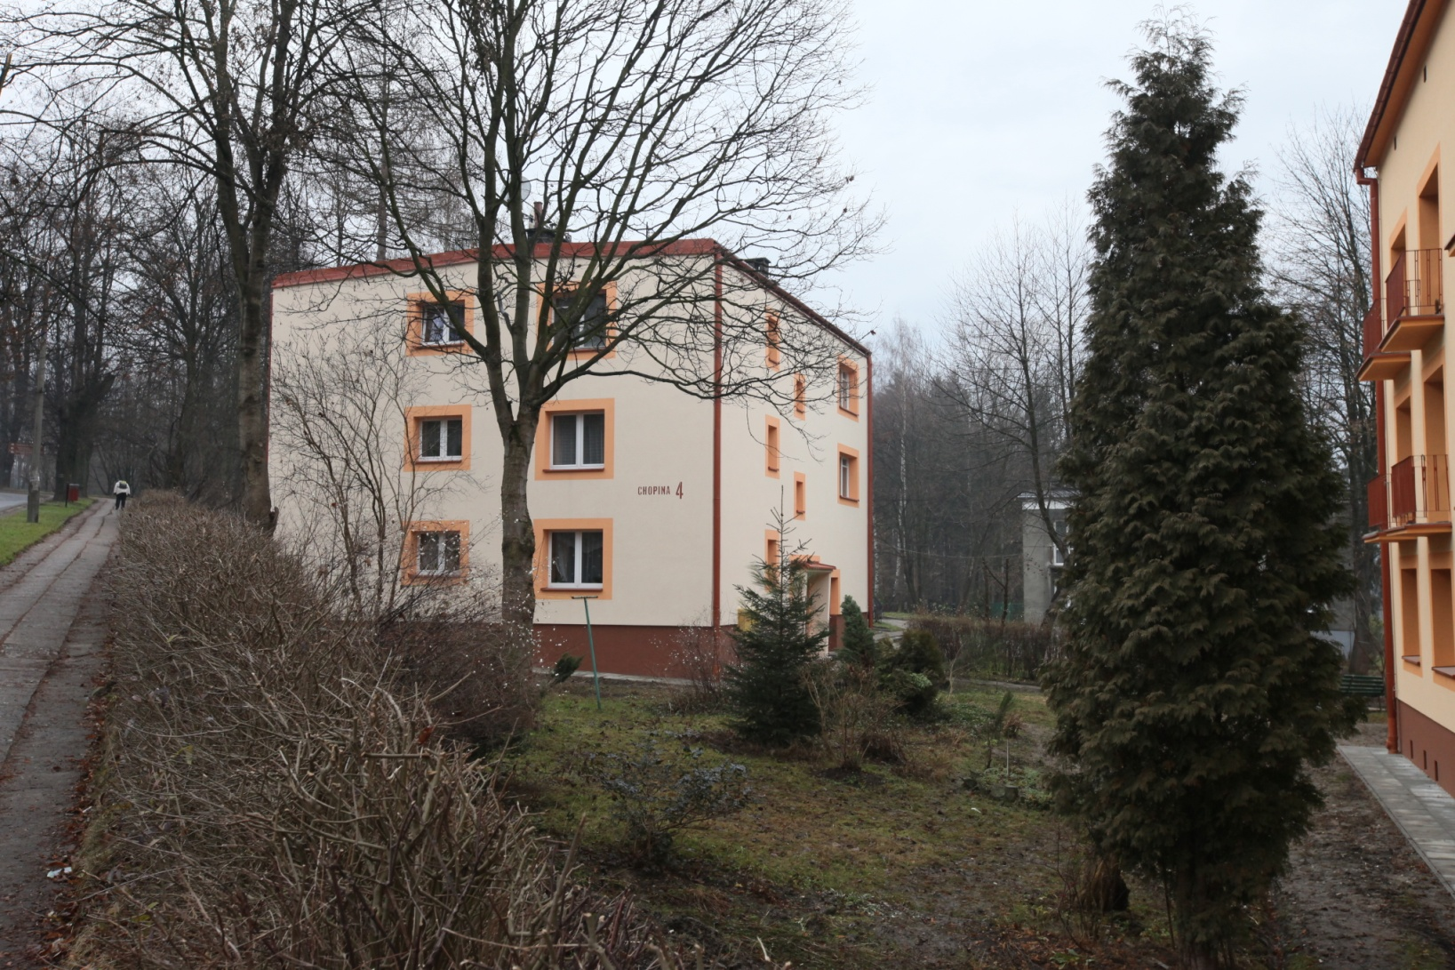
The thermomodernisation of buildings
owned or co-owned by Rabka-Zdrój municipality in the Municipal Housing Department in Rabka-Zdrój.

Slide 21
The thermomodernisation of buildings
owned by Rabka-Zdrój municipality.
1. kindergartens and schools

Slide 22
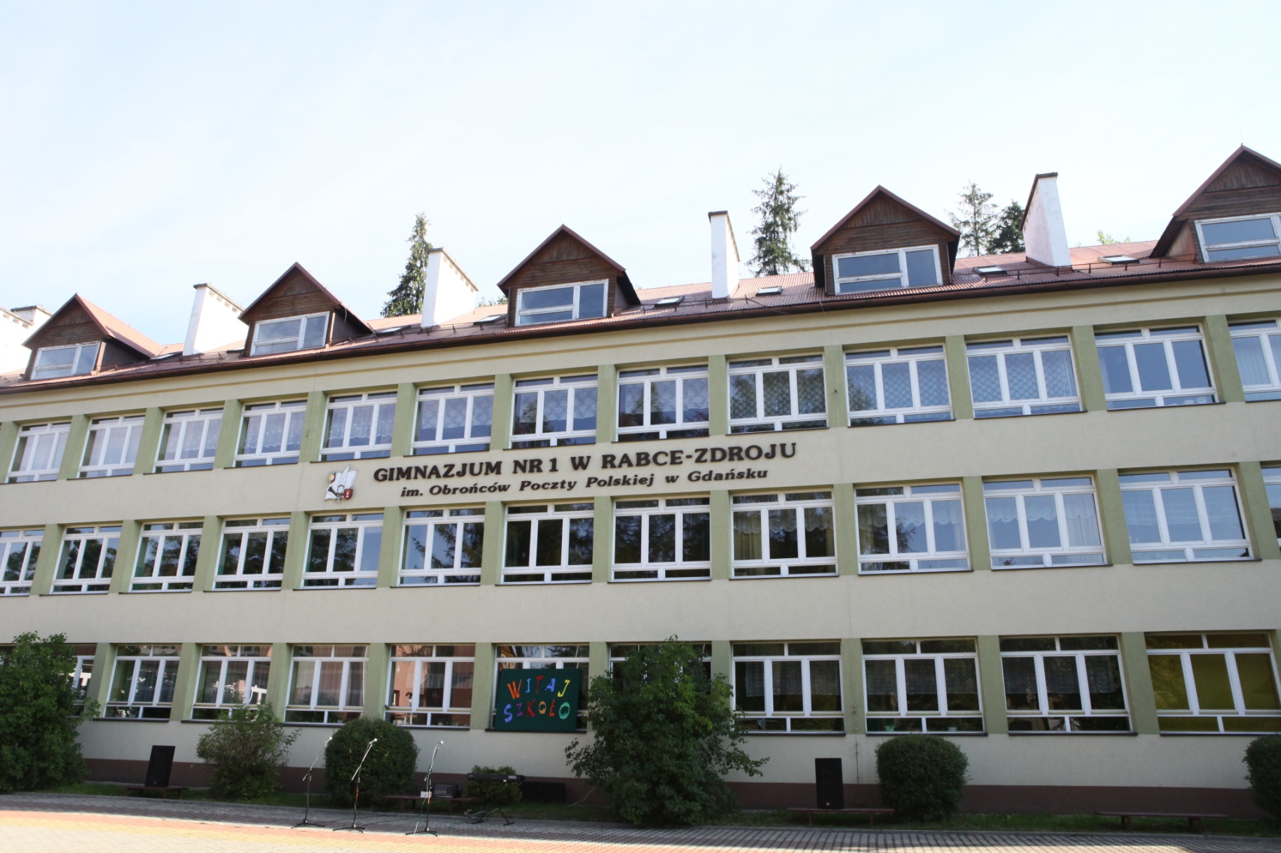
Gimnasium No. 1

Slide 23
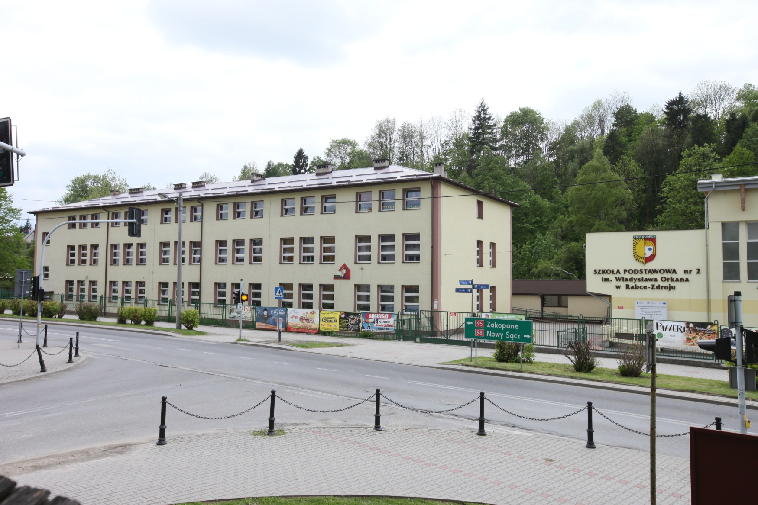
Primary School no. 2

Slide 24
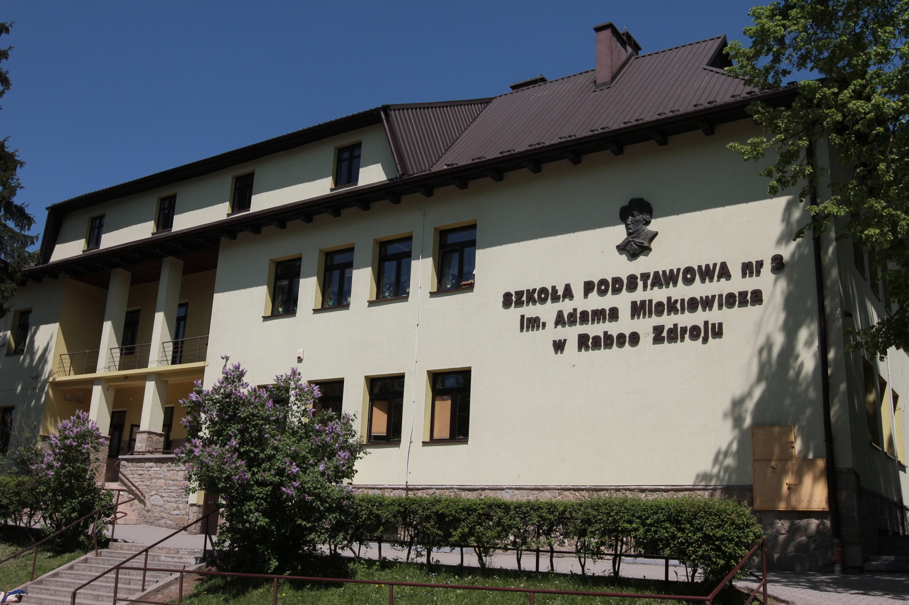
Primary School no. 3

Slide 25
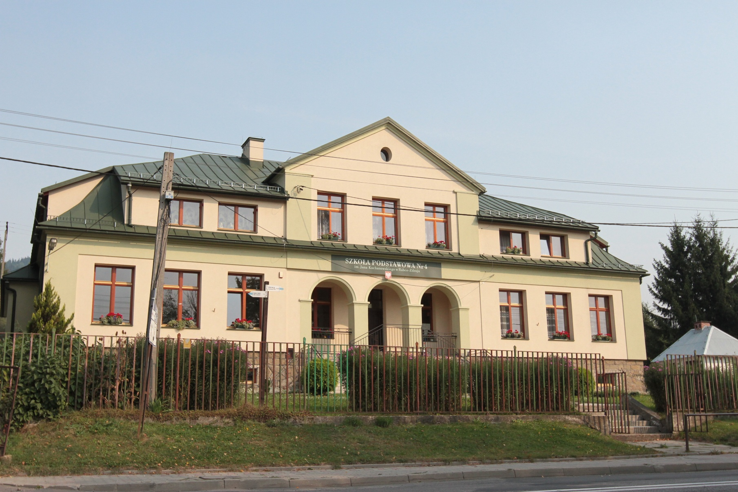
Primary School No. 4

Slide 26
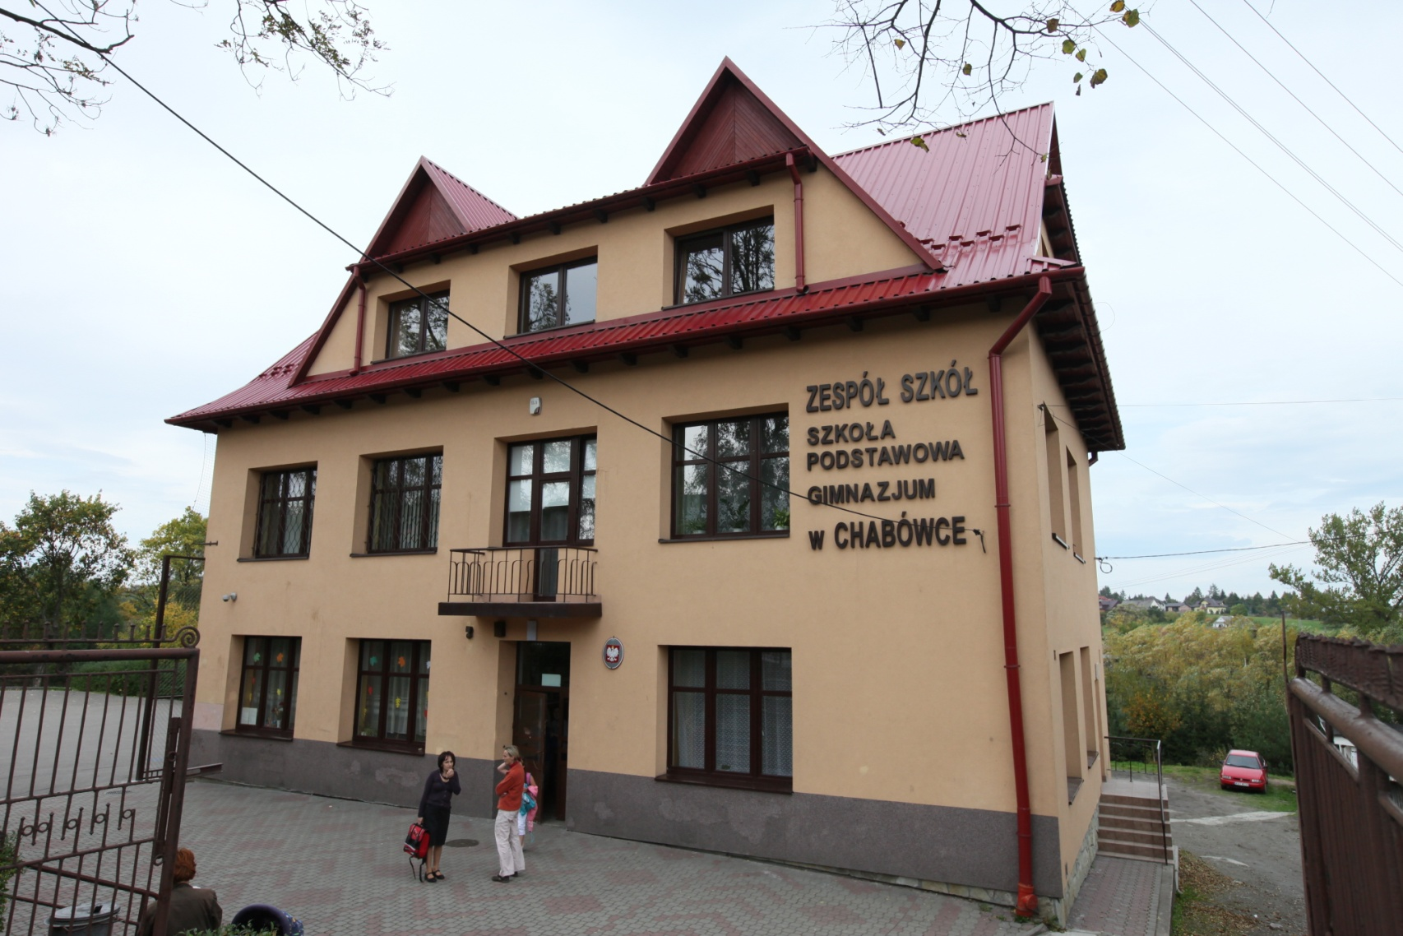
Primary School and Gimnasium in Chabówka

Slide 27
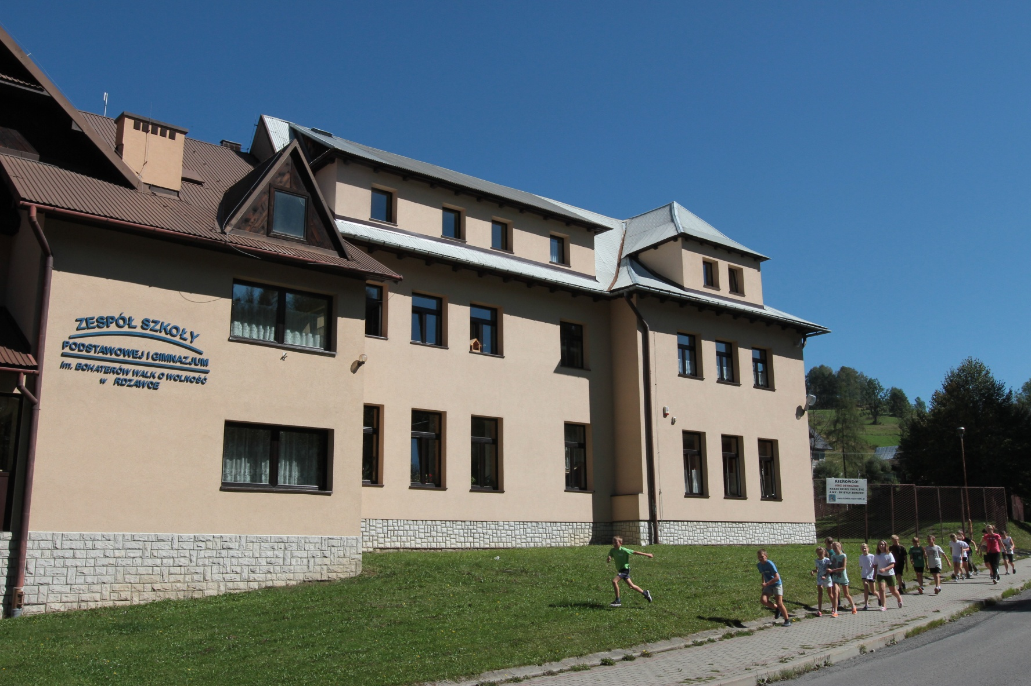
Primary School and Gimnasium in Rdzawka

Slide 28
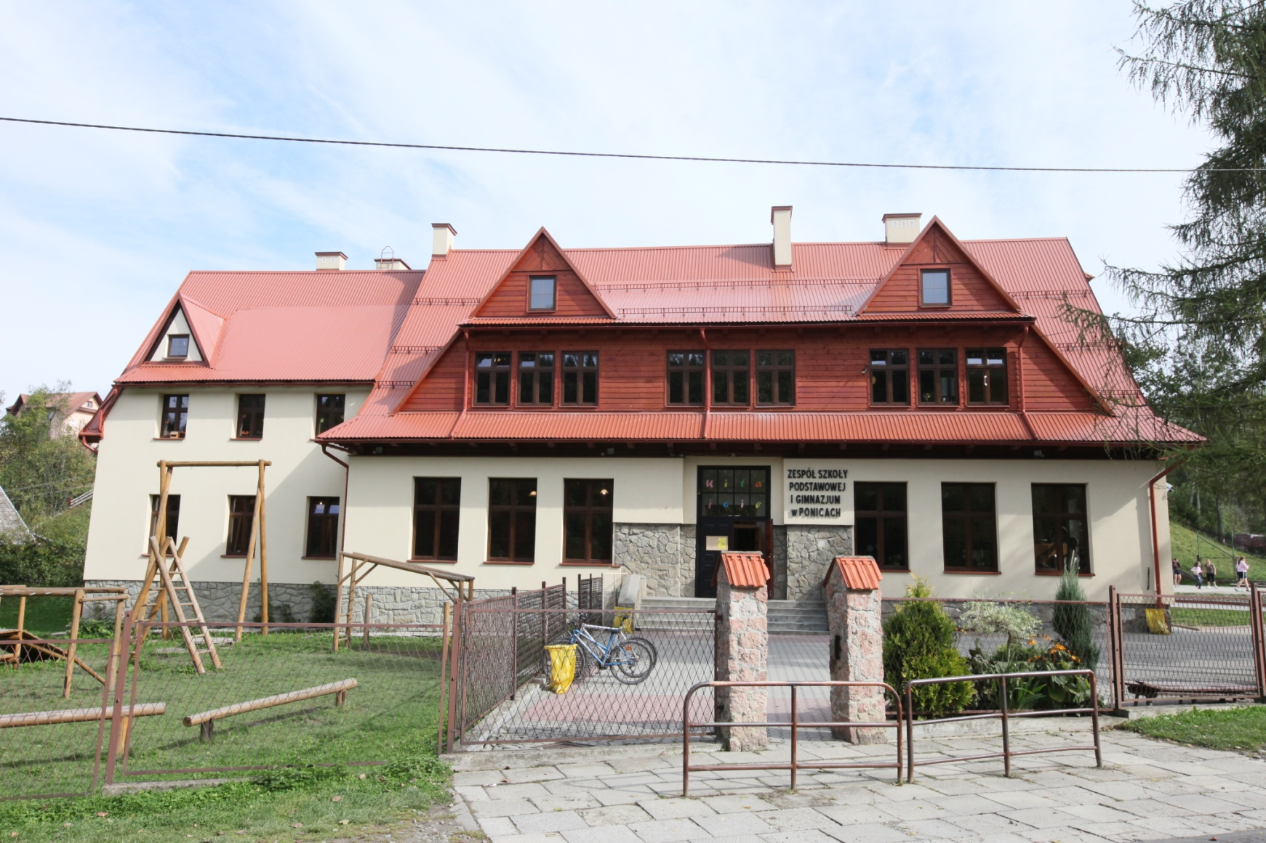
Primary School and Gimnasium in Ponice

Slide 29
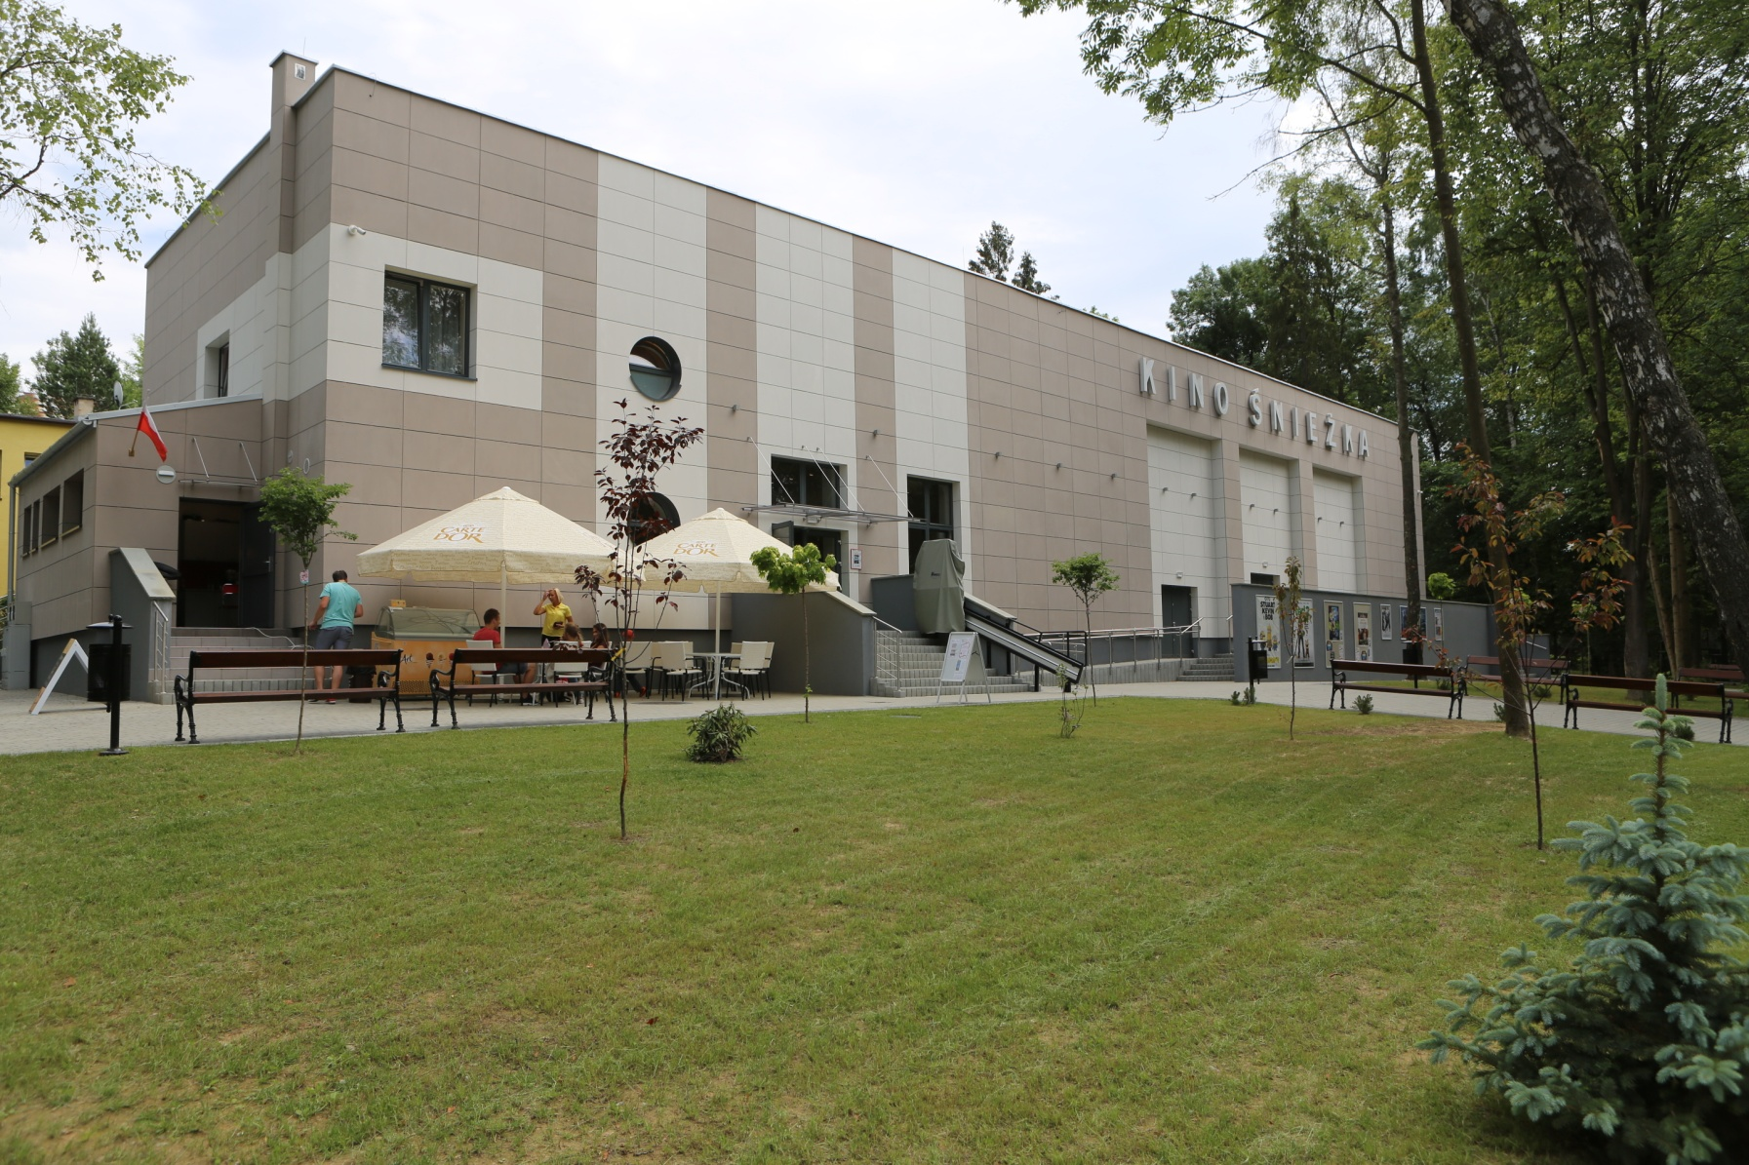
2. „Śnieżka” („Snowflake”) cinema

Slide 30
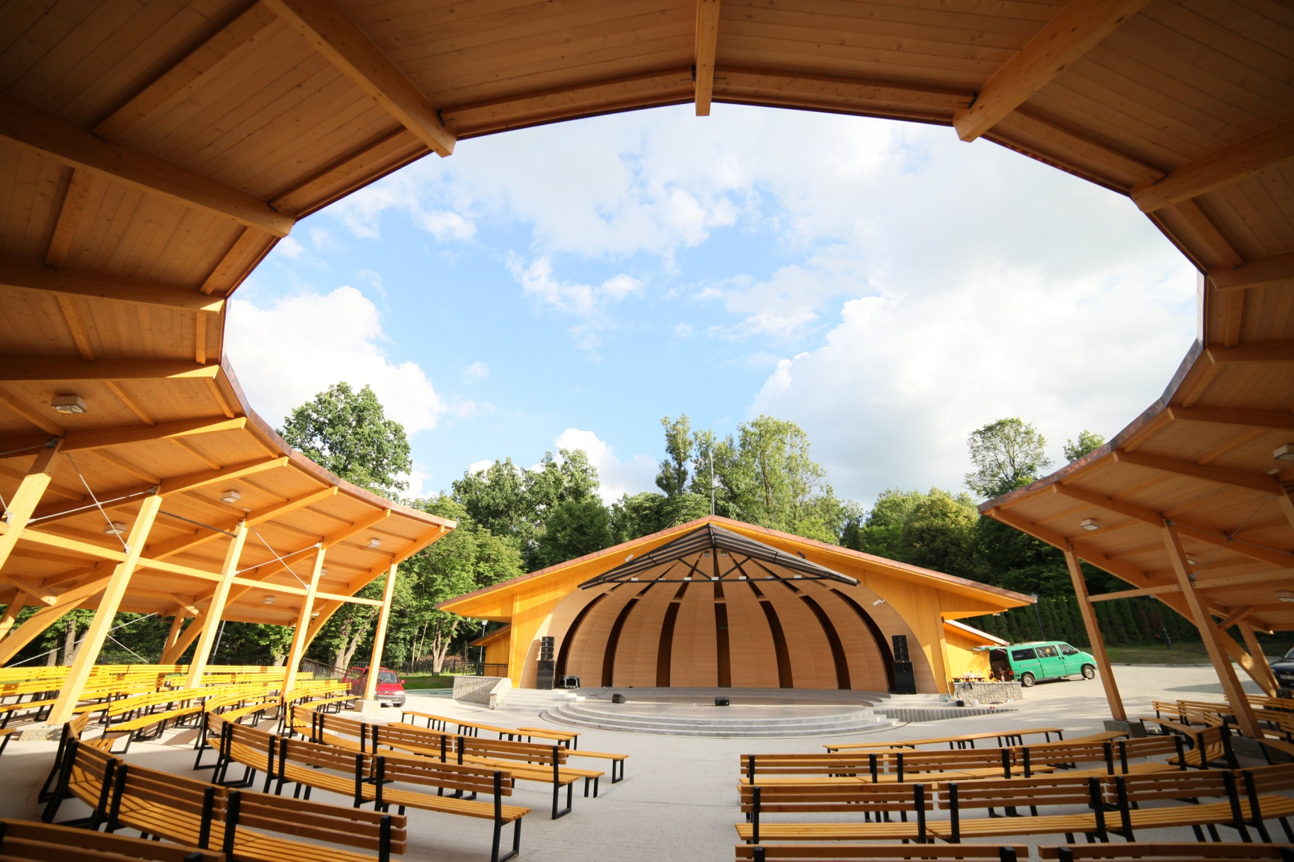
3. Amphitheater

Slide 31
The thermomodernisation of multitenant buildings carried out by Housing Cooperative in Rabka-Zdrój.
In the years 2007-2008, thermomodernisation of 30 multitenant buildings was carried out.
The modernisation included – external walls insulation, ceiling and slab roofs insulation and the replacement of window and door frames.
Earlier, the Cooperative carried out the modernisation of all central heating boilers. The modernisation included the replacement of coal boilers for gas boilers for instance.

Slide 32
The thermomodernisation of
multitenant buildings carried out by Housing Cooperative in Rabka-Zdrój.
Furthermore, the Housing Cooperative built an individual gas boiler-house for the shopping center and a new building in order to avoid large energy loss due to transportation from the boiler-house in neighbouring residential area.
The thermomodernisation of the majority of multitenant houses was also carried out together with the replacement of thermal centers.

Slide 33
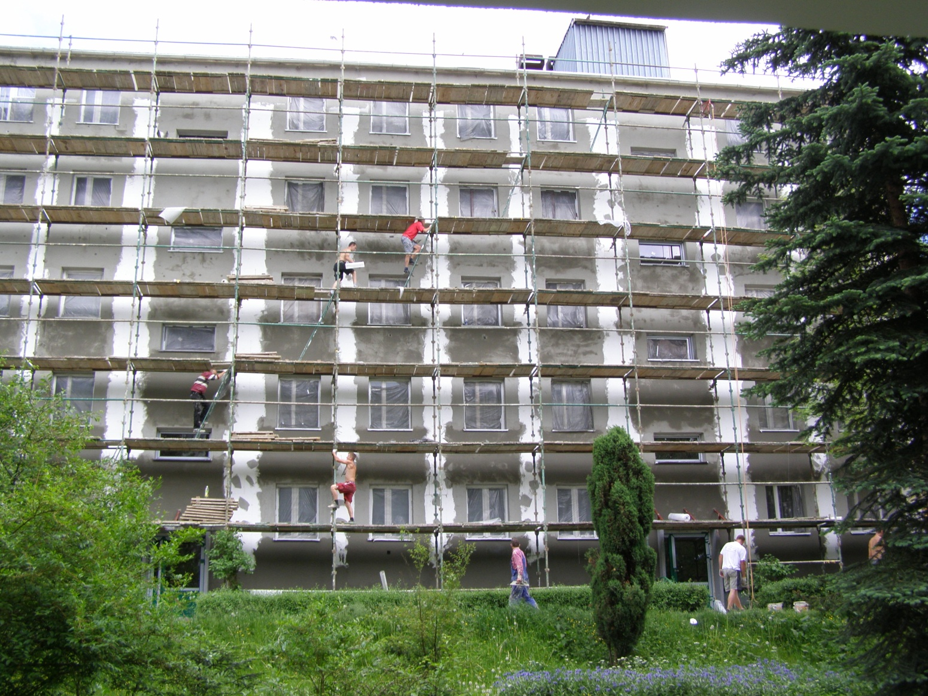
The thermomodernisation of
multitenant buildings carried out by Housing Cooperative in Rabka-Zdrój

Slide 34
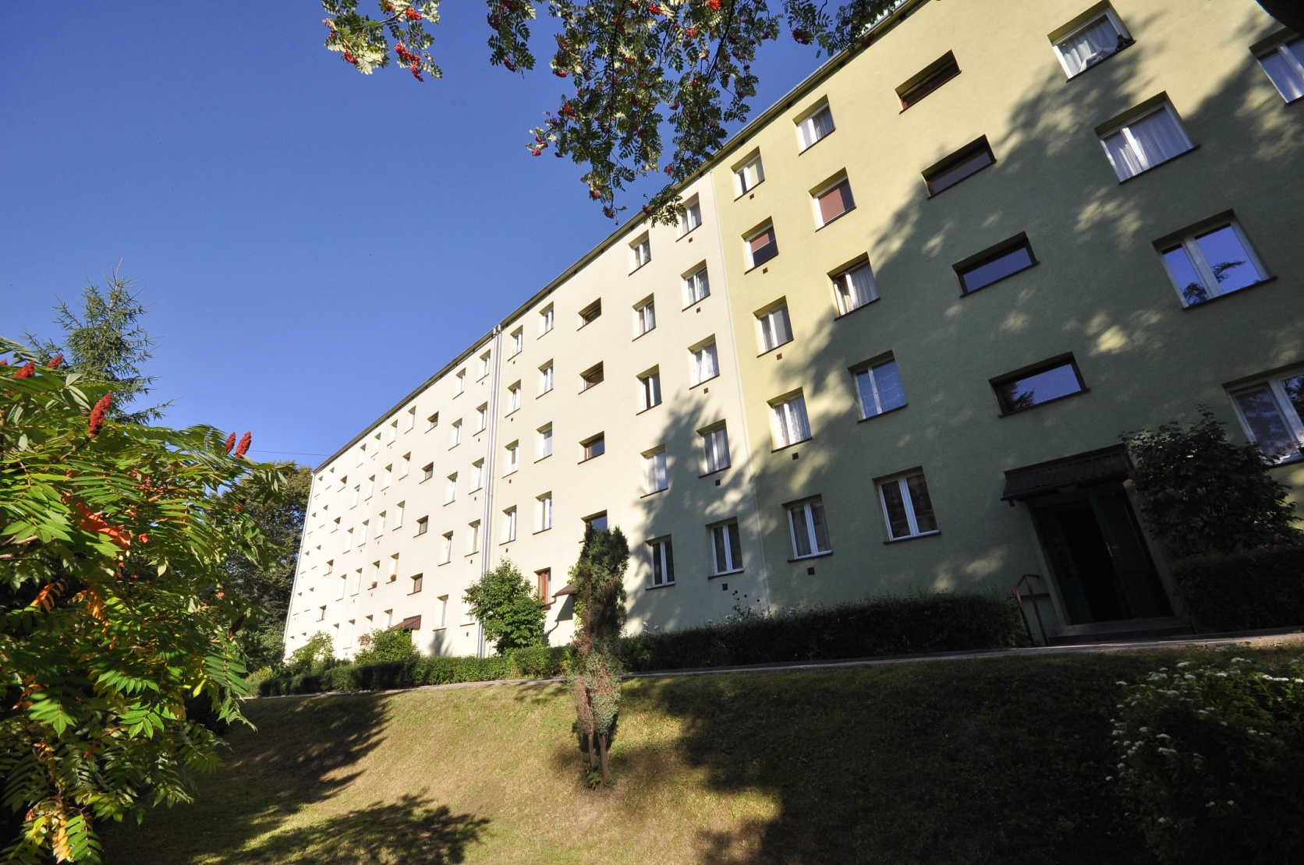
The thermomodernisation of
multitenant buildings carried out by Housing Cooperative in Rabka-Zdrój.

Slide 35
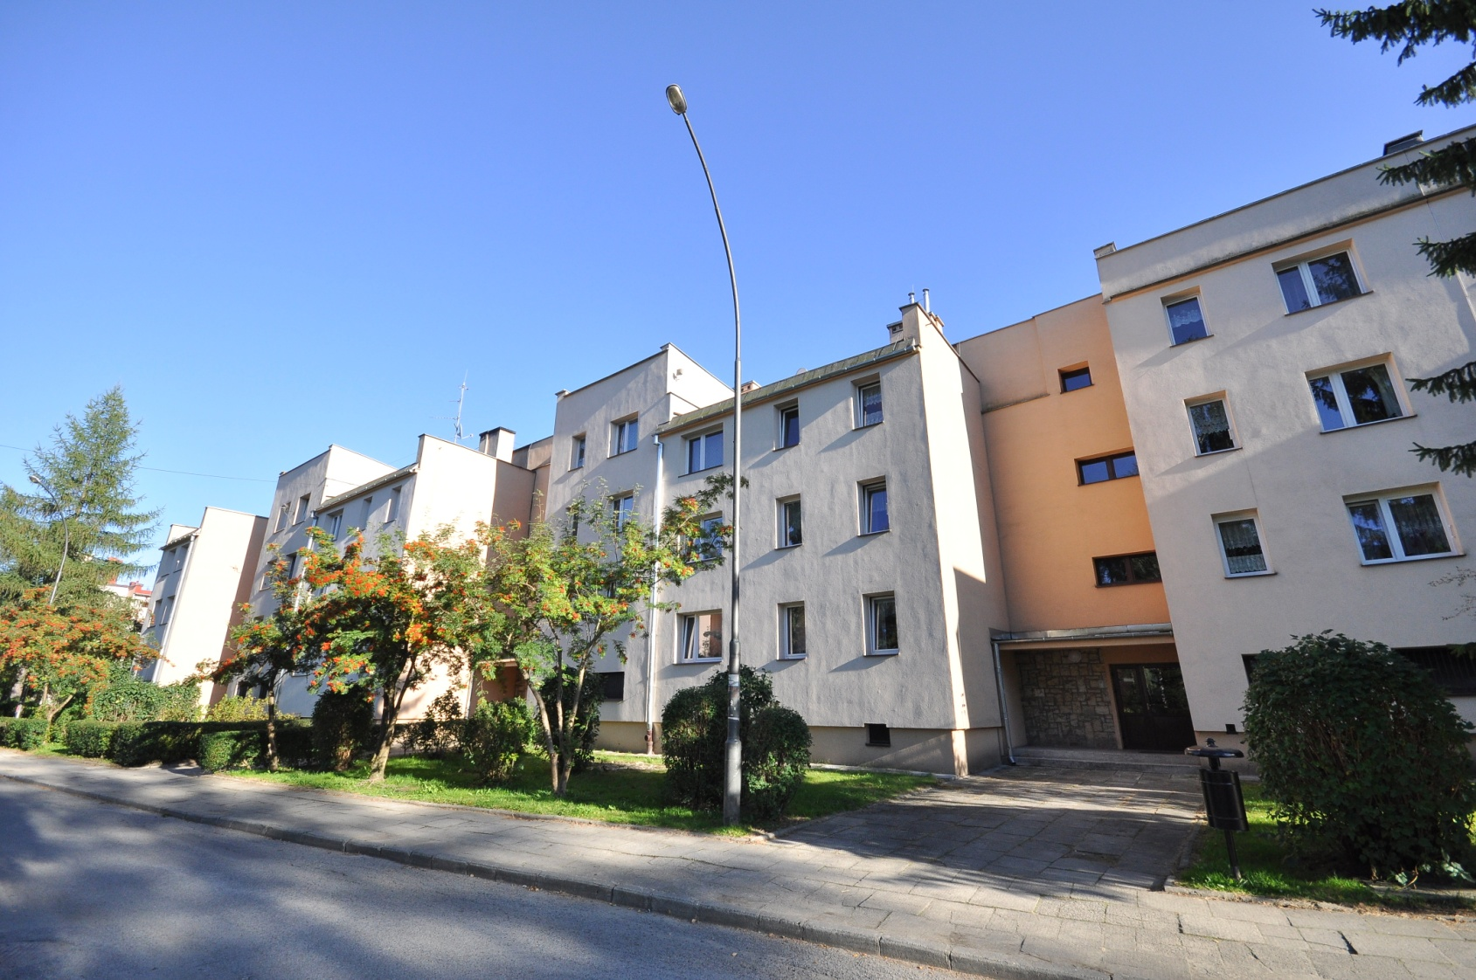
The thermomodernisation of
multitenant buildings carried out by Housing Cooperative in Rabka-Zdrój.

Slide 36
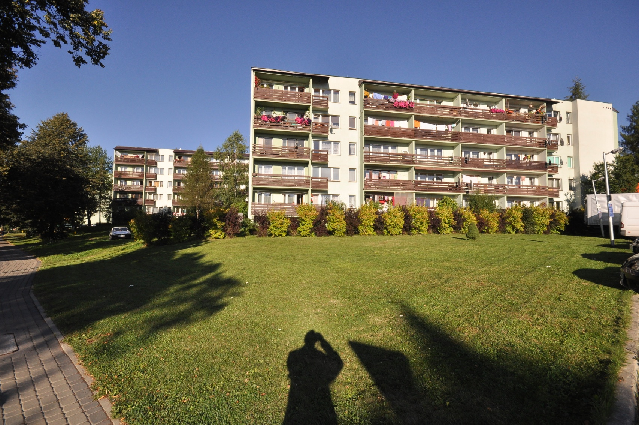
The thermomodernisation of
multitenant buildings carried out by Housing Cooperative in Rabka-Zdrój.

Slide 37
In sanatorium buildings– Thuberculosis and Lung Diseases Institute, holiday resorts and the hospital the heating modernisation was carried out, which included the replacement of solid fuels boiler for gas ones.

Slide 38
Some sanatorium buildings and resorts were thoroughly thermomodernised, which considerably reduced the amount of hazardous gases emissions into the air in the area of Rabka-Zdrój.

Slide 39
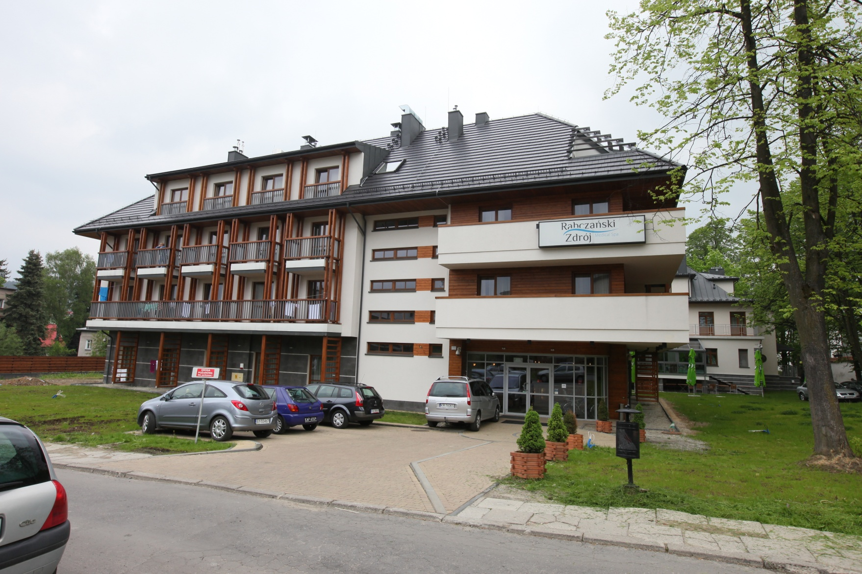
„Rabczański Zdrój” Spa – Uzdrowisko Rabka S.A.

Slide 40
Pavilion VI of the Tuberculosis and Lung Diseases Institute (formerly called „Nazareth”) is an example of a full thermomodernisation that includes the installation of modern air conditioning and ventilation system with heat recovery.

Slide 41
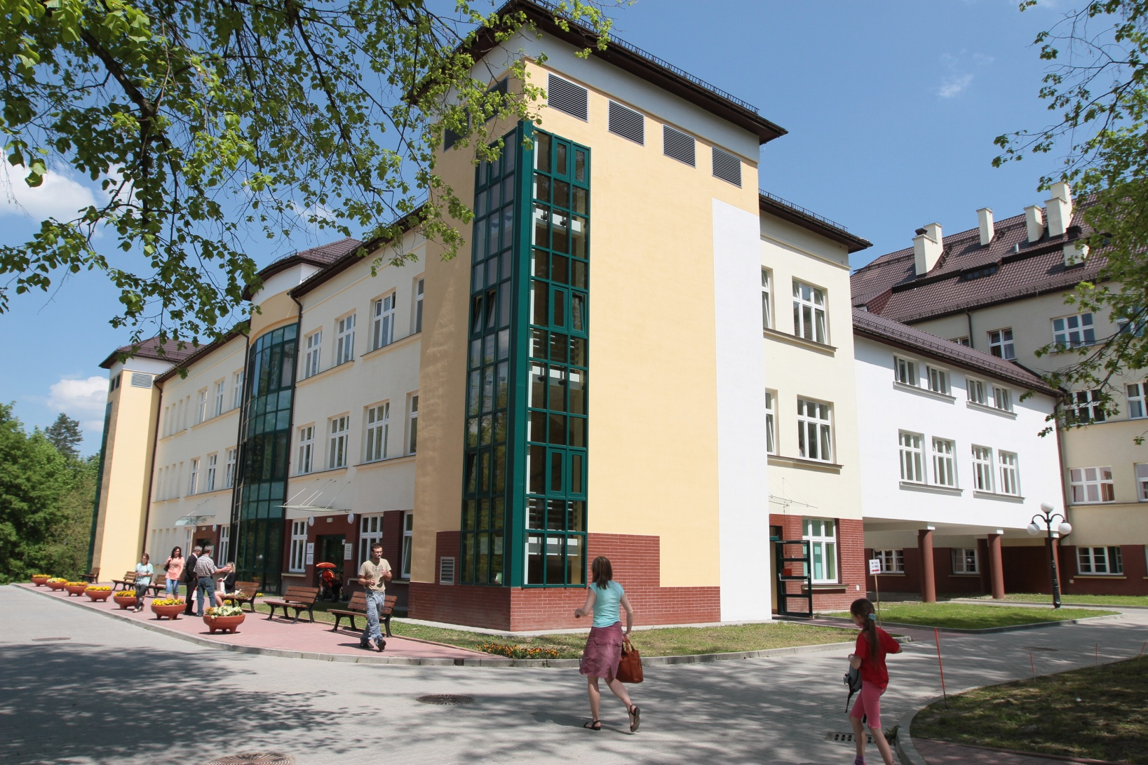
A sanatorium building – Tuberculosis and Lung Diseases Institute

Slide 42
The thermomodernisation of other public facilities

Slide 43
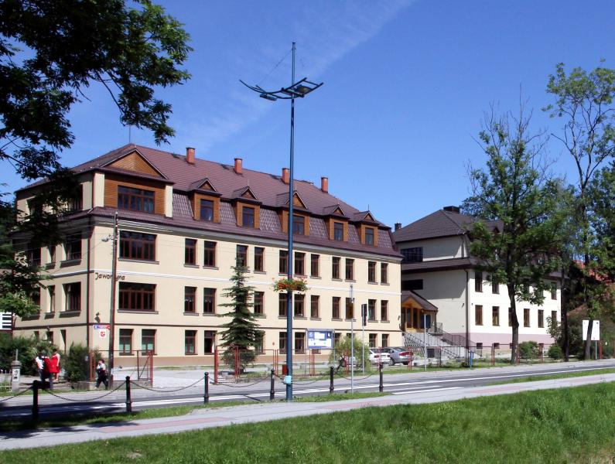
Comprehensive School No. 1

Slide 44
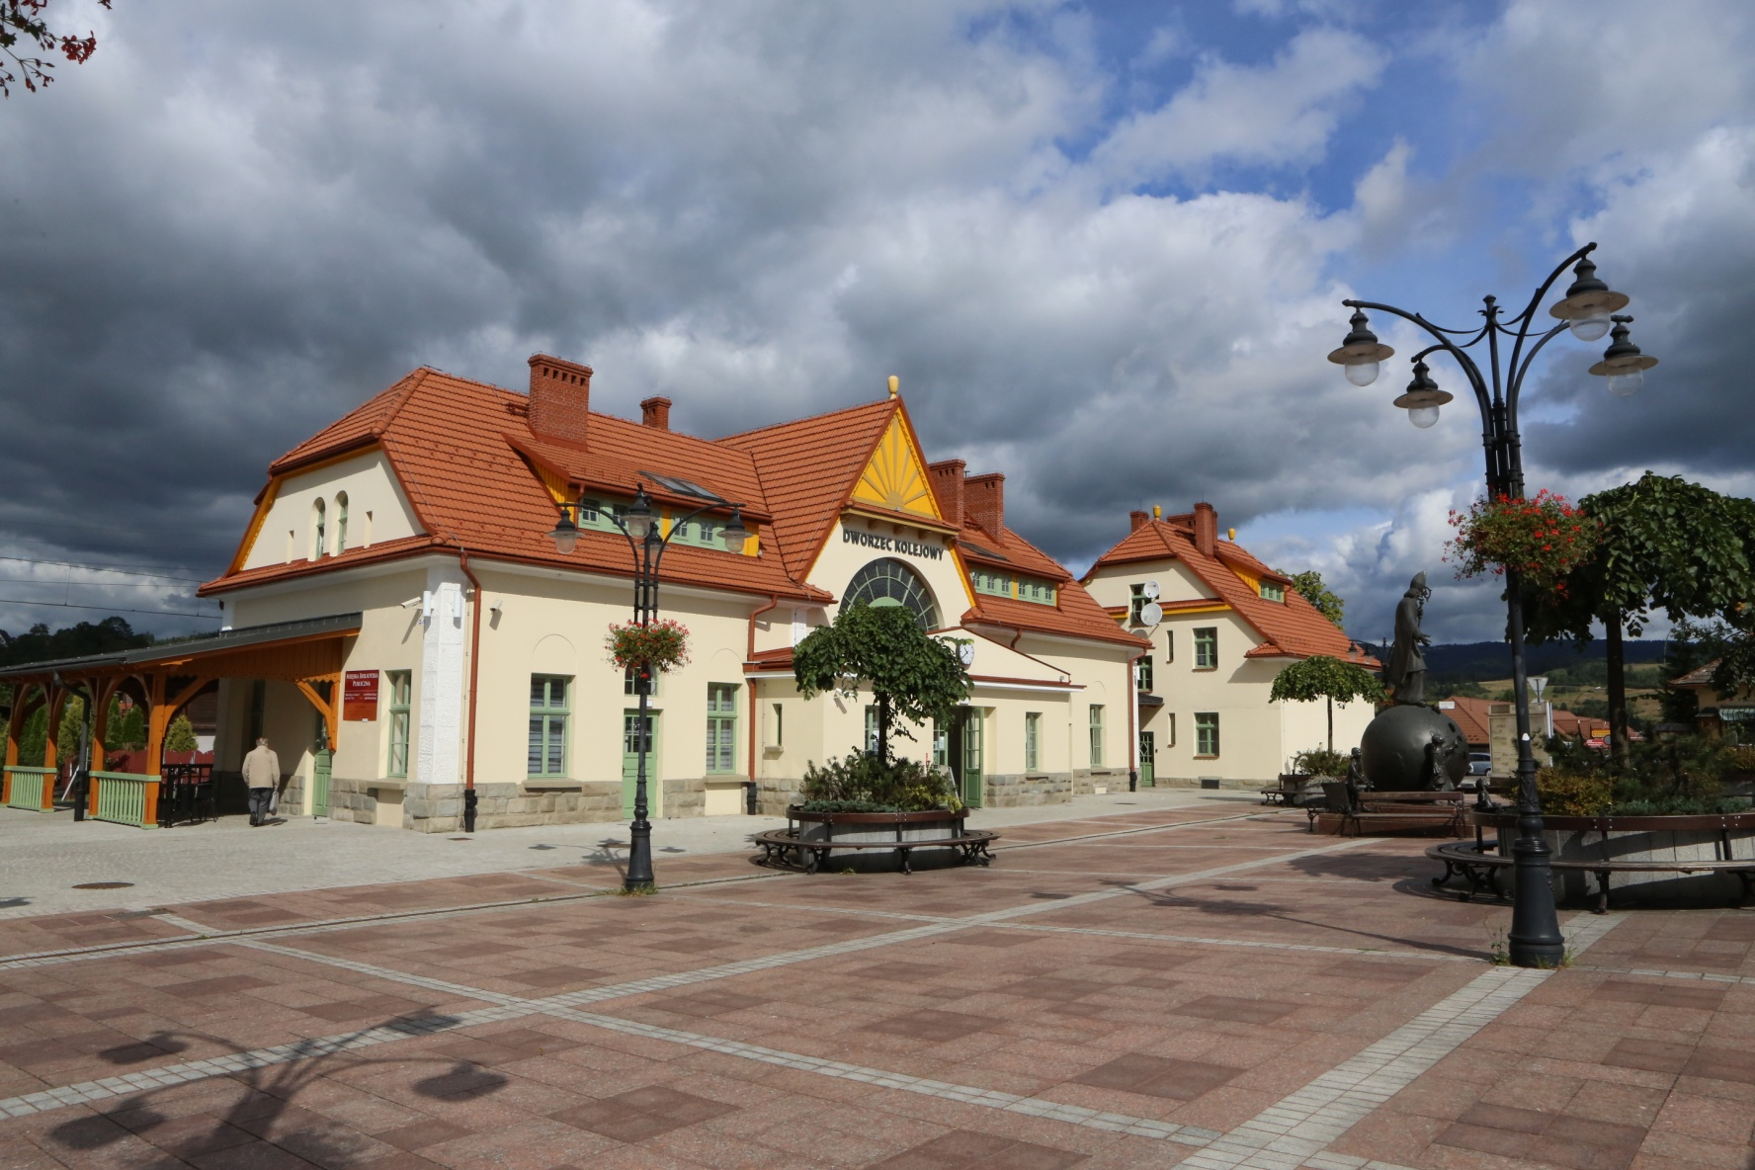
Railway Station
(housing the Public Library)

Slide 45
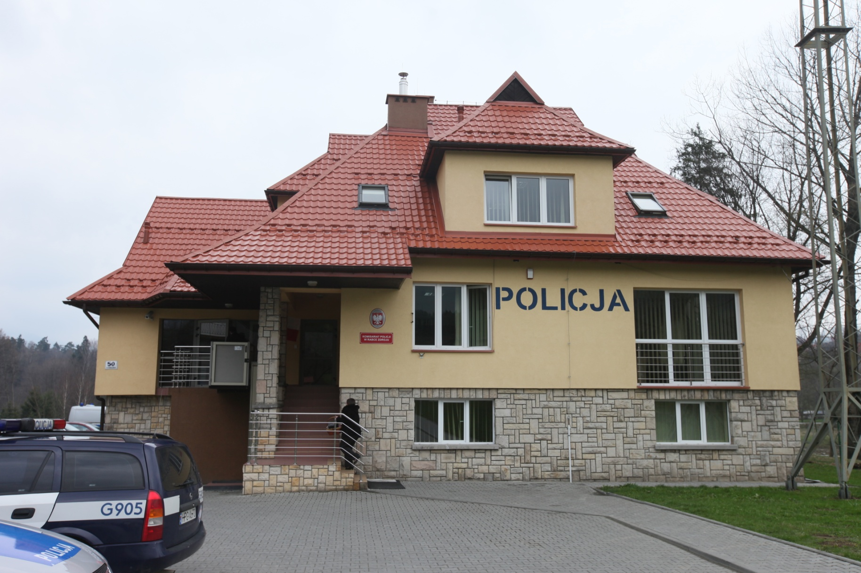
Police Station

Slide 46
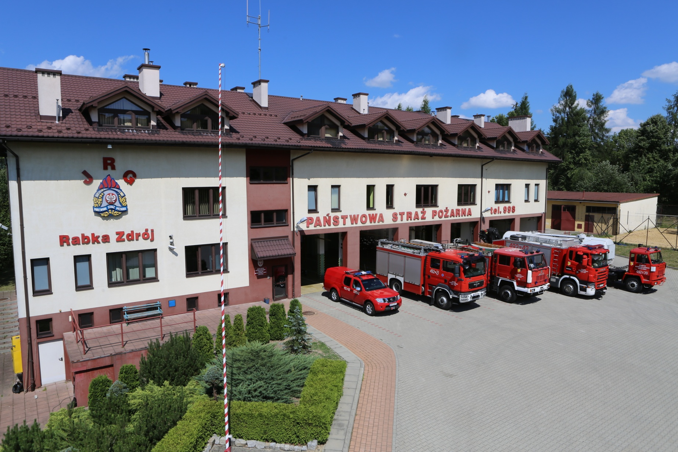
Fire Brigade Station

Slide 47
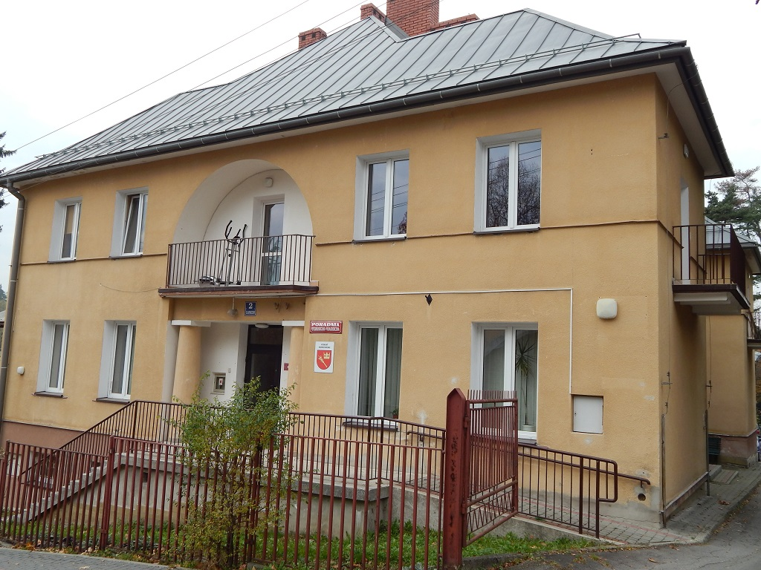
The thermomodernisation of other
public buildings
„Primavera”

Slide 48
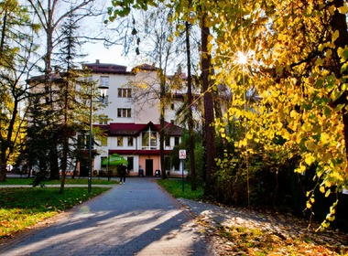
The thermomodernisation of other
public buildings
Cardiology Hospital Rabka Spa

Slide 49
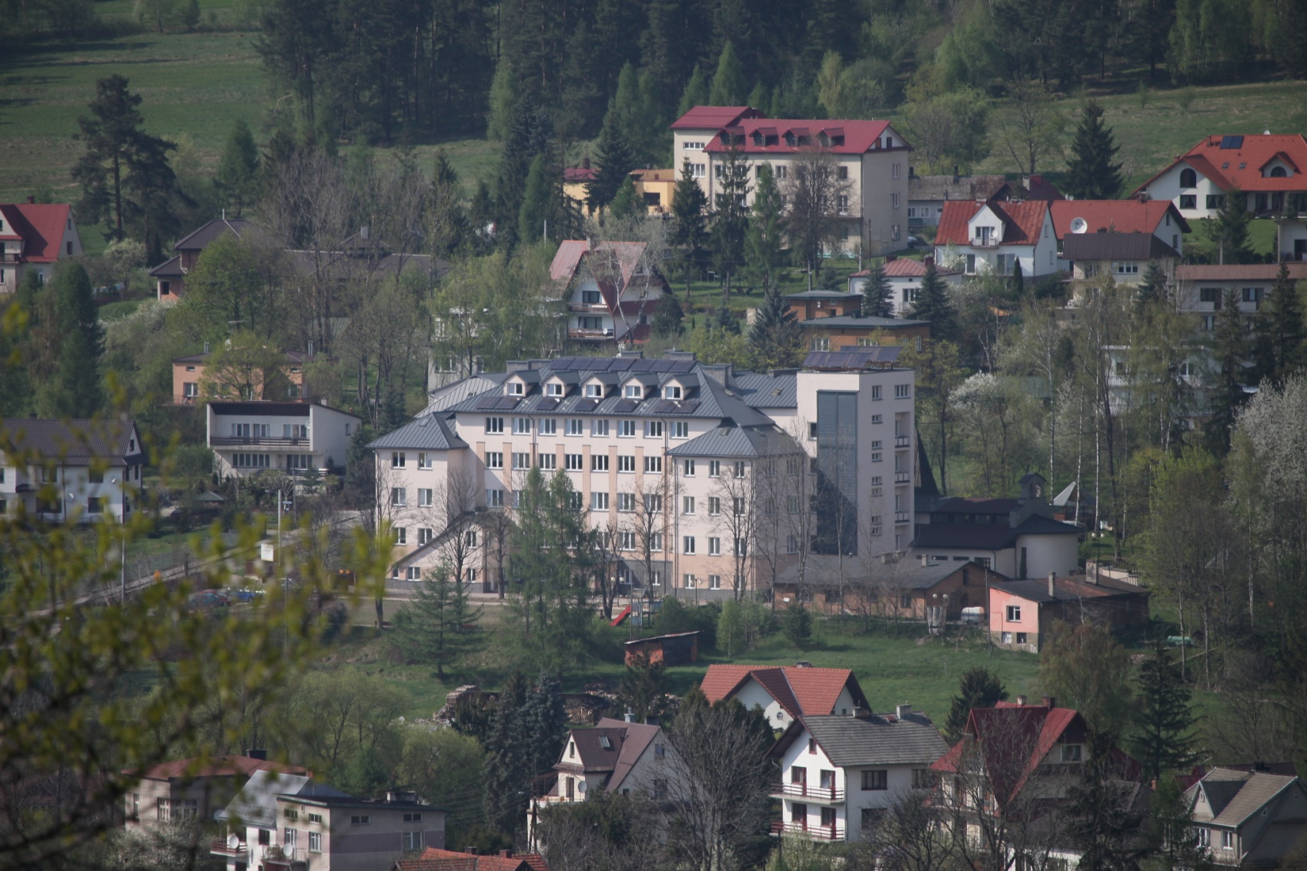
The thermomodernisation of other
public buildings
School for blind and partialy-sighted children

Slide 50
The intentions of Rabka-Zdrój
in the field of further reduction of polluttion emissions from buildings.
On the 25th of November 2015 the City Council in Rabka-Zdrój introduced the Plan of Low-carbon Economy for Rabka-Zdrój Municipality.
The document gives the opportunity for planning the necessary actions which will lead, over a few years, to considerable improvement in the quality of air in Rabka-Zdrój. The document also makes it possible to gain grants from outside institutions for the necessary actions connected with the replacements of energy resources, the installation of renewable resources systems and thermomodernisation.

Slide 51
The intentions of Rabka-Zdrój
in the field of further reduction of polluttion emissions from buildings.
Recently Rabka-Zdrój Municipality has submitted an application to Voivodship Fund for Environmental Protection and Water Management, a programme of low emission called „KAWKA”, which will enable us to receive funds for changing energy resources and installing solar panels for heating water.
KAWKA programme is going to be implemented from the 2nd quarter of 2016 until the 31st of December 2018 in Rabka-Zdrój municipality.

Slide 52
The intentions of Rabka-Zdrój
in the field of further reduction of polluttion emissions from buildings.
Moreover, as part of programme „Ryś” („Lynx”) introduced by Voivodship Fund for Environmental Protection and Water Management in Krakow, individual concerned owners will be able, through application, to receive funds for house thermomodernisation.

Slide 53
Thank you for your attention !
Maria Nowacka, MSc
Municipal Housing
Managment Leader
in Rabka-Zdrój

