Slide 1
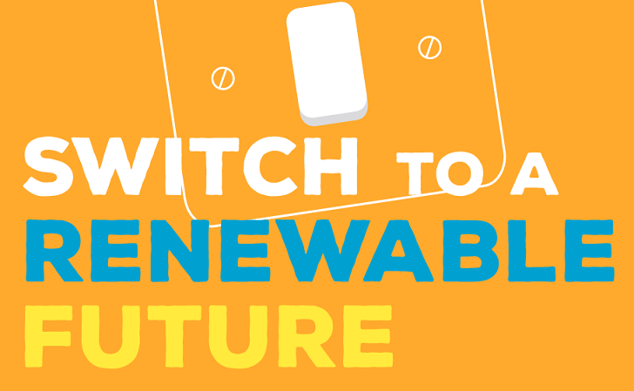


Camille Dressler, Chair,
Scottish Islands Federation

Slide 2

Scotland’s islands: leaders in Low carbon communities
One of the aims of the Scottish islands Federation is to help islands realise their potential as leaders in low carbon communities.
We worked with 13 EU island partners to look into Sustainable Energy planning: Our unique Scottish contribution was to show how island community Trusts have been driving the move towards a low carbon society.
As part of this project, S.I.F. has helped 8 islands carry out their own energy audits with funding from the the Scottish government’s CARES programme.
Today, I would like to tell you about 3 islands in our Federation, Eigg and Mull and Iona to illustrate the way islands are becoming drivers for the low carbon economy.

Slide 3
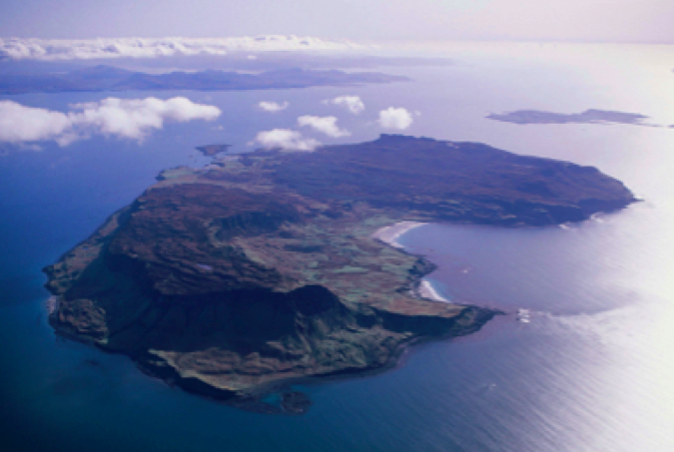
The case of Eigg
One of the first Scottish community buy outs.
Eigg’s electrification was seen as a priority by the
community.
A renewable stand alone grid was the way to
achieve this.
Power was switched on 10 years after the buy-out, giving
the island 24 hours power for the first time ever
The scheme cost £ 1.6 million.
It was financed by the Big Lottery, HIE Lochaber,
Highlands and Islands Community Energy Company,
Scottish Households Renewables Initiative, The Energy
Saving Trust and the Highland Council.
Islands are resilient communities and are used
to identifying their own solutions to their issues.

Slide 4
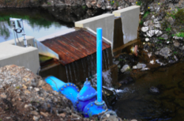
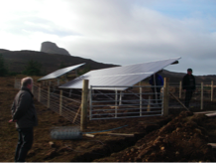
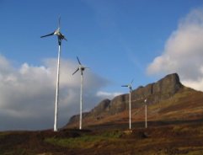
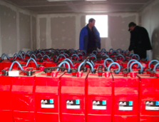
5 kW for each household
3 Hydros = 110 KW
3 photovoltaic panels= 30kW
10 kW for businesses
4 Windmills = 24kW
96 batteries store 24h power
Notes:
From these renewable sources, an 11km high-voltage grid delivers electricity around the island.
Transformers convert the power to domestic voltage into homes and businesses.
From a central control building, power is regulated through inverters and stored in heavy duty batteries.
When renewable generation is low, the system is supported by a pair of 70kW diesel generators, which act alternately as back up and reserve
Each inverter has a maximum output capacity of 5kW and so the maximum power that can flow in or out of the batteries is 60kW.
When the renewable resources together are producing more electricity than is being consumed by the island, then the excess flows into the batteries via the inverters and they become charged.
The inverters monitor continually the state of charge of the batteries. If this falls to 50%, the inverters signal for the standby generator to start. This supplements the power produced by the renewable resources and the batteries become re-charged.
When the charge of the batteries reaches 90%, the inverters signal for the generator to be disconnected and turned off.
A separate control system ensures that the generator and main hydro run together in phase. If any or all of the renewable resources are out of commission for any reason, the generator alone can power the island.

Slide 5
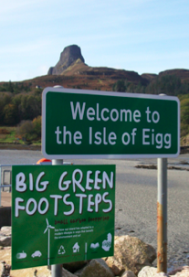
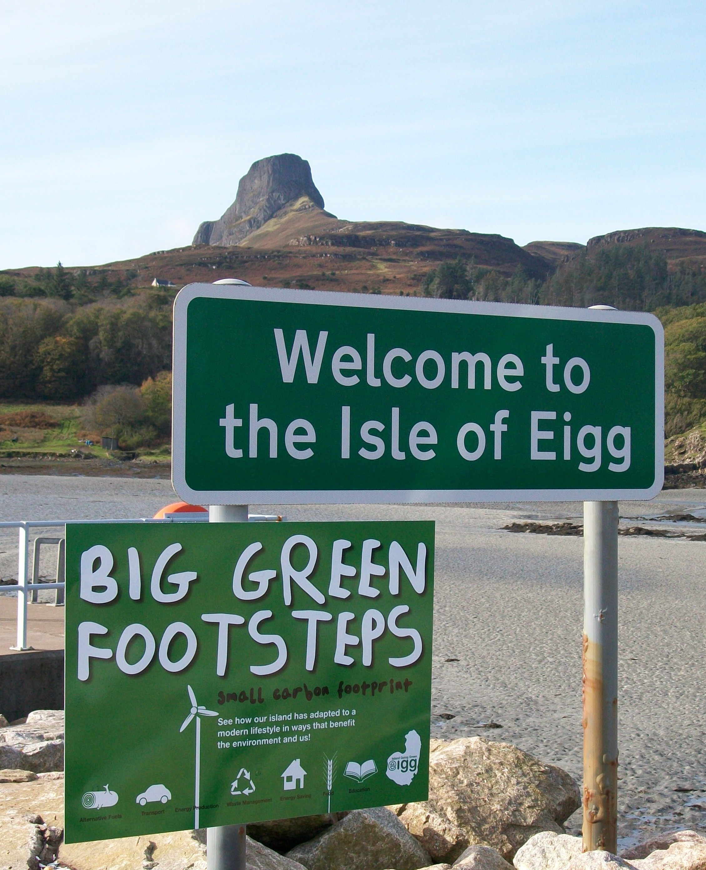
Eigg’s green grid: the multiplying effect
The green grid is operated and maintained by Eigg Electric Ltd
a subsidiary company of the Isle of Eigg Heritage Trust.
Repair and servicing is the responsibility of a trained maintenance
team, creating 3 valuable part-time jobs.
The green grid has been replicated in the neighbouring islands of
Muck, Rum and Canna.
The reduction on C02 from our grid helped Eigg win the Big Green
challenge in 2010, motivating the islanders to reduce their carbon footprint
further, growing their own produce, switching to AAA appliances and solar
hot water tubes and using and producing more woodfuel.

Slide 6
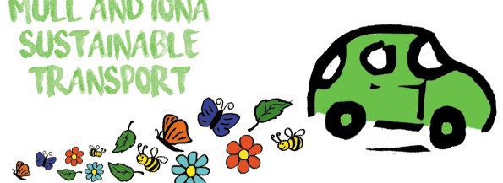
Mull and Iona Sustainable
Transport (MIST)
Mull and Iona Sustainable Transport is part of the Mull and Iona Community Trust.
Travel and transport choices accounts for up to half or more of many households' total CO2 emissions.
With funding from the Scottish government’s Climate Challenge Fund, MIST aims to develop a long term plan for more sustainable transport on Mull and Iona.
The Energy Savings Trust is collaborating with MIST to present some special local events to bring all interested islanders up to speed with electric cars and incentives to switch.
MIST is targeting individuals but also island businesses: under a new Scottish government scheme. Scottish businesses keen to reduce their emissions will now be able to apply for up to £100,000 to switch their transport fleet to electric or plug-in hybrid vehicles.

Slide 7
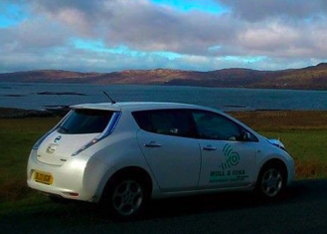
Information sharing is the key to the switch
EV trials: A Nissan Leaf and a Berlingo have been purchased for
individuals, businesses and community groups to test them out.
EV training days include maintenance information
Car Club and Community Transport schemes are being investigated
to utilise the EVs beyond the life time of the project.
Liftsharing : ‘Mull and Iona Lift-share’ operates as a ‘closed group’
on Facebook to help match willing drivers with willing passengers to
share, on or off the islands. A calendar presenting details of lifts
offered is easily checked for available opportunities.
Efficient driving: free training opportunities to improve the efficiency
of drivers keen to save money by reducing fuel consumption.
Notes:
MIST is developing new ways for everyone who is willing to offer or accept a lift to participate easily.
The Mull and Iona Lift Share page established on Facebook has attracted over 400 members to engage.This group is open to any islander over 18 who is interested in linking up to share journeys.

Slide 8
Find out more
www.scottish-islands-federation.co.uk
www.sustainableislands.eu
www.localenergyscotland.org (CARES)
www.isleofeigg.org
www.mict.co.uk/projects-services/mist/
www.mict.co.uk/electric-cars/

