Slide 1

Spa Treatment in Rabka-Zdrój and a Balanced Lifestyle

Slide 2
Agenda:
Rabka and its microclimate
Nature and landscape qualities
„Uzdrowisko Rabka” S.A. („Rabka Spa” Inc)
Brine – natural raw material
Brine functions and usage
Education and treatment
Benefits of balneology

Slide 3
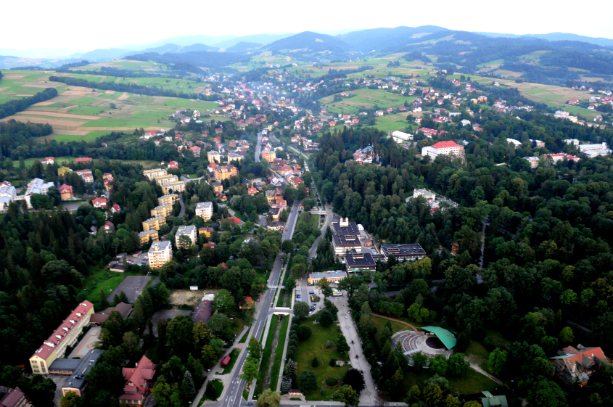
Rabka-Zdrój
Rabka-Zdrój – a foothill town located 500-560m above sea level that stands out for its mild microclimate.
Light breezes, high insolation(1800 hours a year) guarantee dry air and prevent fog formation. The air is clean and, thanks to many forests, rich in essential oils.

Slide 4
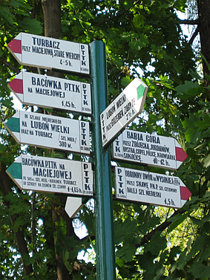
Outstanding nature and landscape qualities
Two hills: Luboń Wielki (1022m a.s.l. ) and Turbacz (1311m a.s.l.) tower over Rabka
During the day the heated air floats from the valleys to the peaks, and in the evening cool and clean air flows from the peaks to the valleys.
The air is constantly ionized with insolation, wind and fall energy.

Slide 5
„Uzdrowisko Rabka” S.A.
Rabka Spa Inc.
About us
Health is our mission
To fulfill the mission, every day, we take great care to meet our patients’ needs as far as their health, relaxation and treatment is concerned.
Our goal is to maintain the high quality of our services and products so that anyone visiting Rabka Spa could benefit from its healing climate and natural resources.

Slide 6
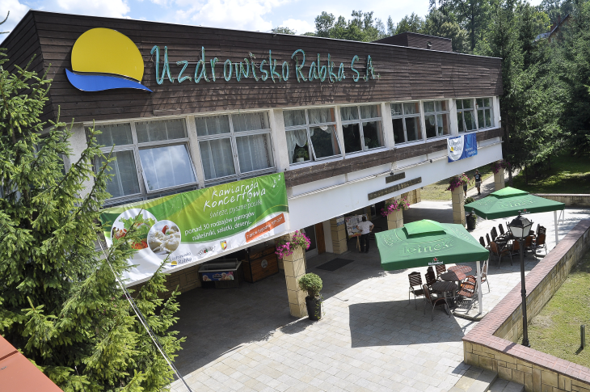
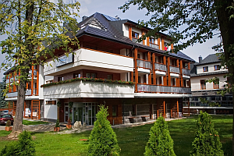
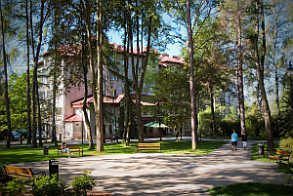
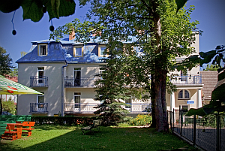
„Uzdrowiska Rabka” S.A. (Rabka Spa Inc.) consists of:
Nature-health centre called „Health and Beauty Centre”,
Spa Cardiology Hospital,
Spa children’s hospital,
Child and Parent Sanatorium,
Sanatorium For Adults

Slide 7
„Uzdrowisko Rabka” S.A.
Rabka Spa Inc.
The beginning of every treatment is a professional evaluation of individual needs of every patient - adult or child.
Spa or sanatorium treatment is recommended and controlled by doctors

Slide 8
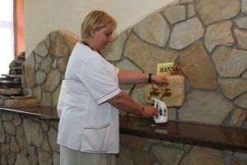
Natural raw material
Brine – water consisting of 15 gr. of salt in a litre.
The healing water comes from the depths of Earth and is produced in very specific conditions:
  in the lack of light or air,
  in high pressure and temperature,
  It is impossible to produce such water in a laboratory.
Brine is „ready-made medicine” and as such, it possesses an official certificate
The most important material is iodine –bromine brine whose concentration of iodine is one of the highest in Europe,
The first bathing centre was established in 1864,

Slide 9
Salt bath effects
The effects are connected with the irritating influence of salt penetrating the skin and sweat glands exits – which makes skin more flexible.
Chloride-sodium ions affect sensory and motor receptors in skin and reduce nerve excitability

Slide 10
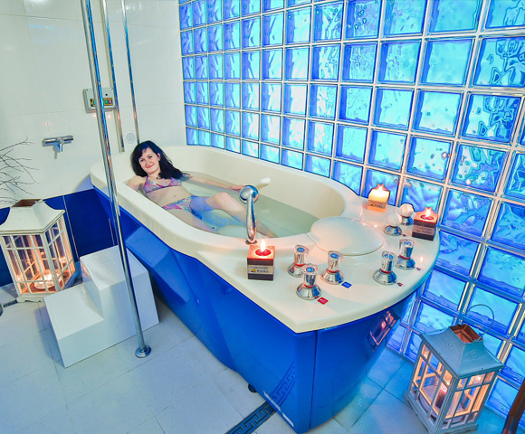
Application
Regular use of
salt baths causes general actions such as narmalisation of blood pressure, better metabolism, muscles relaxation and reduction of nerve excitability.
The baths cure skin and food allergies, osteoarthritis, increase immunology.

Slide 11
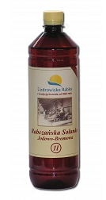
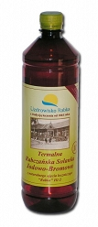
Brine
The unique brine is also used for individual inhalations
Mud treatment has a very wide range of application. Therapeutic mud (peat) makes the base of wraps.
In spa theraphy physical activity is extremely important - kinesitherapy, whirlpool baths, power shower, underwater massage of the whole body and many more.

Slide 12
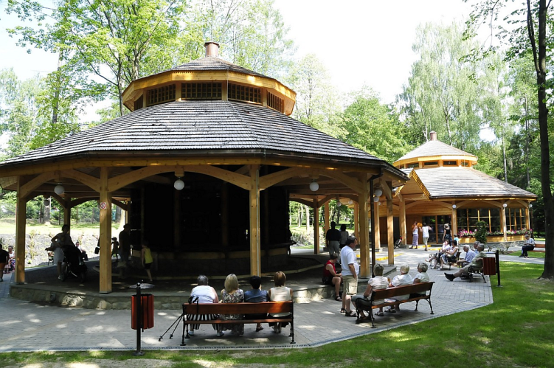
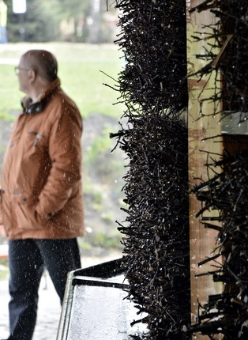
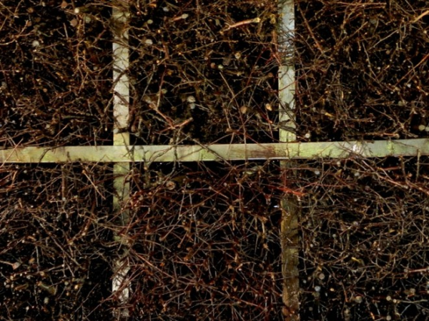
Brine graduation tower
Brine is pumped to the top of the tower, and then, while running down it hits brushwood twigs and partly evaporates.
Walking near the graduation tower helps one to breath deeply, and the salt aerosol is beneficial for the respiratory system.

Slide 13
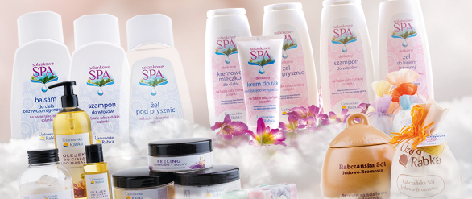
We gather our experience through:
Complex offers for specific target groups: for the harmony of body, mind and spirit, healthy diet, stress management, detox
Relying on local materials and healing/relaxing methods – we offer true experience originating in the unique, local tradition and raw materials (salt baths, mountains, microclimate)
The quality and originality of the products and services
„Uzdrowisko Rabka” S.A. (Rabka Spa Inc.) is the pioneer in using brine in cosmetics.

Slide 14
Lifestyle education
Nine factors connected with diet and lifestyle are responsible for the risk of heart attack in 95% .
These are:
smoking,
cholesterol level,
overpressure,
diabetes,
overweight,
nutritional habits,
physical activity,
alcohol consumption,
Other psychosocial factors – emotional stress and depression.

Slide 15
Spa treatment goals:
Tapping adaptation and compensation skills- which is basic for health improvement after treatment and regaining harmony.
The process is however time-consuming, and thus we cannot expect any miracle recovery after a few day stay in the Spa.

Slide 16
Thank you for your attention.

