Slide 1
Title Meika Bakker Nature Park “Schwäbisch-Fränkischer Wald” – Sustainability-Check

Slide 2
Aims of presentation
What is a Nature Park?
How can a Nature Park support sustainable lifestyle?
“Sustainability-Check”: use of energy
Challenges in participation of “sustainable partners”
Ideas for regions that wish to encourage local partners in sustainable development

Slide 3
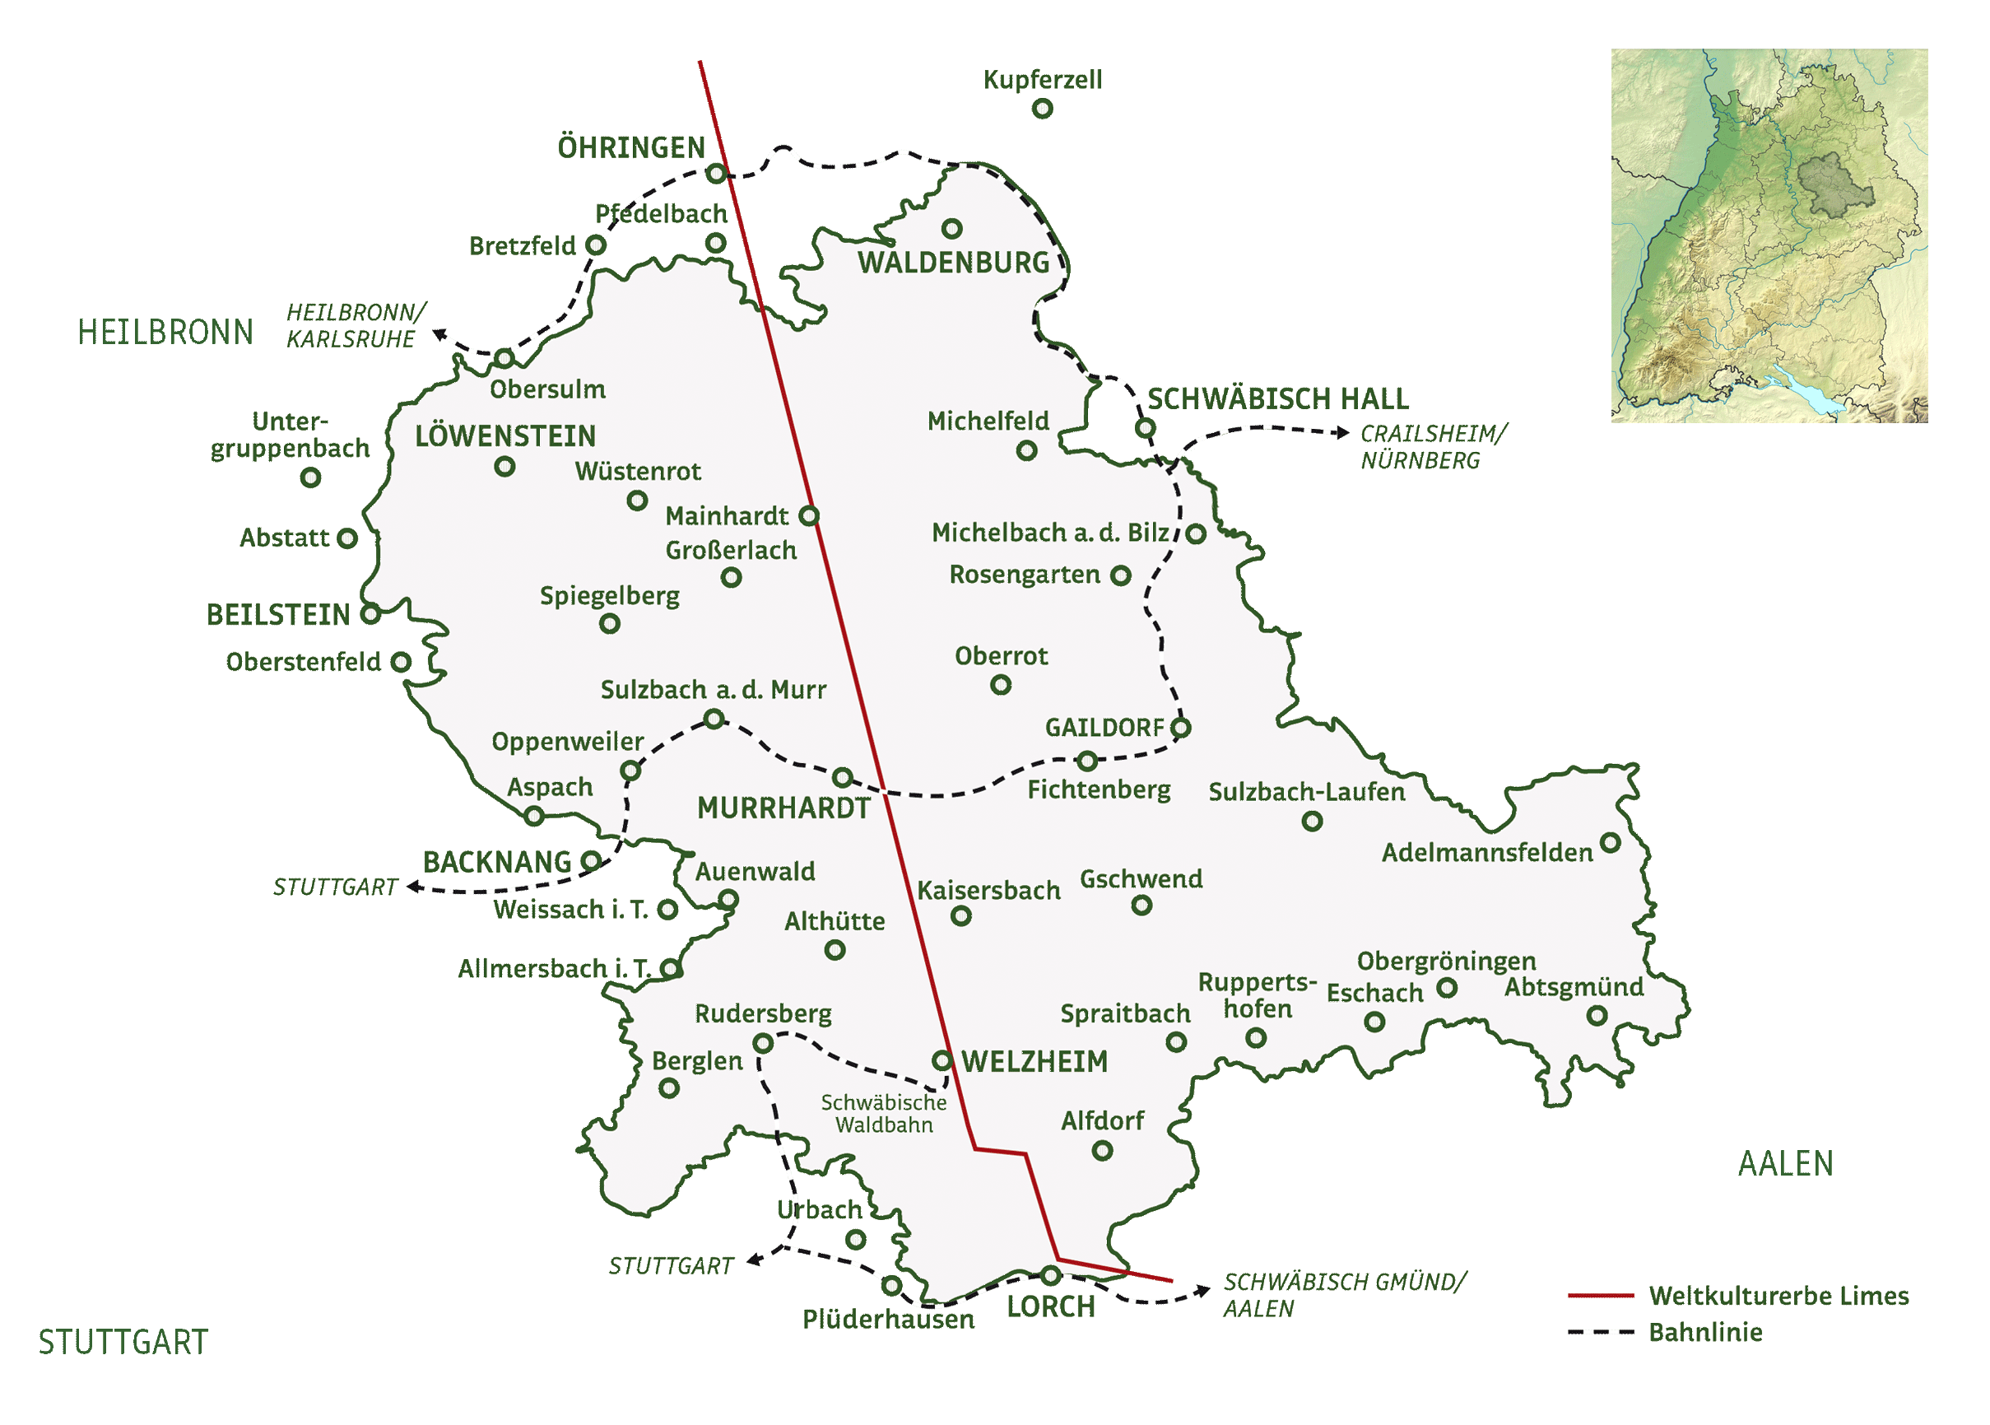
Nature Park
Care for cultural landscapes:
awareness for nature(conservation)
sustainable tourism
support partners to take part in a sustainable way of living
Limes
railway

Slide 4
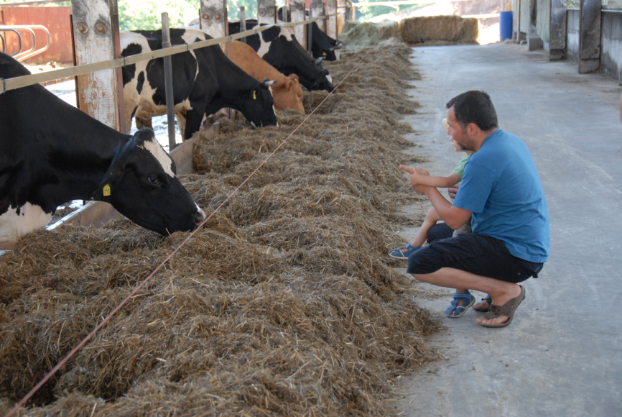
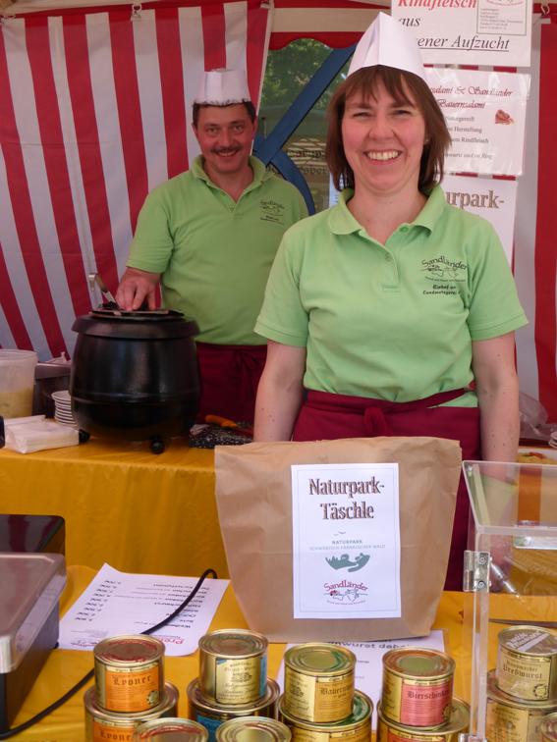
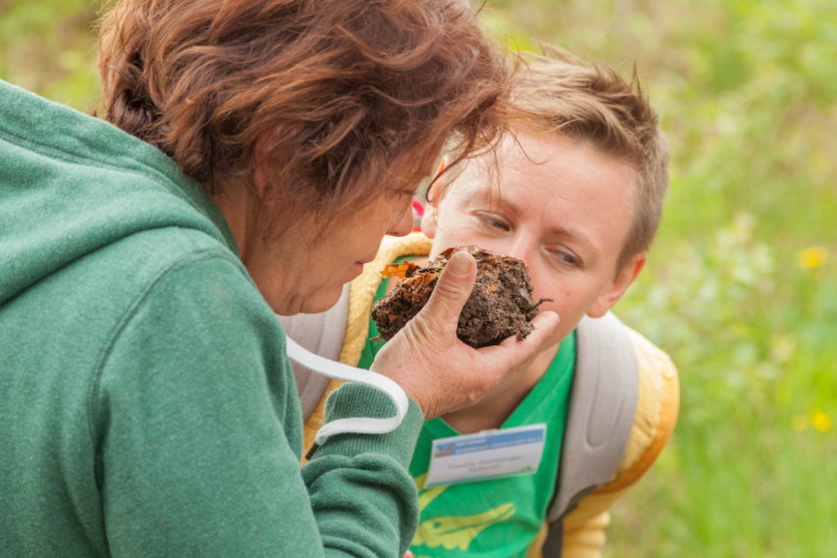
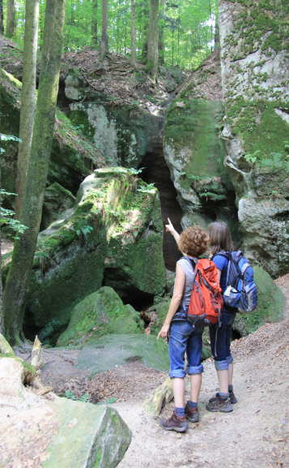
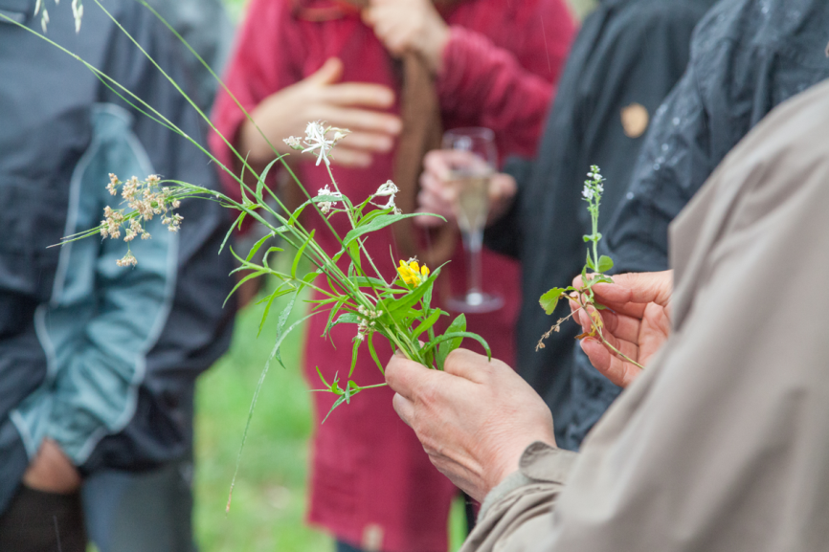
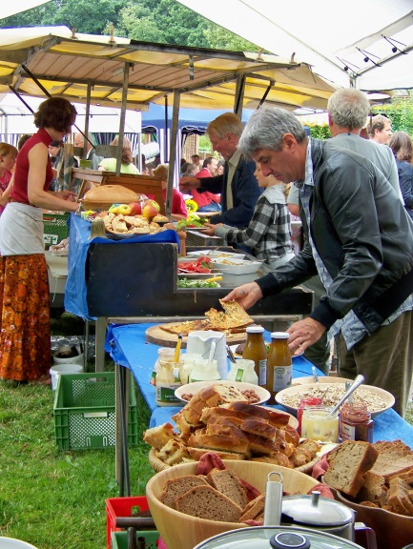
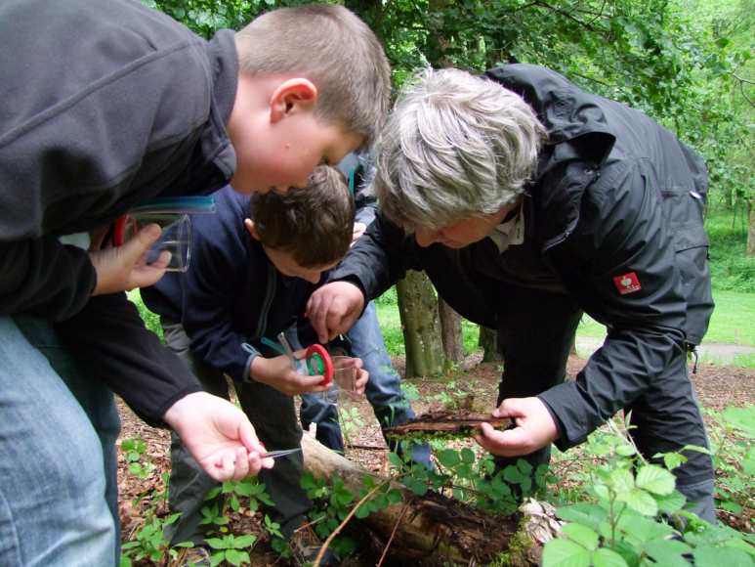
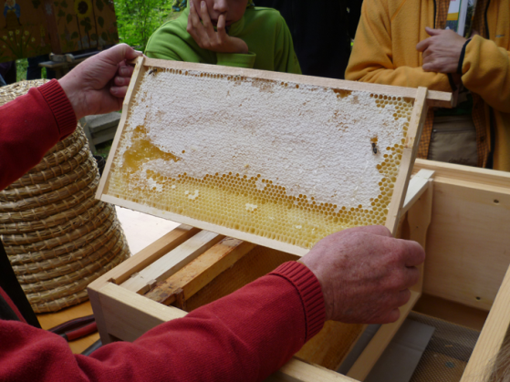
What we do:

Slide 5
Sustainability-Check 2014 - 2017
Baden-Württemberg
Certification of four pilot-regions in 2014: sustainable destination
Nature Park: report of sustainable measures, criteria, participation of local partners (25 %)

Slide 6
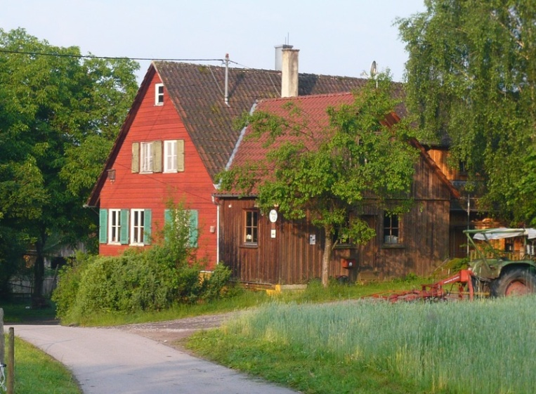
Sustainability-Check – support of local partners
partner: Wacholderhof
online-checklist
annual monitoring
aims
Criteria-catalog,
measures
for sustainable development (e.g. use of energy)

Slide 7
Sustainability-Check – criteria “energy”
Direct critera „Energy“ | Indirect criteria „Energy“
efficiency consumption of electricity, water, waste dealing with electricity, water and waste | percentage of organic/fair/regional food use of environmental-friendly products

Slide 8
Sustainability-Check – support of local partners
partner: Wacholderhof
online-checklist
annual monitoring
aims
Criteria-catalog,
measures
for sustainable development (e.g. use of energy)
self-evaluation, more conscious handling of resources
NP: certificate, marketing, information, joint activities
TourCert: consulting, training courses

Slide 9
Conclusions
Our Certification as a “sustainable destination” can offer an incentive for dealing with sustainable lifestyles and a more conscious use of energy
Challenges:
control implementation, soft criteria, system based on self-evaluation and trust, finding new partners
Questions:
How to create added value for our partners?
Ideas:
cooperation with communities, knowledge-sharing, competitions
Notes:
Aim end of 2017: 25 % = 54 (begin 2016 = 18)

