Slide 1
The future of renewables in the UK
Jan-Willem Bode
4 March 2016

Slide 2
The next 20 minutes
Mongoose Energy
The Future of Renewables
Solar grid parity?
Community energy vs regular energy
Cheap capital?

Slide 3
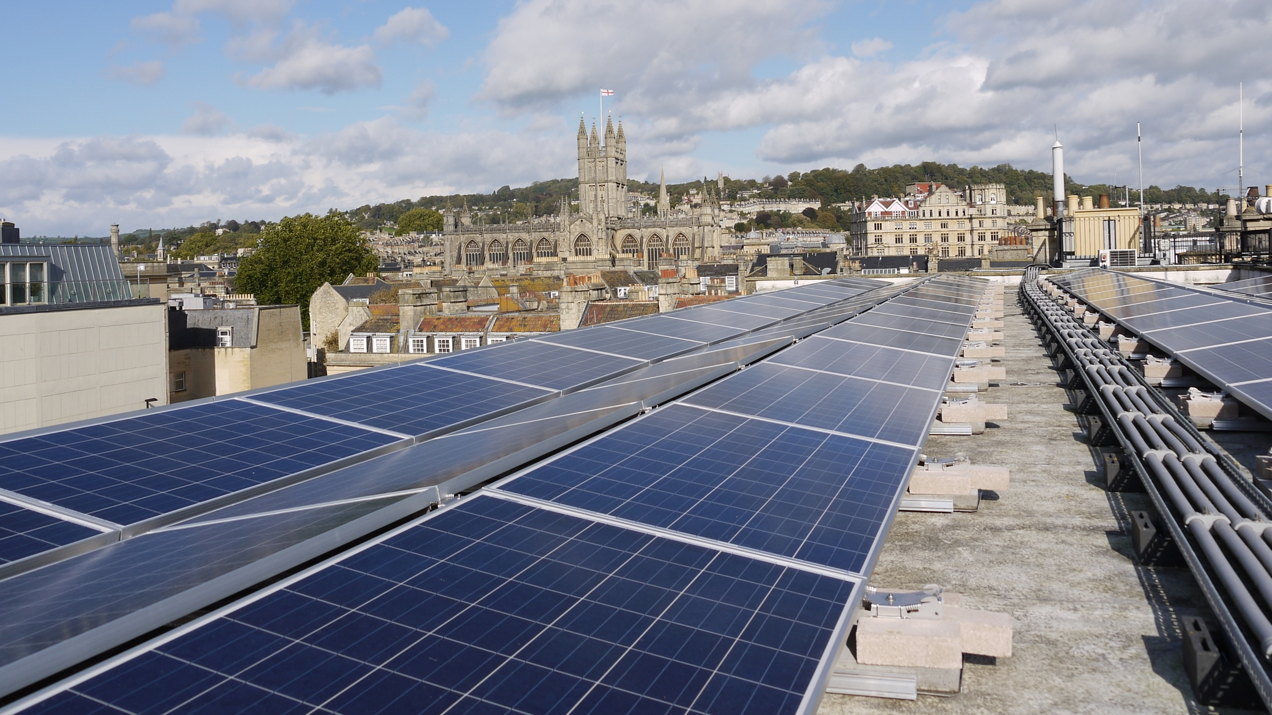
Transforming the nature of energy ownership

Slide 4
Ownership and governance
Community
co-operative
(always >50%)
Investors
Employees
Mongoose Energy Ltd
Generation
Supply

Slide 5
Mongoose Board
Independent chair: Sir Ed Davey
3 non-execs from co-op (elected by members)
1 non-exec employee representative
2 non-execs from the investors
3 executive directors

Slide 6
The core: the community groups

Slide 7
Generation
Assets under management: £40m
AUM by end of June: £80m
Pipeline for next year: £110m
Ground mount solar
Offshore wind

Slide 8
Generation
Mongoose manages the projects and runs the corporate secretariat of the bencoms
Priority is to ensure payment of investors
Track record: BWCE, LCG and WWCE have paid 7% since beginning

Slide 9
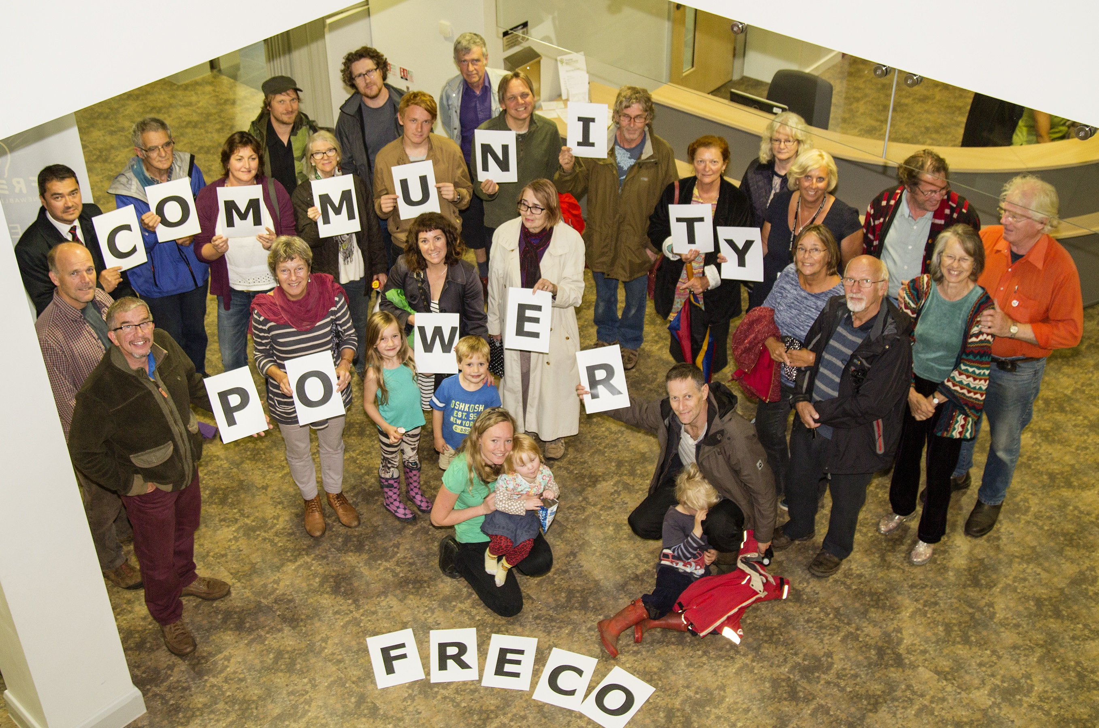
Frome Renewable Energy Co-op
Launched first share offer May 2015
Raised £280,000 in four days
Installed 200kw solar pv

Slide 10
Supply
In full preparation mode to launch a supply business
Estimated launch late 2016
Working closely with the community groups to develop a simple, transparent and fair proposition
Majority of benefits to community

Slide 11
The future of renewables
It is all uncertain
LECs gone
FIT effectively gone (except rooftop)
RO going
EIS gone, no SITR

Slide 12
Short term
Consolidation of the sector
Refinancing existing assets
Cheap money is leaving the UK
More and more assets are coming to market
New projects?
Some RO, offshore wind, AD, biomass, etc but all rapidly decreasing

Slide 13
It’s all about
Grid parity
Access to cheap capital

Slide 14
Grid parity: ground mounted solar
Impact of MIP and cost reduction
Required:
Lower cost of capital
Vertical integration (higher PPAs)
Energy prices?

Slide 15
Community energy
Fundamentally, community energy has a
lower cost of capital than “regular” renewables
(equity maxed at 6-7% vs >10%)
In practice, cost of capital higher:
Share offer - timing
Lower leverage factors
Underwriting requirements
Expensive construction, bridge, mezzanine finance
And: no refi to institutional investors, no access to low cost longer term capital
And – no community energy supply business exists as of yet

Slide 16
Community energy
Initially some extra support (cFIT, SITR)
Afterwards – financial instruments at commercial levels:
Underwriting of share offers
Community-owned bonds
Flexible mezzanine instruments
Affordable senior debt for community instruments
→ Parity with “regular” – all projects community?

Slide 17
Pathways to parity: We are almost there!

Slide 18
Cheap capital
Money is leaving the UK as a consequence of government announcements – but money for refinancing still available
Community energy does not have easy access to cheap capital
More assets coming to market
Prices of assets coming down
Competition for money going up

Slide 19
Cheap capital (2)
However, the divestment trend is continuing, with money looking for a home
→source of new cheap money?

Slide 20
So concluding
Short term
Consolidation
Refinancing
Larger facilities to get access to institutional capital
Medium term
Grid parity
More cheap capital

Slide 21
Jan-Willem Bode
jw.bode@mongoose.energy
07760 558 337
twitter.com/mongooseenergy
facebook.com/mongooseenergy
It is a revolution, we are at the beginning, but we are winning

