Slide 1
Renewables are reducing the wholesale cost of electricity
Keith Barnham
Emeritus Professor of Physics
Imperial College London
k.barnham@ic.ac.uk
The Burning Answer:
a User’s Guide to the Solar Revolution
Weidenfeld and Nicholson 2014
www.burninganswers.com
Keith Barnham, Kaspar Knorr, Massimo Mazzer, “Recent progress towards all-renewable electricity supplies” Nature Materials, 15 (2), pp. 115-116, (2016)

Slide 2
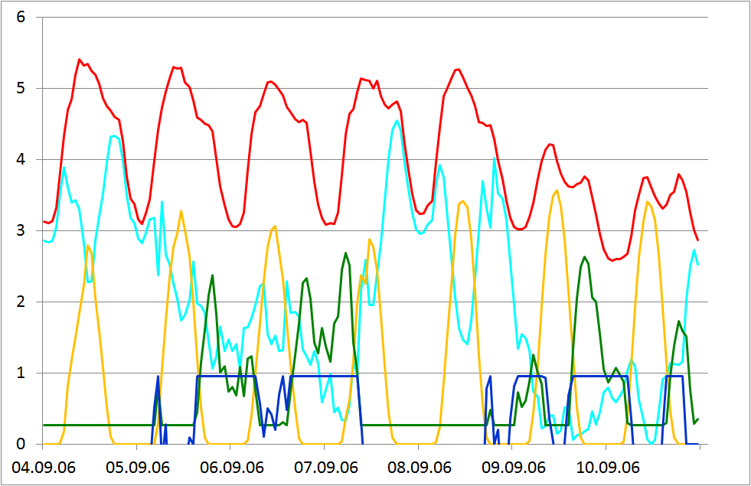
KKW: combined power plant
Kombikraftwerk all-renewable project started in 2006
Over 2006 it matched 1/10,000 of actual German electric power demand with real-time output of PV, wind & biogas generators
PV and wind together can supply 78% German power demand
Only 17% back-up power by
biogas electricity required
Only 5% back-up from storage
was necessary
KKW gives targets for all-
renewable Germany -
adapt for UK (tomorrow)

Slide 3
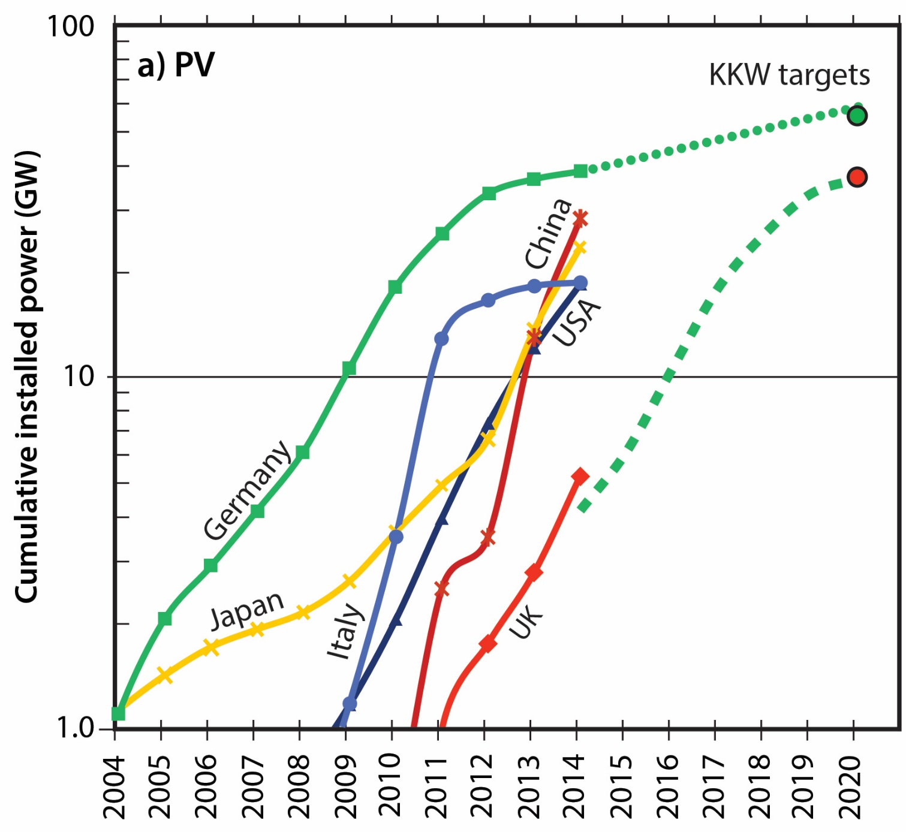
PV power increasing exponentially
Germany
2025
EDF?
K.Barnham, K.Knorr, M.Mazzer, Nature Materials, Feb. 2016

Slide 4
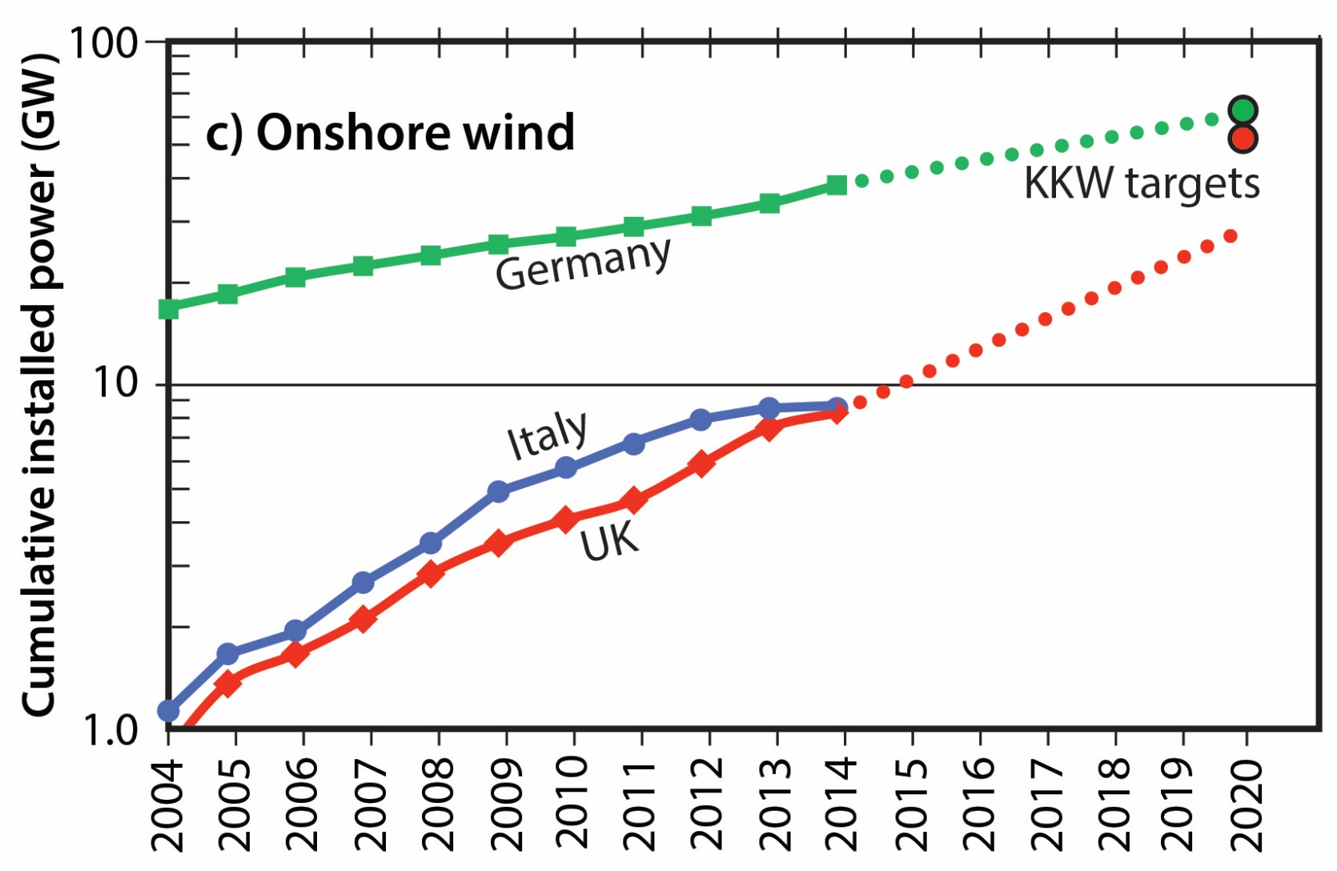
Onshore Wind Power Germany, Italy & UK
2025
EDF?
Germany will hit KKW target by 2020. UK without cuts by 2022
Need local ownership/benefit as pioneered in Denmark

Slide 5
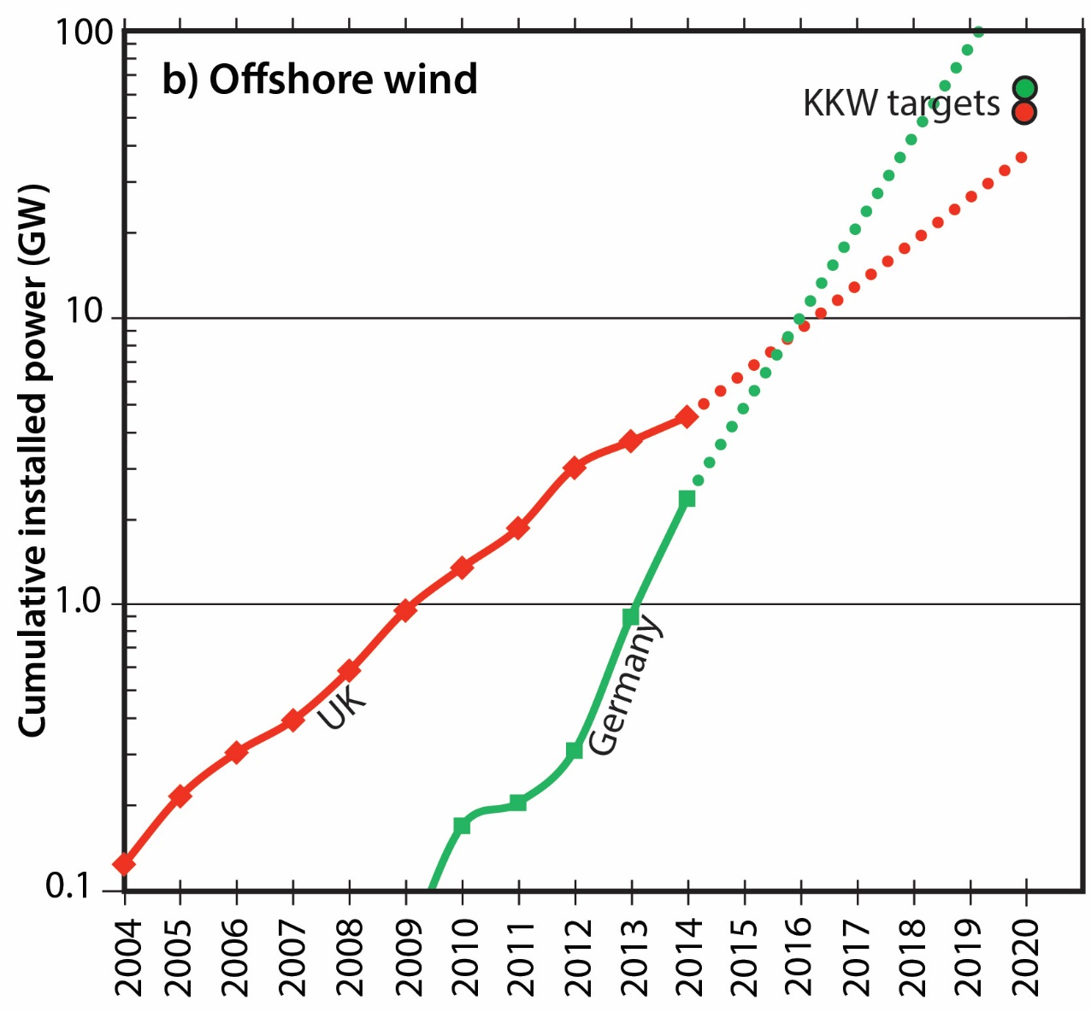
Offshore Wind Power Germany & UK
2025
EDF?
Despite being large scale in a difficult environment, off-shore wind power has increased exponentially like much smaller scale PV

Slide 6
Exponential rising markets lead to falling wholesale prices
Good Energy showed 2014 fall in UK due to cheaper renewables

Slide 7
Possible effects of UK subsidy cuts

Slide 8
Wholesale electricity prices 2025
+ Wholesale electricity costs already achieved in Germany 2012 - 2015

Slide 9
Conclusions
German PV & wind on course for all-renewable electricity targets by 2020
Without the cuts UK would follow by 2022
Wholesale electricity cost fall consistent UK & Germany as fraction of renewable penetration
Aim of cuts to PV & onshore wind - space for expensive & high carbon gas & nuclear
By 2025 “pessimistic” assumption for renewables means “hard-working bill payers” will fund 7p of 9p nuclear cost for each kWh

